Slide 1
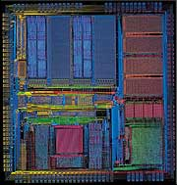
VHDL
Parviz Keshavarzi
Quick
Review
Feb, 2022

Slide 2
Acknowledgement
These slides used or are derived from the following source:
  Dr. Karam Chatha’s VHDL course taught at Arizona State University.
  Melnik
  Jason D. Bakos “VHDL and HDL Designer Primer” university of South Carolina
  Tuft Slides
  Nitin Yogi, Digital Logic Circuits course (yoginit@auburn.edu)
  ECE 448 George Mason University

Slide 3
Part 1:
VHDL In a Glance

Slide 4
VHDL Program Structure
Every VHDL program consists of two main parts:
  Entity
  Architecture
Entity describes Inputs and outputs of a design
Architecture describes functionality of a design

Slide 5
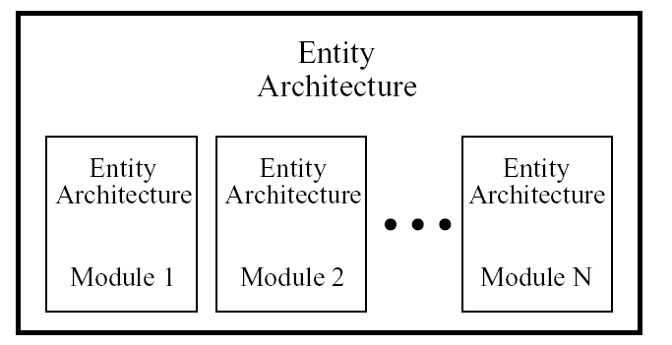
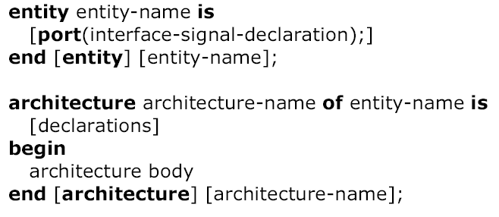
VHDL Program Structure

Slide 6
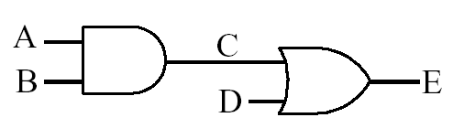
VHDL Program Structure Example
Concurrent signal assignment
<=
target_signal <= expression;
Data-flow VHDL Example:
ENTITY AndOrGates IS
PORT ( A, B, D : IN BIT;
E : OUT BIT) ;
END AndOrGates;
ARCHITECTURE dataflow OF AndOrGates IS
SIGNAL C: BIT;
BEGIN
C <= A AND B;
E <= C OR D;
END dataflow ;

Slide 7
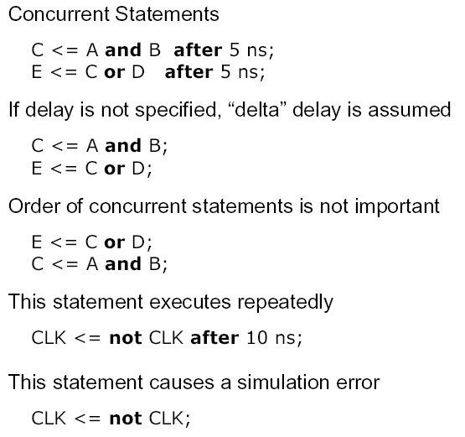
VHDL Description of
Combinational Networks

Slide 8
Data-Flow VHDL
Concurrent Statements
simple concurrent signal assignment
(⇐)
conditional concurrent signal assignment
(when-else)
selected concurrent signal assignment
(with-select-when)

Slide 9

Gates

Slide 10
Logic Operators
Logic operators
Logic operators precedence
and or nand nor xor not xnor
only in VHDL-93
and above
Highest
not
and or nand nor xor xnor
Lowest
Notes:
No order precedents

Slide 11
Basic Gates – AND, OR, NOT
x
1
.
x
2
.
.
x
1
x
x
x
x
…
x
x
2
1
2
1
2
n
x
n
(a) AND gates
x
1
x
x
2
1
x
1
+
x
2
x
1
+
x
2
+
…
+
x
n
x
2
x
n
(b) OR gates
x
x
(c) NOT gate

Slide 12
Basic Gates – NAND, NOR
…
…

Slide 13
DeMorgan’s Theorem and other symbols
for NAND, NOR
x
1
x
1
x
1
x
2
x
2
x
2
(a)
x
1
x
2
=
x
1
+
x
2
x
1
x
1
x
1
x
2
x
2
x
2
(b)
x
1
+
x
2
=
x
1
x
2

Slide 14
Basic Gates – XOR
x
1
x
2
f
=
x
1
⊕
x
2
0
0
0
0
1
1
x
1
0
1
1
f
=
x
⊕
x
1
1
0
x
2
1
2
(a) Truth table
(b) Graphical symbol
x
1
x
2
f
=
x
1
⊕
x
2
(c) Sum-of-products implementation

Slide 15
Basic Gates – XNOR
x
1
x
2
f
=
x
1
⊕
x
2
0
0
1
0
1
0
x
1
0
0
1
.
x
f
=
x
1
⊕
x
2
=
x
1
x
2
1
1
1
2
(a) Truth table
(b) Graphical symbol
x
1
x
2
f
=
x
1
⊕
x
2
(c) Sum-of-products implementation

Slide 16
Data-flow VHDL Example: Full Adder
x
y
s
cin
cout

Slide 17
Data-flow VHDL Example: Full Adder
ENTITY fulladder IS
PORT ( x : IN BIT;
y : IN BIT;
cin : IN BIT;
s : OUT BIT;
cout : OUT BIT) ;
END fulladder ;
ARCHITECTURE dataflow OF fulladder IS
BEGIN
s <= x XOR y XOR cin ;
cout <= (x AND y) OR (cin AND x) OR (cin AND y) ;
END dataflow ;

Slide 18
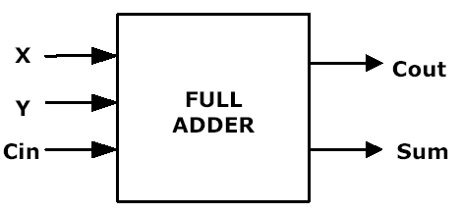
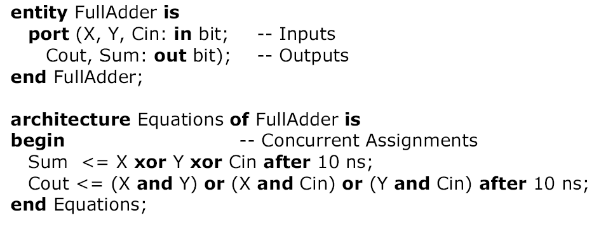
Entity-Architecture Pair
Full Adder Example

Slide 19
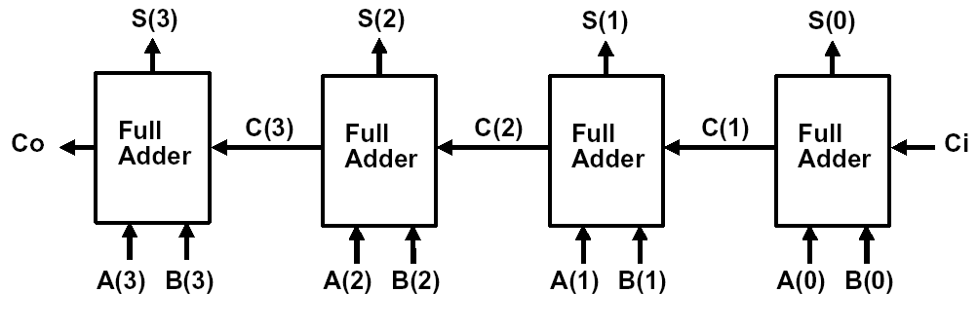
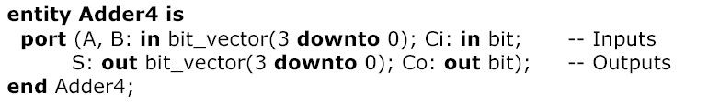
4-bit Adder

Slide 20
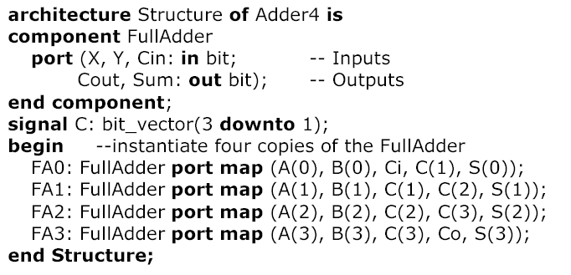
4-bit Adder (cont’d)

Slide 21
Conditional concurrent signal assignment
When - Else
target_signal <= value1 when condition1 else
value2 when condition2 else
. . .
valueN-1 when conditionN-1 else
valueN;

Slide 22
2-to-1 Multiplexer
s
s
f
w
0
0
0
w
f
0
w
1
1
1
w
1
(a) Graphical symbol
(b) Truth table
VHDL: f <= w1 WHEN s = '1' ELSE w0 ;
or
f <= w0 WHEN s = '0' ELSE w1 ;

Slide 23
Cascade of two multiplexers
w
0
3
0
w
1
y
2
w
1
1
s2
s1
VHDL:
y <= w1 WHEN s1 = '1' ELSE
w2 WHEN s2 = '1' ELSE
w3 ;

Slide 24
Selected concurrent signal assignment
With –Select-When
with choice_expression select
target_signal <= expression1 when choices_1,
expression2 when choices_2,
. . .
expressionN when choices_N;

Slide 25
4-to-1 Multiplexer
(a) Graphic symbol
(b) Truth table
s
s
0
s
s
f
s
1
0
1
w
0
0
w
0
00
0
w
0
1
w
1
01
1
f
w
w
10
1
0
2
2
w
11
1
1
w
3
3
s <= s1 & s0;
WITH s SELECT
f <= w3WHEN “11",
w2 WHEN "10",
w1 WHEN "01",
w0 WHEN OTHERS ;

Slide 26
Process

Slide 27
Process
Contain sequential statements that define algorithms
Executed when one of the signals in the sensitivity list has an event
proc1: process (a,b,c)
begin
x<=a and b and c;
end process proc1;
proc2: process
begin
x<=a and b and c;
wait on a,b,c;
end process proc2;

Slide 28
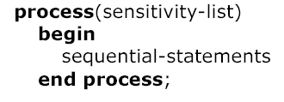
Modeling Flip-Flops Using VHDL Processes
Whenever one of the signals in the sensitivity list changes, the sequential statements are executed
in sequence one time
General form of process

Slide 29
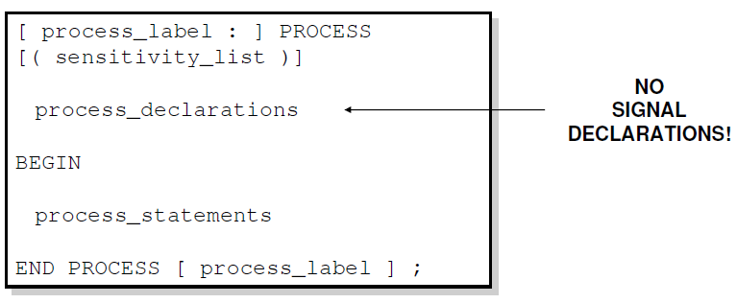
Sequential Style Syntax
Assignments are executed sequentially inside processes.

Slide 30
Sequential Statements
{Signal, Variable} assignments
Flow control
  if <condition> then <statments>
  [elsif <condition> then <statments>]
  else <statements>
  end if;
  for <range> loop <statments> end loop;
  while <condition> loop <statments> end loop;
  case <condition> is
    when <value> => <statements>;
    when <value> => <statements>;
    when others => <statements>;
Wait on <signal> until <expression> for <time>;

Slide 31
Wait Statements
Wait on an alternative to a sensitivity list
  Note: a process cannot have both wait statement(s)
  and a sensitivity list
Generic form of a process with wait statement(s)
How wait statements work?
Execute seq. statement until
a wait statement is encountered.
Wait until the specified condition is satisfied.
Then execute the next
set of sequential statements until
the next wait statement is encountered.
...
When the end of the process is reached start over again at the beginning.
process
begin
sequential-statements
wait statement
sequential-statements
wait-statement
...
end process;

Slide 32
Forms of Wait Statements
wait on sensitivity-list;
wait for time-expression;
wait until boolean-expression;
Wait on
  until one of the signals in the sensitivity list changes
Wait for
  waits until the time specified by the time expression has elapsed
  What is this:
  wait for 0 ns;
Wait until
  the boolean expression is evaluated whenever one of the signals in the expression changes, and the process continues execution when the expression evaluates to TRUE

Slide 33
If statement: examples
if sel = ‘0’ then
  result <= input_0; -- executed if sel = 0
else
  result <= input_1; -- executed if sel /= 0
end if;
if sel = ‘0’ then
  result <= input_0; -- executed if sel = 0
elsif sel = 1 then
  result <= input_1; -- executed if sel = 1
else
  result <= input_2; -- executed if sel /= 0, 1
end if;

Slide 34
2-to-1 Multiplexer
s
s
f
w
0
0
0
w
f
0
w
1
1
1
w
1
(a) Graphical symbol
(b) Truth table
if sel = ‘1’ then
  f <= w1;
else
  f <= w0;
  end if;

Slide 35
Case statement: examples
type opcodes is (nop, add, sub);
case opcode is
  when add => acc <= acc + op;
  when sub => acc <= acc – op;
  when nop => null;
end case;

Slide 36
4-to-1 Multiplexer
(a) Graphic symbol
(b) Truth table
s
s
0
s
s
f
s
1
0
1
w
0
0
w
0
00
0
w
0
1
w
1
01
1
f
w
w
10
1
0
2
2
w
11
1
1
w
3
3
s <= s1 & s0;
CASE s IS
WHEN “11" => f <= w3;
WHEN "10" => f <= w2;
WHEN "01" => f <= w1;
WHEN OTHERS => f <= w0;

Slide 37
Case statement: rules
all possible values of the selector expression must
be covered,
each possible value must be covered by one and
only one choice,
the choice values must be locally static, that is known
at analysis stage, and
if the others choice is used, it must be the last
alternative and the only choice in the alternative.

Slide 38
Registers

Slide 39
Edge-Trigger Register
Graphical symbol
Truth table
Clk
D
Q(t+1)
D
Q
0
↑
0
Clock
↑
1
1
0
–
Q(t)
1
–
Q(t)
Timing diagram
t
1
t
2
t
3
t
4
Clock
D
Q
Time

Slide 40
Edge-Trigger Register: Another Edge definition
ENTITY EdgeReg IS
PORT ( D, Clock : IN BIT ;
Q : OUT BIT) ;
END EdgeReg ;
ARCHITECTURE behavioral OF EdgeReg IS
BEGIN
PROCESS ( Clock )
BEGIN
IF Clock'EVENT AND Clock = '1' THEN
Q <= D ;
END IF ;
END PROCESS ;
END behavioral ;
D
Q
Clock

Slide 41
Edge-Trigger Register: VHDL Code
ENTITY EdgeReg IS
PORT ( D, Clock : IN BIT ;
Q : OUT BIT) ;
END EdgeReg ;
ARCHITECTURE behavioral2 OF EdgeReg IS
BEGIN
PROCESS ( Clock )
BEGIN
IF rising_edge(Clock) THEN
Q <= D ;
END IF ;
END PROCESS ;
END behavioral2;
D
Q
Clock
- rising_edge() is only in VHDL-93 and above

Slide 42
D latch
Graphical symbol
Truth table
Clock
D
Q(t+1)
D
Q
Q(t)
0
–
Clock
1
0
0
1
1
1
Timing diagram
t
1
t
2
t
3
t
4
Clock
D
Q
Time

Slide 43
D latch
ENTITY latch IS
PORT ( D, Clock : IN BIT;
Q : OUT BIT) ;
END latch ;
ARCHITECTURE behavioral OF latch IS
BEGIN
PROCESS ( D, Clock )
BEGIN
IF Clock = '1' THEN
Q <= D ;
END IF ;
END PROCESS ;
END behavioral;
D
Q
Clock

Slide 44
Edge-Trigger Reg. with asynchronous reset
ENTITY Reg_ar IS
PORT ( D, Reset, Clock : IN ; BIT
Q : OUT BIT) ;
END Reg_ar ;
ARCHITECTURE behavioral OF Reg_ar IS
BEGIN
PROCESS ( Reset, Clock )
BEGIN
IF Reset = '1' THEN
Q <= '0' ;
ELSIF rising_edge(Clock) THEN
Q <= D ;
END IF ;
END PROCESS ;
END behavioral ;
D
Q
Clock
Reset

Slide 45
Synthesis

Slide 46
Synthesis
Synthesis converts a high level VHDL description code into the gate level netlist (contains gates and their interconnections), it is usually with the help of synthesis tools.
For VHDL,
  only a subset of the language is synthesizable,
  and different tools support different subsets.
  RTL style code is encouraged because it is synthesizable.
In RTL, it is possible to split the code into two blocks that contain:
  either purely combinational logic
  or sequential block (e.g. process) for register, FSM, ‘’’

Slide 47
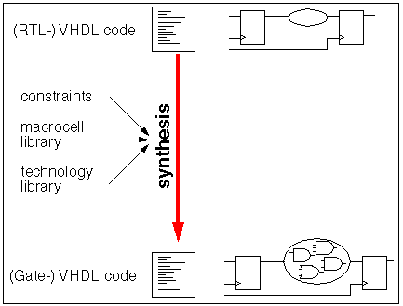

Slide 48
Synthesis Inpus and Outputs
Synthesis Inputs:
  VHDL Code Design
  Constraints
  Technology Library
Synthesis Output:
  Gates and their interconnections
For simulation, we can use the unsynthesizable VHDL or Verilog code in the test bench to generate the stimulus.

Slide 49
std_logic Type

Slide 50
Example VHDL Code
3 sections to a piece of VHDL code
File extension for a VHDL file is .vhd
Name of the file should be the same as the entity name (nand_gate.vhd) [OpenCores Coding Guidelines]
LIBRARY ieee;
USE ieee.std_logic_1164.all;
ENTITY nand_gate IS
PORT(
a : IN STD_LOGIC;
b : IN STD_LOGIC;
z : OUT STD_LOGIC);
END nand_gate;
ARCHITECTURE model OF nand_gate IS
BEGIN
z <= a NAND b;
END model;
LIBRARY DECLARATION
ENTITY DECLARATION
ARCHITECTURE BODY

Slide 51
IEEE 1164 Standard Logic
std_logic type: a 9-valued logic system
  ‘U’ – Uninitialized
  ‘X’ – Forcing Unknown
  ‘0’ – Forcing 0
  ‘1’ – Forcing 1
  ‘Z’ – High impedance
  ‘W’ – Weak unknown
  ‘L’ – Weak 0
  ‘H’ – Weak 1
  ‘-’ – Don’t care
If forcing and weak signal are tied together, the forcing signal dominates.
Useful in modeling the internal operation of certain types of ICs.
In this course we use a subset of the IEEE values: X10Z

Slide 52
BIT versus STD_LOGIC
BIT type can only have a value of '0' or '1'
STD_LOGIC can have nine values
  '0', '1', 'Z', 'U', 'X', 'L', 'H', 'W', '-'
  Useful mainly for simulation
  '0', '1', and 'Z' are synthesizable
  (your codes should contain only these
  three values)

Slide 53
Generic and Generate

Slide 54
Generic Statement
Generics allow the component to be customized upon instantiation.
Generics pass information from the entity to the architecture.
Common uses of generics
  Customize timing
  Alter range of subtypes
  Change size of arrays
ENTITY adder IS
GENERIC(n: natural :=2);
PORT(
A: IN STD_LOGIC_VECTOR(n-1 DOWNTO 0);
B: IN STD_LOGIC_VECTOR(n-1 DOWNTO 0);
C: OUT STD_LOGIC;
SUM: OUT STD_LOGIC_VECTOR(n-1 DOWNTO 0) );
END adder;

Slide 55
Generics
entity ADDER is generic(n: natural :=2); port( A: in std_logic_vector(n-1 downto 0); B: in std_logic_vector(n-1 downto 0); carry: out std_logic; sum: out std_logic_vector(n-1 downto 0) ); end ADDER;
entity ADDER is generic(n: natural :=2); port( A: in std_logic_vector(n-1 downto 0); B: in std_logic_vector(n-1 downto 0); carry: out std_logic; sum: out std_logic_vector(n-1 downto 0) ); end ADDER;
entity ADDER is generic(n: natural :=2); port( A: in std_logic_vector(n-1 downto 0); B: in std_logic_vector(n-1 downto 0); carry: out std_logic; sum: out std_logic_vector(n-1 downto 0) ); end ADDER;
entity ADDER is generic(n: natural :=2); port( A: in std_logic_vector(n-1 downto 0); B: in std_logic_vector(n-1 downto 0); carry: out std_logic; sum: out std_logic_vector(n-1 downto 0) ); end ADDER;
Generics allow the component to be customized upon instantiation.
Generics pass information from the entity to the architecture.
Common uses of generics
  Customize timing
  Alter range of subtypes
  Change size of arrays
ENTITY adder IS
GENERIC(n: natural :=2);
PORT(
A: IN STD_LOGIC_VECTOR(n-1 DOWNTO 0);
B: IN STD_LOGIC_VECTOR(n-1 DOWNTO 0);
C: OUT STD_LOGIC;
SUM: OUT STD_LOGIC_VECTOR(n-1 DOWNTO 0) );
END adder;

Slide 56
A word on generics
Generics are typically integer values
  In this class, the entity inputs and outputs should be std_logic or std_logic_vector
  But the generics can be integer
Generics are given a default value
  GENERIC ( N : INTEGER := 16 ) ;
  This value can be overwritten when entity is instantiated as a component
Generics are very useful when instantiating an often-used component
  Need a 32-bit register in one place, and 16-bit register in another
  Can use the same generic code, just configure them differently

Slide 57
Use of OTHERS
OTHERS stand for any index value that has
not been previously mentioned.
Q <= “00000001” can be written as Q <= (0 => ‘1’, OTHERS => ‘0’)
Q <= “10000001” can be written as Q <= (7 => ‘1’, 0 => ‘1’, OTHERS => ‘0’)
or Q <= (7 | 0 => ‘1’, OTHERS => ‘0’)
Q <= “00011110” can be written as Q <= (4 downto 1=> ‘1’, OTHERS => ‘0’)

Slide 58
Component Instantiation in VHDL-87
U1: regn GENERIC MAP (N => 4)
PORT MAP (D => z ,
Reset => reset ,
Clock => clk,
Q => t );

Slide 59
Component Instantiation in VHDL-93
U1: ENTITY work.regn(behavioral)
GENERIC MAP (N => 4)
PORT MAP (D => z ,
Reset => reset ,
Clock => clk,
Q => t );

Slide 60
N-bit register with enable
LIBRARY ieee ;
USE ieee.std_logic_1164.all ;
ENTITY regne IS
GENERIC ( N : INTEGER := 8 ) ;
PORT ( D : IN STD_LOGIC_VECTOR(N-1 DOWNTO 0) ;
Enable, Clock : IN STD_LOGIC ;
Q : OUT STD_LOGIC_VECTOR(N-1 DOWNTO 0) ) ;
END regne ;
ARCHITECTURE behavioral OF regne IS
BEGIN
PROCESS (Clock)
BEGIN
IF rising_edge(Clock) THEN
IF Enable = '1' THEN
Q <= D ;
END IF ;
END IF;
END PROCESS ;
END behavioral ;
N
Enable
N
D
Q
Clock
regn

Slide 61
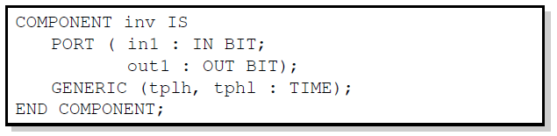
Technology Modeling
One use of generics is to alter the timing of a certain component.
It is possible to indicate a generic timing delay and then specify the exact delay at instantiation.
The example above declares the interface to a component named inv.
The propagation time for high-to-low and low-to-high transitions can be specified later.

Slide 62
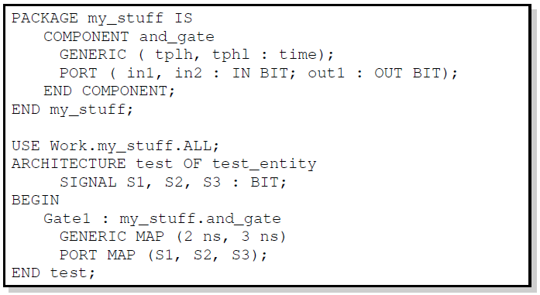
Structural Statements
The GENERIC MAP is similar to the PORT MAP in that it maps specific values to generics declared in the component.

Slide 63
Generate Statement
Structural for-loops: The GENERATE statement
  Some structures in digital hardware are repetitive in nature. (RAM, ROM, registers, adders, multipliers, …)
  VHDL provides the GENERATE statement to automatically create regular hardware.
  Any VHDL concurrent statement may be included in a GENERATE statement, including another GENERATE statement.

Slide 64
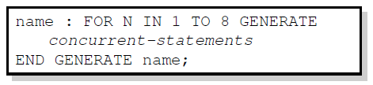
Generate Statement Syntax
All objects created are similar.
The GENERATE parameter must be discrete and is undefined outside the GENERATE statement.

Slide 65
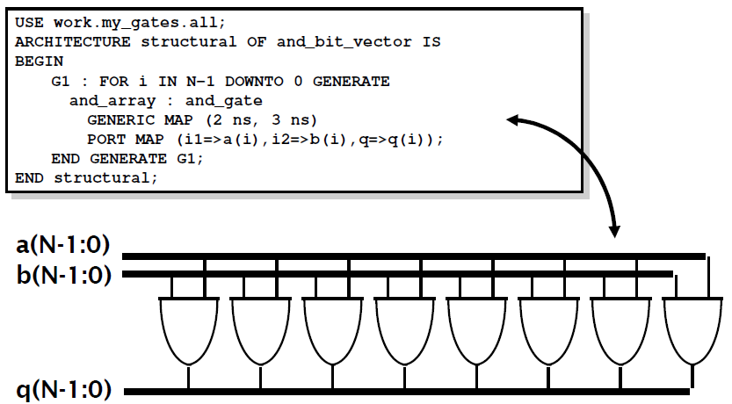
Example: Array of AND-gates

Slide 66
Buffer, Decoder, Encoder

Slide 67
Tri-state Buffer
e
x
f
e
= 0
(a) A tri-state buffer
x
f
e
x
f
e
= 1
x
f
0
0
Z
0
1
Z
1
0
0
(b) Equivalent circuit
1
1
1
(c) Truth table

Slide 68
Tri-state Buffer entity
LIBRARY ieee;
USE ieee.std_logic_1164.all;
ENTITY tri_state IS
PORT ( e: IN STD_LOGIC;
x: IN STD_LOGIC;
f: OUT STD_LOGIC
);
END tri_state;
ARCHITECTURE dataflow OF tri_state IS
BEGIN
f <= x WHEN (e = ‘1’) ELSE ‘Z’;
END dataflow;

Slide 69
Four types of Tri-state Buffers
f <= x WHEN (e = '1') ELSE 'Z';
f <= not x WHEN (e = '1') ELSE 'Z';
f <= x WHEN (e = '0') ELSE 'Z';
f <= not x WHEN (e = '0') ELSE 'Z';

Slide 70
2-to-4 Decoder
(b) Graphical symbol
(a) Truth table
w
y
w
1
3
w
y
En
w
w
y
y
y
y
0
2
y
1
0
3
2
1
0
y
1
1
0
0
0
0
0
1
En
y
0
1
0
1
0
0
1
0
1
1
0
0
1
0
0
Enw <= En & w ;
WITH Enw SELECT
y <= "0001" WHEN "100",
"0010" WHEN "101",
"0100" WHEN "110",
"1000" WHEN "111",
"0000" WHEN OTHERS ;
1
1
1
1
0
0
0
0
x
x
0
0
0
0

Slide 71
VHDL code for a 2-to-4 Decoder entity
LIBRARY ieee ;
USE ieee.std_logic_1164.all ;
ENTITY dec2to4 IS
PORT ( w : IN STD_LOGIC_VECTOR(1 DOWNTO 0) ;
En : IN STD_LOGIC ;
y : OUT STD_LOGIC_VECTOR(3 DOWNTO 0) ) ;
END dec2to4 ;
ARCHITECTURE dataflow OF dec2to4 IS
SIGNAL Enw : STD_LOGIC_VECTOR(2 DOWNTO 0) ;
BEGIN
Enw <= En & w ;
WITH Enw SELECT
y <= "0001" WHEN "100",
"0010" WHEN "101",
"0100" WHEN "110",
"1000" WHEN "111",
"0000" WHEN OTHERS ;
END dataflow ;

Slide 72
Priority Encoder
w
0
y
0
y
w
1
w
y
w
1
y <= "11" WHEN w(3) = '1' ELSE
"10" WHEN w(2) = '1' ELSE
"01" WHEN w(1) = '1' ELSE
"00" ;
z <= '0' WHEN w = "0000" ELSE '1' ;
2
w
z
3
w
3
w
2
w
1
w
0
y
1
y
0
z
0
0
0
0
-
-
0
0
0
0
1
0
0
1
0
0
1
-
0
1
1
0
1
-
-
1
0
1
1
-
-
-
1
1
1

Slide 73
VHDL code for a Priority Encoder entity
LIBRARY ieee ;
USE ieee.std_logic_1164.all ;
ENTITY priority IS
PORT ( w : IN STD_LOGIC_VECTOR(3 DOWNTO 0) ;
y : OUT STD_LOGIC_VECTOR(1 DOWNTO 0) ;
z : OUT STD_LOGIC ) ;
END priority ;
ARCHITECTURE dataflow OF priority IS
BEGIN
y <= "11" WHEN w(3) = '1' ELSE
"10" WHEN w(2) = '1' ELSE
"01" WHEN w(1) = '1' ELSE
"00" ;
z <= '0' WHEN w = "0000" ELSE '1' ;
END dataflow ;

Slide 74
State Machines

Slide 75
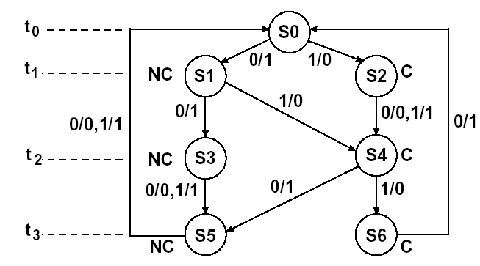
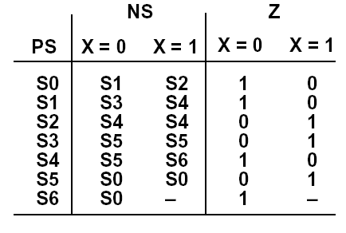
Modeling a Sequential Machine
Mealy Machine for
8421 BCD to 8421 BCD + 3 bit serial converter
How to model this in VHDL?

Slide 76
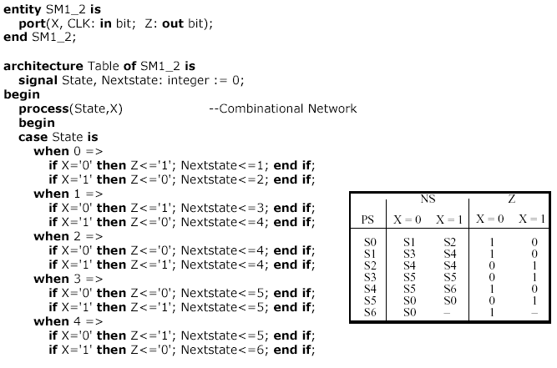
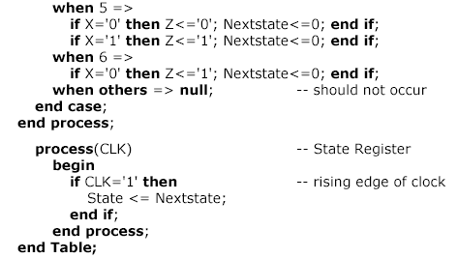
Behavioral VHDL Model
Two processes:
  the first represents the combinational network;
  the second represents
  the state register

Slide 77

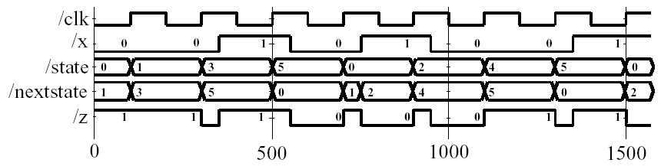
Simulation of the VHDL Model
Simulation command file:
Waveforms:

Slide 78
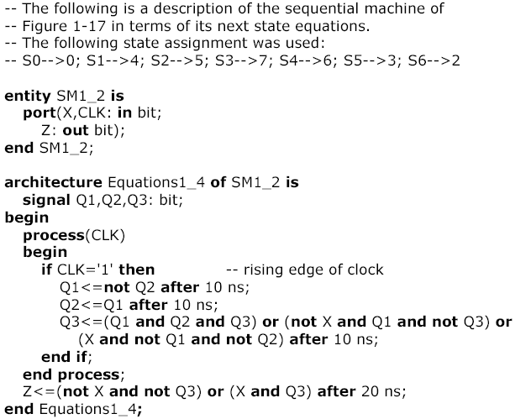
Dataflow VHDL Model

Slide 79
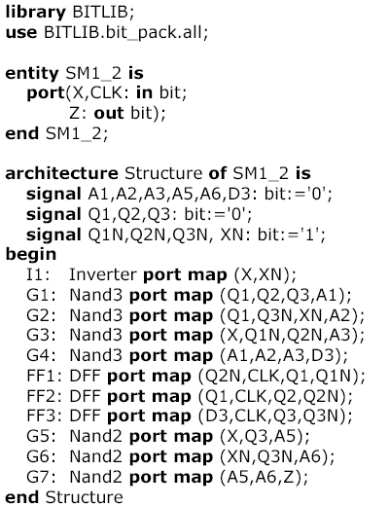
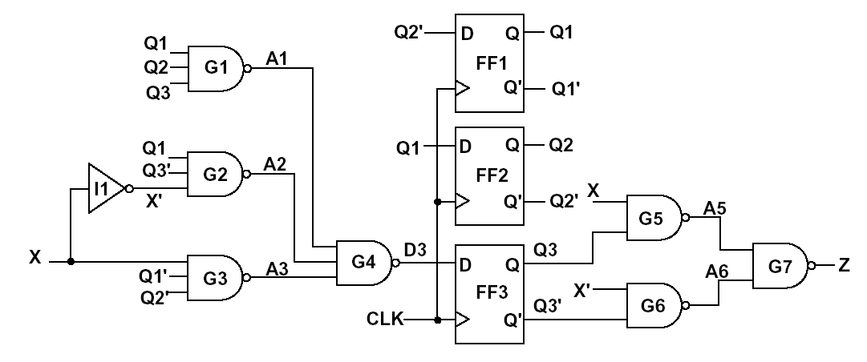
Structural Model
Package bit_pack is a part of library BITLIB –
includes gates, flip-flops, counters
(See Appendix B for details)

Slide 80

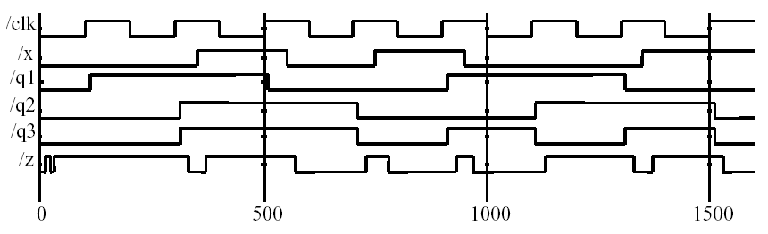
Simulation of the Structural Model
Simulation command file:
Waveforms:

Slide 81
Delay Types

Slide 82
Delay Types
All VHDL signal assignment statements prescribe an amount of time that must transpire before the signal assumes its new value
This prescribed delay can be in one of three forms:
  Transport -- prescribes propagation delay only
  Inertial -- prescribes propagation delay and minimum input pulse width
  Delta -- the default if no delay time is explicitly specified
Input
Output
delay
Notes:
There are several types of delay in VHDL, and understanding of how delay works in a process is key to writing and understanding VHDL.
It bears repeating that any signal assignment in VHDL is actually a scheduling for a future value to be placed on that signal. When a signal assignment statement is executed, the signal maintains its original value until the time for the scheduled update to the new value. Any signal assignment statement will incur a delay of one of the three types listed in this slide.

Slide 83
Transport Delay
Transport delay must be explicitly specified
  I.e. keyword “TRANSPORT” must be used
Signal will assume its new value
after specified delay
-- TRANSPORT delay example
Output <= TRANSPORT NOT Input AFTER 10 ns;
Input
Output
Input
Output
0 5 10 15 20 25 30 35
Notes:
The keyword TRANSPORT must be used to specify a transport delay.
Transport delay is the simplest in that when it is specified, any change in an input signal value may result in a new value being assigned to the output signal after the specified propagation delay.
Note that no restrictions are specified on input pulse widths. In this example, Output will be an inverted copy of Input delayed by the 10ns propagation delay regardless of the pulse widths seen on Input .

Slide 84
Inertial Delay
Provides for specification propagation delay and input pulse width, i.e. ‘inertia’ of output:
Inertial delay is default and REJECT is optional:
target <= [REJECT time_expression] INERTIAL waveform;
Output <= NOT Input AFTER 10 ns;
-- Propagation delay and minimum pulse width are 10ns
Input
Input
Output
Output
0 5 10 15 20 25 30 35
Notes:
The keyword INERTIAL may be used in the signal assignment statement to specify an inertial delay, or it may be left out because inertial delay is used by default in VHDL signal assignment statements which contain “after” clauses.
If the optional REJECT construct is not used, the specified delay is then used as both the ‘inertia’ (i.e. minimum input pulse width requirement) and the propagation delay for the signal. Note that in the example above, pulses on Input narrower than 10ns are not observed on Output.

Slide 85
Inertial Delay (cont.)
Example of gate with ‘inertia’ smaller than propagation delay
  e.g. Inverter with propagation delay of 10ns which suppresses pulses shorter than 5ns
Note: the REJECT feature is new
to VHDL 1076-1993
Output <= REJECT 5ns INERTIAL NOT Input AFTER 10ns;
Input
Output
0 5 10 15 20 25 30 35
Notes:
The REJECT construct is a new feature to VHDL introduced in the VHDL 1076-1993 standard. The REJECT construct can only be used with the keyword INERTIAL to include a time parameter that specifies the input pulse width constraint.
Prior to this, a description for such a gate would have needed the use of an intermediate signal with the appropriate inertial delay followed by an assignment of this intermediate signal’s value to the actual output via a transport delay.

Slide 86
Delta Delay
Default signal assignment propagation delay if no delay is explicitly prescribed
  VHDL signal assignments do not take place immediately
  Delta is an infinitesimal VHDL time unit so that all signal assignments can result in signals assuming their values at a future time
  E.g.
Supports a model of concurrent VHDL process execution
  Order in which processes are executed by simulator does not affect simulation output
Output <= NOT Input;
-- Output assumes new value in one delta cycle
Notes:
VHDL allows the designer to describe systems at various levels of abstraction. As such, timing and delay information may not always be included in a VHDL description.
A delta (or delta cycle) is essentially an infinitesimal, but quantized, unit of time. The delta delay mechanism is used to provide a minimum delay in a signal assignment statement so that the simulation cycle described earlier can operate correctly when signal assignment statements do not include explicitly specified delays. That is:
1) all active processes can execute in the same simulation cycle
2) each active process will suspend at wait statement
3) when all processes are suspended simulation is advanced the minimum time necessary so that some signals can take on their new values
4) processes then determine if the new signal values satisfy the conditions to proceed from the wait statement at which they are suspended

Slide 87
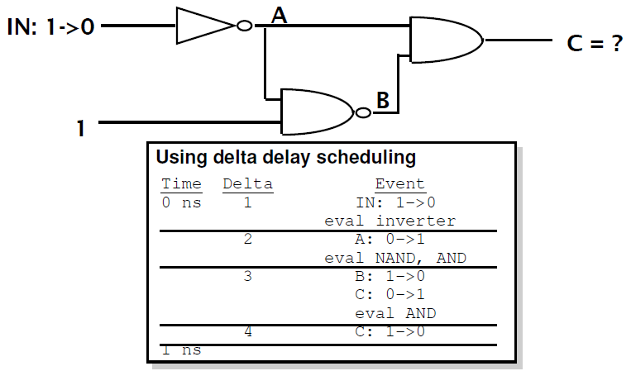
Example – Delta Delay

Slide 88
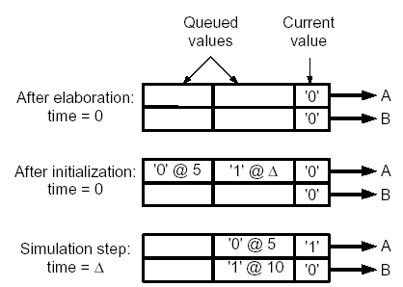
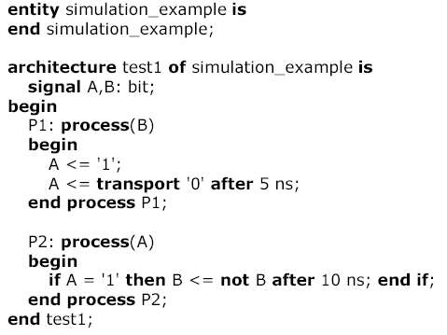
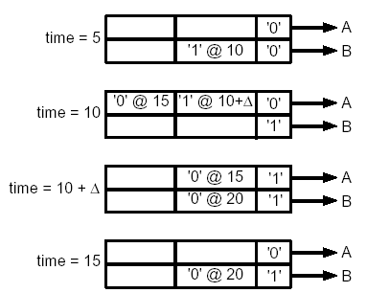
Simulation Example

Slide 89
Problem #1
entity not_another_prob is
port (in1, in2: in bit;
a: out bit);
end not_another_prob;
architecture oh_behave of not_another_prob is
signal b, c, d, e, f: bit;
begin
L1: d <= not(in1);
L2: c<= not(in2);
L3: f <= (d and in2) ;
L4: e <= (c and in1) ;
L5: a <= not b;
L6: b <= e or f;
end oh_behave;
Using the labels, list the order in which the following signal assignments are evaluated if in2 changes from a '0' to a '1'. Assume in1 has been a '1' and in2 has been a '0' for a long time, and then at time t in2 changes from a '0' to a '1'.

Slide 90
Problem #2
Under what conditions do the two assignments below result in the same behavior? Different behavior? Draw waveforms to support your answers.
out <= reject 5 ns inertial (not a) after 20 ns;
out <= transport (not a) after 20 ns;

Slide 91
Variable & Signal

Slide 92
Variables
What are they for:
Local storage in processes,
procedures, and functions
Declaring variables
variable list_of_variable_names : type_name
[ := initial value ];
Variables must be declared within the process in which they are used and are local to the process
  Note: exception to this is SHARED variables

Slide 93
Signals
Signals must be declared outside a process
Declaration form
signal list_of_signal_names : type_name
[ := initial value ];
Declared in an architecture can be used
anywhere within that architecture

Slide 94
Constants
Declaration form
constant constant_name : type_name := constant_value;
constant delay1 : time := 5 ns;
Constants declared at the start of an architecture
can be used anywhere within that architecture
Constants declared within a process are local
to that process

Slide 95
Variables vs. Signals
Variable assignment statement
variable_name := expression;
  expression is evaluated and the variable is instantaneously updated
  (no delay, not even delta delay)
Signal assignment statement
signal_name <= expression [after delay];
  expression is evaluated and the signal is scheduled to change after delay; if no delay is specified the signal is scheduled to be updated after a delta delay

Slide 96
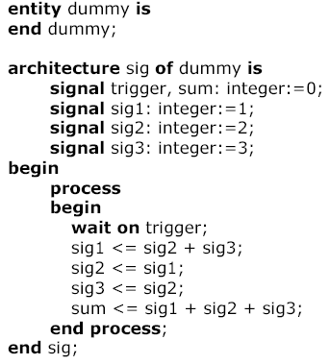
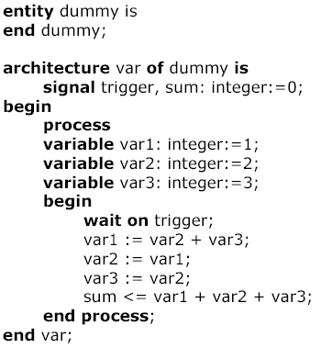
Variables vs. Signals (cont’d)
Process Using Signals
Process Using Variables
Sum = ?
Sum = ?

Slide 97
Predefined VHDL Types
Variables, signals, and constants can have any one of the predefined VHDL types or they can have a user-defined type
Predefined Types
  bit – {‘0’, ‘1’}
  boolean – {TRUE, FALSE}
  integer – [-2³¹ - 1.. 2³¹ – 1}
  real – floating point number in range –1.0E38 to +1.0E38
  character – legal VHDL characters including lower- uppercase letters, digits, special characters, ...
  time – an integer with units fs, ps, ns, us, ms, sec, min, or hr

Slide 98
User Defined Type
Common user-defined type is enumerated
type state_type is (S0, S1, S2, S3, S4, S5);
signal state : state_type := S1;
If no initialization, the default initialization is the leftmost element in the enumeration list (S0 in this example)
VHDL is strongly typed language =>
signals and variables of different types cannot be mixed in the same assignment statement,
and no automatic type conversion is performed

Slide 99
Arrays
Example
type SHORT_WORD is array (15 downto 0) of bit;
signal DATA_WORD : SHORT_WORD;
variable ALT_WORD : SHORT_WORD := “0101010101010101”;
constant ONE_WORD : SHORT_WORD := (others => ‘1’);
  ALT_WORD(0) – rightmost bit
  ALT_WORD(5 downto 0) – low order 6 bits
General form
type arrayTypeName is array index_range of element_type;
signal arrayName : arrayTypeName [:=InitialValues];

Slide 100
Arrays (cont’d)
Multidimensional arrays
type matrix4x3 is array (1 to 4, 1 to 3) of integer;
variable matrixA: matrix4x3 :=
((1,2,3), (4,5,6), (7,8,9), (10,11,12));
  matrixA(3, 2) = ?
Unconstrained array type
type intvec is array (natural range<>) of integer;
type matrix is array (natural range<>,natural range<>)
of integer;
  range must be specified when the array object is declared
signal intvec5 : intvec(1 to 5) := (3,2,6,8,1);

Slide 101
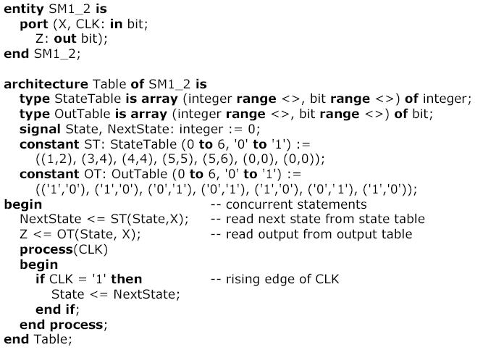
Sequential Machine Model
Using State Table

Slide 102

Predefined Unconstrained Array Types
Bit_vector, string
constant A : bit_vector(0 to 5) := “10101”;
-- (‘1’, ‘0’, ‘1’, ‘0’, ‘1’);
Subtypes
  include a subset of the values specified by the type
subtype SHORT_WORD is : bit_vector(15 to 0);
POSITIVE, NATURAL –
predefined subtypes of type integer

Slide 103
VHDL Operators
Binary logical operators: and or nand nor xor xnor
Relational: = /= < <= > >=
Shift: sll srl sla sra rol ror
Adding: + - & (concatenation)
Unary sign: + -
Multiplying: * / mod rem
Miscellaneous: not abs **
Class 7 has the highest precedence (applied first),
followed by class 6, then class 5, etc

Slide 104
ROM

Slide 105
ROM 8x16 example (1)
3
Addr
8x16
ROM
Dout
16
C

Slide 106
ROM 8x16 example (2)
LIBRARY ieee;
USE ieee.std_logic_1164.all;
USE ieee.numeric_std.all;
ENTITY rom IS
PORT (
Addr : IN STD_LOGIC_VECTOR(2 DOWNTO 0);
Dout : OUT STD_LOGIC_VECTOR(15 DOWNTO 0)
);
END rom;

Slide 107
ROM 8x16 example (3)
ARCHITECTURE dataflow OF rom IS
SIGNAL temp: INTEGER RANGE 0 TO 7;
TYPE vector_array IS ARRAY (0 to 7) OF STD_LOGIC_VECTOR(15 DOWNTO 0);
CONSTANT memory : vector_array :=
( X”800A",
X"D459",
X"A870",
X"7853",
X"650D",
X"642F",
X"F742",
X"F548");
BEGIN
temp <= to_integer(unsigned(Addr));
Dout <= memory(temp);
END dataflow;

Slide 108
ROM 8x16 example (4)
ARCHITECTURE dataflow OF rom IS
TYPE vector_array IS ARRAY (0 to 7) OF STD_LOGIC_VECTOR(15 DOWNTO 0);
CONSTANT memory : vector_array :=
( X"800A",
X"D459",
X"A870",
X"7853",
X"650D",
X"642F",
X"F742",
X"F548");
BEGIN
Dout <= memory(to_integer(unsigned(Addr)));
END dataflow;

