Slide 1
Combinational-Circuit Building Blocks
Data Flow Modeling of
Combinational Logic
ECE 448
Lecture 3

Slide 2
Reading
Required
P. Chu, FPGA Prototyping by VHDL Examples
  Chapter 3, RT-level combinational circuit
Recommended
S. Brown and Z. Vranesic, Fundamentals of Digital
Logic with VHDL Design
Chapter 6, Combinational-Circuit Building Blocks
Chapter 5.5, Design of Arithmetic Circuits Using
CAD Tools

Slide 3

Adders

Slide 4
Adder mod 2¹⁶
16
16
X
Y
S
16

Slide 5
VHDL code for an Adder mod 2¹⁶
LIBRARY ieee ;
USE ieee.std_logic_1164.all ;
USE ieee.numeric_std.all ;
ENTITY adder16 IS
PORT ( X : IN STD_LOGIC_VECTOR(15 DOWNTO 0) ;
Y : IN STD_LOGIC_VECTOR(15 DOWNTO 0) ;
S : OUT STD_LOGIC_VECTOR(15 DOWNTO 0) ) ;
END adder16 ;
ARCHITECTURE dataflow OF adder16 IS
BEGIN
S <= std_logic_vector(unsigned(X) + unsigned(Y));
END dataflow ;

Slide 6
Signed and Unsigned Types
Behave exactly like
STD_LOGIC_VECTOR
plus, they determine whether a given vector
should be treated as a signed or unsigned number.
Require
USE ieee.numeric_std.all;

Slide 7
16-bit Unsigned Adder
16
16
X
Y
+
Cout
Cin
S
16

Slide 8
Addition of Unsigned Numbers (1)
LIBRARY ieee ;
USE ieee.std_logic_1164.all ;
USE ieee.numeric_std.all ;
ENTITY adder16 IS
PORT ( Cin : IN STD_LOGIC ;
X : IN STD_LOGIC_VECTOR(15 DOWNTO 0) ;
Y : IN STD_LOGIC_VECTOR(15 DOWNTO 0) ;
S : OUT STD_LOGIC_VECTOR(15 DOWNTO 0) ;
Cout : OUT STD_LOGIC ) ;
END adder16 ;

Slide 9
Addition of Unsigned Numbers (3)
ARCHITECTURE dataflow OF adder16 IS
signal USum: unsigned(16 DOWNTO 0) ;
signal UCin: unsigned(0 downto 0);
BEGIN
UCin(0) <= Cin;
USum <= unsigned('0' & X) + unsigned(Y) + UCin;
S <= std_logic_vector(USum(15 downto 0));
Cout <= USum(16) ;
END dataflow ;

Slide 10
IEEE numeric_std package
How to infer arithmetic operators?
In standard VHDL:
  signal a, b, sum: integer;
  . . .
  sum <= a + b;
What’s wrong with integer data type?

Slide 11
IEEE numeric_std package: define integer as a an array of elements of std_logic
Two new data types: unsigned, signed
The array interpreted as an unsigned or signed binary number
E.g.,
  signal x, y: signed(15 downto 0);
Need invoke package to use the data type
  library ieee;
  use ieee.std_logic_1164.all;
  use ieee.numeric_std.all;

Slide 12
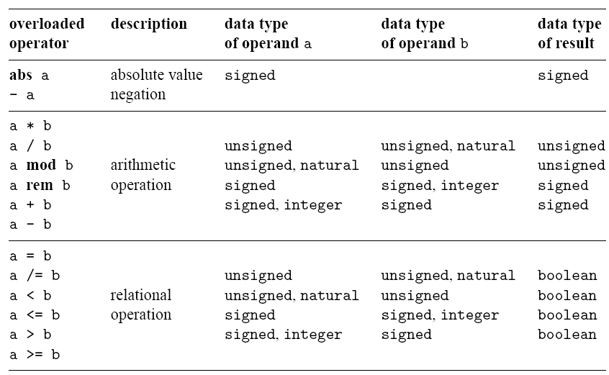
Overloaded operators in
IEEE numeric_std package

Slide 13
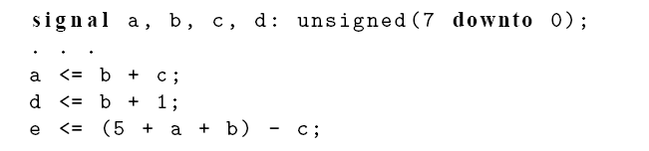
E.g.,

Slide 14
Type conversion
Std_logic_vector, unsigned, signed are defined as an array of element of std_logic
They considered as three different data types in VHDL
Type conversion between data types:
  type conversion function
  Type casting (for “closely related” data types)

Slide 15
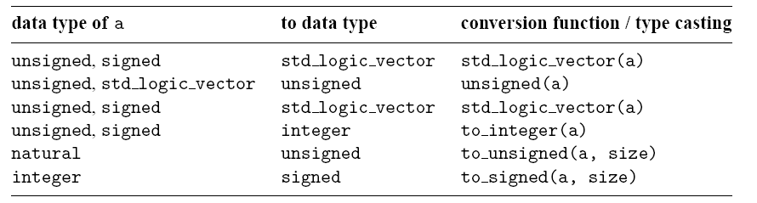
Type conversion between number-related data types

Slide 16
E.g.
  library ieee;
  use ieee.std_logic_1164.all;
  use ieee.numeric_std.all;
  . . .
  signal s1, s2, s3, s4, s5, s6: std_logic_vector(3 downto 0);
  signal u1, u2, u3, u4, u6, u7: unsigned(3 downto 0);
  signal sg: signed(3 downto 0);

Slide 17
  Ok
  u3 <= u2 + u1; --- ok, both operands unsigned
  u4 <= u2 + 1; --- ok, operands unsigned and natural
  Wrong
  u5 <= sg; -- type mismatch
  u6 <= 5; -- type mismatch
  Fix
  u5 <= unsigned(sg); -- type casting
  u6 <= to_unsigned(5,4); -- conversion function

Slide 18
  Wrong
  u7 <= sg + u1; -- + undefined over the types
  Fix
  u7 <= unsigned(sg) + u1; -- ok, but be careful
  Wrong
  s3 <= u3; -- type mismatch
  s4 <= 5; -- type mismatch
  Fix
  s3 <= std_logic_vector(u3); -- type casting
  s4 <= std_logic_vector(to_unsigned(5,4));

Slide 19
  Wrong
  s5 <= s2 + s1; + undefined over std_logic_vector
  s6 <= s2 + 1; + undefined
  Fix
  s5 <= std_logic_vector(unsigned(s2) + unsigned(s1));
  s6 <= std_logic_vector(unsigned(s2) + 1);

Slide 20
Multipliers

Slide 21
Unsigned vs. Signed Multiplication
Unsigned
Signed
1111
1111
15
15
1111
1111
-1
-1
x
x
x
x
11100001
225
00000001
1

Slide 22
8x8-bit Unsigned Multiplier
8
8
a
b
*
c
U
16

Slide 23
8x8-bit Signed Multiplier
8
8
a
b
*
c
S
16

Slide 24
8x8-bit Unsigned and Signed Multiplier
8
8
a
b
cu
cs
16
16

Slide 25
Multiplication of signed and unsigned numbers
LIBRARY ieee;
USE ieee.std_logic_1164.all;
USE ieee.numeric_std.all ;
entity multiply is
port(
a : in STD_LOGIC_VECTOR(7 downto 0);
b : in STD_LOGIC_VECTOR(7 downto 0);
cu : out STD_LOGIC_VECTOR(15 downto 0);
cs : out STD_LOGIC_VECTOR(15 downto 0)
);
end multiply;
architecture dataflow of multiply is
begin
-- signed multiplication
cs <= STD_LOGIC_VECTOR(SIGNED(a)*SIGNED(b));
-- unsigned multiplication
cu <= STD_LOGIC_VECTOR(UNSIGNED(a)*UNSIGNED(b));
end dataflow;

Slide 26
Buffers

Slide 27
Tri-state Buffer
e
x
f
e
= 0
(a) A tri-state buffer
x
f
e
x
f
e
= 1
x
f
0
0
0
1
1
0
(b) Equivalent circuit
1
1
(c) Truth table

Slide 28
Tri-state Buffer
e
x
f
e
= 0
(a) A tri-state buffer
x
f
e
x
f
e
= 1
x
f
0
0
Z
0
1
Z
1
0
0
(b) Equivalent circuit
1
1
1
(c) Truth table

Slide 29
Four types of Tri-state Buffers

Slide 30
Four types of Tri-state Buffers
f <= x WHEN (e = '1') ELSE 'Z';
f <= not x WHEN (e = '1') ELSE 'Z';
f <= x WHEN (e = '0') ELSE 'Z';
f <= not x WHEN (e = '0') ELSE 'Z';

Slide 31
Tri-state Buffer entity (1)
LIBRARY ieee;
USE ieee.std_logic_1164.all;
ENTITY tri_state IS
PORT ( e: IN STD_LOGIC;
x: IN STD_LOGIC;
f: OUT STD_LOGIC
);
END tri_state;

Slide 32
Tri-state Buffer entity (2)
ARCHITECTURE dataflow OF tri_state IS
BEGIN
f <= x WHEN (e = ‘1’) ELSE ‘Z’;
END dataflow;

