Slide 1
FPGA
Internal
Structures
System on Chip
Parviz Keshavarzi
2020

Slide 2
Rabaey, Chandrakasan and Nikolic “Digital Integrated Circuits A Design Perspective “, 2002
Haibo Wang, ECE 428 Programmable ASIC Design
ECE Department, Southern Illinois University

Slide 4
A Historical Perspective: the PLA
Product terms
x
0
x
1
AND
x
2
OR
plane
plane
f
0
f
1
x
0
x
1
x
2

Slide 5
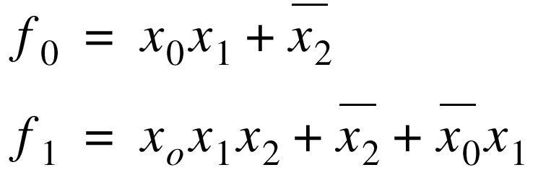
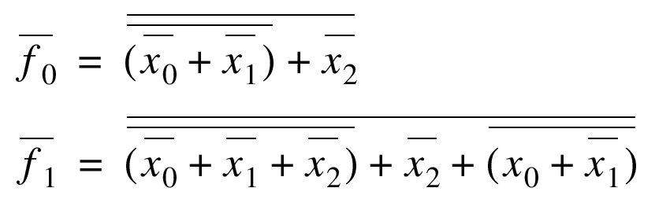
Two-Level Logic
Every logic function can be
expressed in sum-of-products
format (AND-OR)
minterm
Inverting format (NOR-NOR) more effective

Slide 6
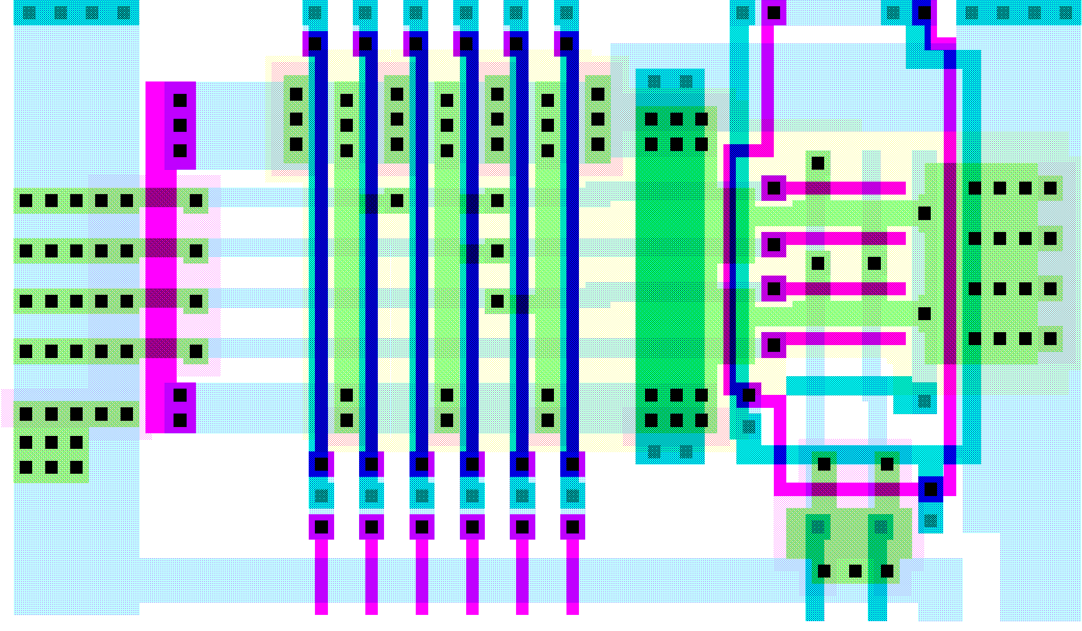
PLA Layout – Exploiting Regularity
And-Plane
Or-Plane
V
DD
φ
GND

Slide 7
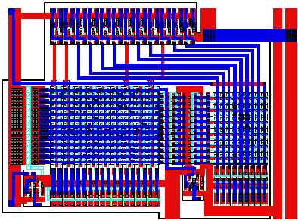
Breathing Some New Life in PLAs
River PLAs
A cascade of multiple-output PLAs.
Adjacent PLAs are connected via river routing.
No placement and routing needed.
Output buffers and the input buffers of the next stage are shared.
Courtesy B. Brayton

Slide 9
FPGA
FPGA consists of an array of programmable basic logic
cells surrounded by programmable interconnect.
FPGA Structure
Programmable
interconnect
Logic cell
I/O Cell

Slide 10
Field-Programmable Gate Arrays
Logic blocks
  to implement combinational
  and sequential logic
Interconnect
  wires to connect inputs and
  outputs to logic blocks
I/O blocks
  special logic blocks at periphery
  of device for external connections
Key questions:
  how to make logic blocks programmable?
  how to connect the wires?
  after the chip has been fabbed

Slide 11
2-input MUX as programmable logic block
Configuration
A
B
S
F=
0
0
0
0
0
X
1
X
A
0
0
Y
1
Y
F
0
Y
X
XY
B
1
X
0
Y
XY
Y
0
X
XY
Y
1
X
X
+
Y
S
1
0
X
X
1
0
Y
Y
1
1
1
1

Slide 12
Implementing Logic functions with LUTs
Each logic block in an FPGA has a small number of inputs and outputs
The most commonly used logic block is a lookup table (LUT), which contains storage cells that are used to implement a small logic function

Slide 13
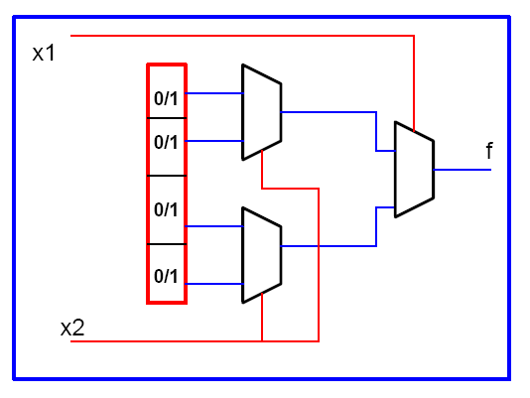
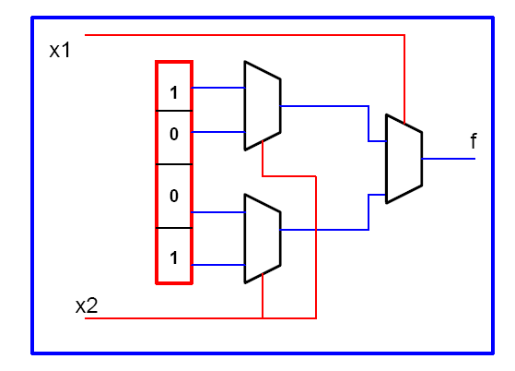
Two-input LUT

Slide 14
LUT-Based Logic Cell
In
Out
Out
00
0
01
1
10
1
Memory
11
0
ln1
ln2

Slide 15
2-input mux as programmable logic block
Configuration
A
B
S
F=
0
0
0
0
0
X
1
X
A
0
0
Y
1
Y
F
0
Y
X
XY
B
1
X
0
Y
XY
Y
0
X
XY
Y
1
X
X
1
Y
S
1
0
X
X
1
0
Y
Y
1
1
1
1

Slide 16
Logic Cell of Actel Fuse-Based FPGA

Slide 17
Look-up Table Based Logic Cell

Slide 18
LUT-Based Logic Cell
Figure must be
updated
C
....C
4
1
4
xx
xxxx
xxxx
xxxx
D
4
Bits
xxxx
Logic
xx
control
xx
D
3
function
xx
x
xx
x
of
xx
D
xx
2
xxx
D
1
Logic
function
x
xx
xx
of
x
x
x
x
F
xxx
4
Bits
xxxx
F
Logic
xx
control
xx
3
function
xx
x
xx
x
F
of
xx
2
xx
F
xxx
1
x
xx
xx
xxxxx
H
x
x
P
Multiplexer Controlled
Xilinx 4000 Series
by Configuration Program
Courtesy Xilinx

Slide 19
Array-Based Programmable Wiring
Interconnect
Point
Programmed interconnection
Input/output pin
Cell
Horizontal
tracks
Vertical tracks

Slide 20
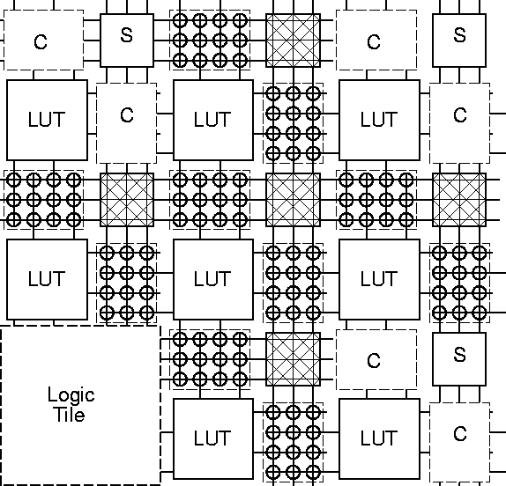
Mesh-based Interconnect Network
Switch Box
Connect Box
Interconnect
Point
Courtesy Dehon and Wawrzyniek

Slide 21
Transistor Implementation of Mesh
Courtesy Dehon and Wawrzyniek

Slide 22
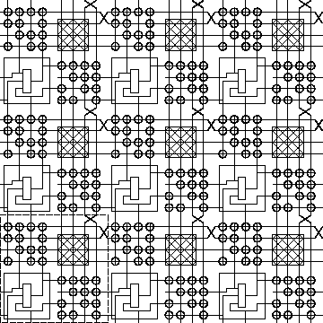
Hierarchical Mesh Network
Use overlayed mesh
to support longer connections
Reduced fanout and reduced
resistance
Courtesy Dehon and Wawrzyniek

Slide 23
Field-Programmable Gate Arrays
Fuse-based
Standard-cell like
floorplan

Slide 24
Xilinx 4000 Interconnect Architecture
12
Quad
8
Single
4
Double
3
Long
CLB
2
Direct
Connect
3
Long
12
4
4
8
4
8
4
2
Quad
Long
Global
Long
Double
Single
Global
Carry
Direct
Clock
Clock
Chain
Connect
Courtesy Xilinx

Slide 25
Field-Programmable Gate Arrays
Logic blocks
  to implement combinational
  and sequential logic
Interconnect
  wires to connect inputs and
  outputs to logic blocks
I/O blocks
  special logic blocks at periphery
  of device for external connections
Key questions:
  how to make logic blocks programmable?
  how to connect the wires?
  after the chip has been fabbed

Slide 26
Xilinx Programmable Gate Arrays
CLB - Configurable Logic Block
  5-input, 1 output function
  or 2 4-input, 1 output functions
  optional register on outputs
Built-in fast carry logic
Can be used as memory
Three types of routing
  direct
  general-purpose
  long lines of various lengths
RAM-programmable
  can be reconfigured

Slide 27
