Slide 1
FPGA
CPLD
Internal
Structures
System on Chip
Parviz Keshavarzi
2017

Slide 2
Rabaey, Chandrakasan and Nikolic “Digital Integrated Circuits A Design Perspective “, 2002
Haibo Wang, ECE 428 Programmable ASIC Design
ECE Department, Southern Illinois University

Slide 3
ASIC Design vs FPGA Design

Slide 4
Implementation Choices
Digital Circuit Implementation Approaches
Custom
Semicustom
Cell-based
Array-based
Standard Cells
Ma
cro Cells
Pre-diffused
Pre-wired
Compiled Cells
(Gate Arrays)
(FPGAs)

Slide 5
FPGA v.s. CPLD
Capacitance
 | SPLDs | CPLDs | FPGAs
Equivalent gates | 0 ~ 200 | 200 ~ 12,000 | 1000 ~ 1,000,000
Applications
CPLDs
FPGAs
Implement random glue logics or
Replace circuits previously
implemented by multiple SPLDs
Circuits that can exploit wide
AND/OR gates, and do not need
a very large number of flip-flops
are good candidates for
implementation in CPLDs.
FPGAs can be used in various applications: prototyping, FPGA-based computers, on-site hardware re-configuration, DSP, logic emulation, network components, etc.

Slide 6
Cell-based Design (or standard cells)
Routing channel
requirements are
reduced by presence
of more interconnect
layers

Slide 7
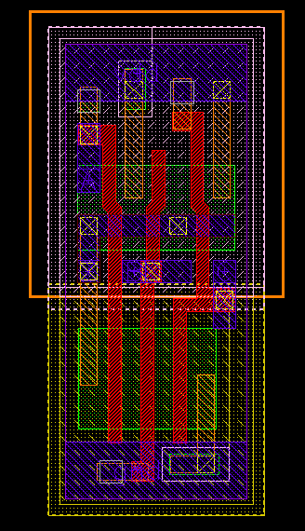
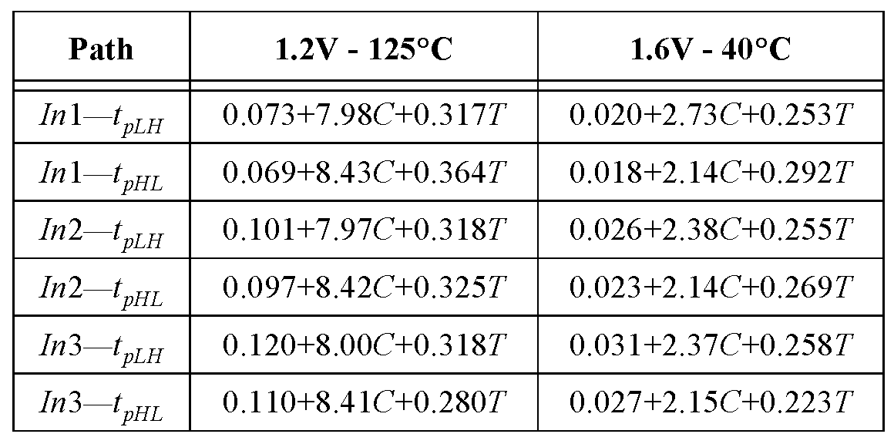
Standard Cell - Example
3-input NAND cell
(from ST Microelectronics):
C = Load capacitance
T = input rise/fall time

Slide 8
Late-Binding Implementation
Array-based
Pre-diffused
Pre-wired
(Gate Arrays)
(FPGAs)

Slide 9
PLA
Programmable AND Plane
Programmable OR Plane
Programmable Node
Un-programmed
Connect
Disconnect
X
Y
O1
O2
O3
O4
X
XY
Y
XY
X
X
XY
XY
Y
Y

Slide 10
PLA
Programmable AND Plane
Programmable OR Plane
YZ
XZ
XYZ
XY
X
Y
Z
XY+YZ
?
?
XZ+XYZ

Slide 11
PAL
Programmable AND Plane
Fix OR Plane
X
Y
O1
O2
O3
O4

Slide 12
PAL with Logic Expanders
Programmable AND Plane
Fix OR Plane
?
Logic expanders

Slide 13
PLA v.s. PAL
PLAs are more flexible than PALs since both AND & OR planes are
programmable in PLAs.
Because both AND & OR planes are programmable, PLAs are expensive
to fabricate and have large propagation delay.
By using fix OR gates, PALs are cheaper and faster than PLAs.
Logic expanders increase the flexibilities of PALs, but result in significant
propagation delay.
PALs usually contain D flip-flops connected to the outputs of OR gates
to implement sequential circuits.
PLAs and PALs are usually referred to as SPLD.

Slide 14
Array-Based Programmable Logic
I
5
I
4
I
3
I
2
I
1
I
0
Programmable
I
I
I
I
Programmable
OR array
3
2
1
0
OR array
I
5
I
4
I
3
I
2
I
1
I
0
Fixed OR array
Programmable AND array
Fixed AND array
Programmable AND array
O
3
O
2
O
1
O
0
O
3
O
2
O
1
O
0
O
3
O
2
O
1
O
0
PLA
PROM
PAL
Indicates programmable connection
Indicates fixed connection

Slide 15
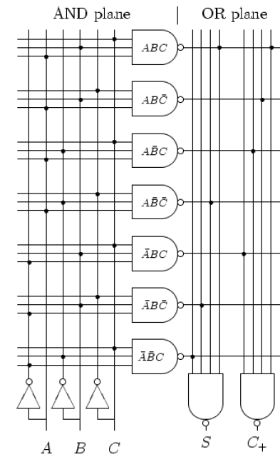
Implementing functions with PLA

Slide 16
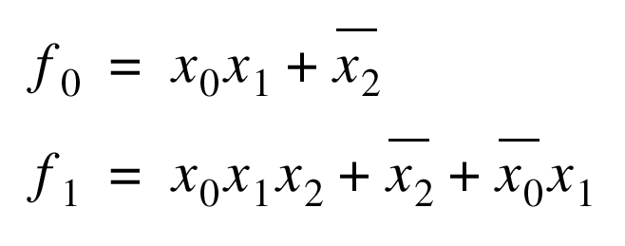
Programming a PROM
1
X
2
X
1
X
0
: programmed node
NA
NA
f
1
f
0

Slide 17
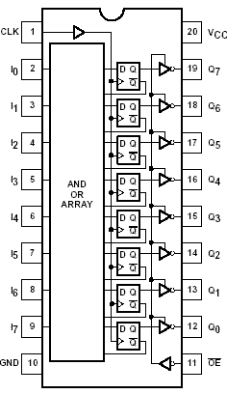
PAL 16R8

Slide 18
More Complex PAL
Higher capacity devices
Single PAL architecture is not feasible
Programmable logic planes grow too quickly
Multiple PALs integrated together
Complex Programmable Logic Device (CPLD)

Slide 19
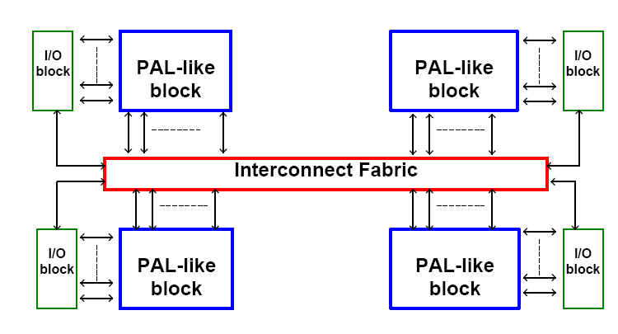
CPLD

Slide 20
CPLD
A CPLD comprises multiple PAL-like blocks on a single
chip with programmable interconnect to connect the blocks.
CPLD Architecture
PAL-like
block
PAL-like
block
I/O block
I/O block
Programmable interconnect
I/O block
PAL-like
block
PAL-like
block
I/O block

Slide 21
More Complex PAL
i inputs, j minterms/macrocell, k macrocells
From Smith97

Slide 22
Altera MAX CPLD
I/O Cell
LAB (Logic Array Block)
LAB
LAB
LA
(local
array)
LAB
LAB
• • •
LAB
LAB
Altera MAX chip
Macroccell
Chip-wide
interconnect
Each LAB contains 16 macrocells

Slide 23
Macrocell of Altera MAX CPLD
System clock
System enable
Local Array
Clock, clear, preset, enable
3
Programmable
inversion
M
OUT
D
Q
5
Product term
select
Parallel expander
To next macrocell
114
Macrocell
MAX 9000 has 33 inputs, can you explain why LA has 114 inputs?

Slide 24
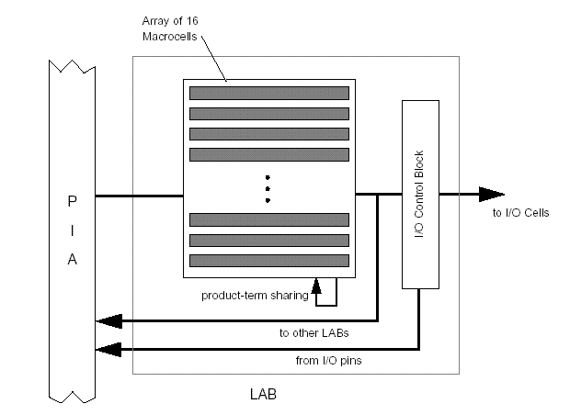
Altera CPLD
Array of Logic Array Blocks (LABs)
Programmable Interconnect Array (PIA): Array of interconnect wires
LAB I/O ←PIA→ LAB I/O
Chip I/O ↔ PIA
Chip I/O ↔ LABs
MAX 7000

Slide 25
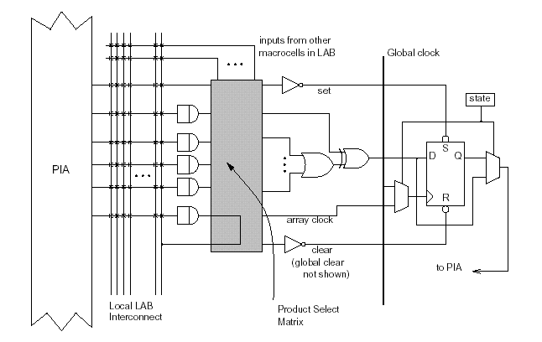
MAX 7000 Macrocell

Slide 26
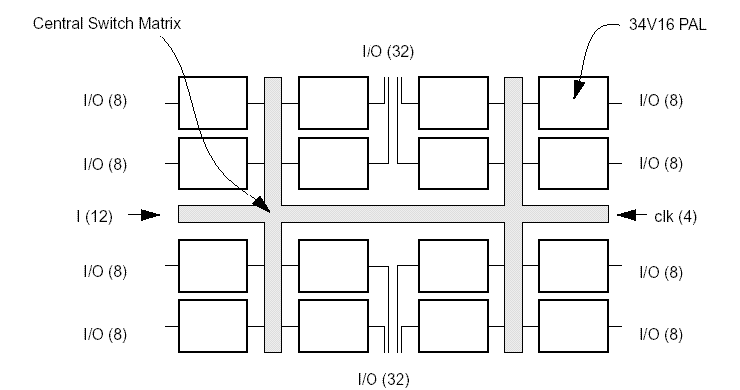
AMD - CPLD
AMD Mach 4 CPLD

Slide 27
Altera MAX Interconnect Architecture
column channel
row channel
t
PIA
LAB1
LAB2
LAB
PIA
t
PIA
LAB6
Array-based
(MAX 3000-7000)
Mesh-based
(MAX 9000)
Courtesy Altera

Slide 28
Definitions
Programmable logic devices (PLDs)
(or Field Programmable Device (FPD)):
a general term that refers to any type of integrated circuit used for implementing digital hardware, where the chip can be configured by the end user to realize different designs. Programming of such a device often involves placing the chip into a special programming unit, but some chips can also be configured “in-system”.
Source: S. Brown and J. Rose, FPGA and CPLD Architectures: A Tutorial,
IEEE Design and Test of Computer, 1996

Slide 29
Classifications
PLA — a Programmable Logic Array (PLA) is a relatively
small FPD that contains two levels of logic, an AND-
plane and an OR-plane, where both levels are
programmable
PAL — a Programmable Array Logic (PAL) is a relatively
small FPD that has a programmable AND-plane
followed by a fixed OR-plane
SPLD — refers to any type of Simple PLD, usually either a
PLA or PAL
CPLD — a more Complex PLD that consists of an
arrangement of multiple SPLD-like blocks on a
single chip.
FPGA — a Field-Programmable Gate Array is an FPD
featuring a general structure that allows very high
logic capacity.

Slide 30
Late-Binding Implementation
Array-based
Pre-diffused
Pre-wired
(Gate Arrays)
(FPGA's)

Slide 31
Prewired Arrays
Classification of prewired arrays (or field-programmable devices):
Based on Programming Technique
  Fuse-based (program-once)
  Non-volatile EPROM based
  RAM based
Programmable Logic Style
  Array-Based
  Look-up Table
Programmable Interconnect Style
  Channel-routing
  Mesh networks

Slide 32
Programming Technologies
Fuse and anti-fuse
  fuse makes or breaks link between two wires
  typical connections are 50-300 ohm
  one-time programmable
Flash
  High density
  Process issues
RAM-based
  memory bit controls a switch that connects/disconnects two wires
  typical connections are .5K-1K ohm
  can be programmed and re-programmed easily (tested at factory)

Slide 33
Fuse-Based FPGA
antifuse polysilicon
ONO dielectric
n
⁺
antifuse diffusion
2
l
Open by default, closed by applying current pulse
From Smith97

Slide 34
FPGA
FPGA consists of an array of programmable basic logic
cells surrounded by programmable interconnect.
FPGA Structure
Programmable
interconnect
Logic cell
I/O Cell

Slide 35
Field-Programmable Gate Arrays
Logic blocks
  to implement combinational
  and sequential logic
Interconnect
  wires to connect inputs and
  outputs to logic blocks
I/O blocks
  special logic blocks at periphery
  of device for external connections
Key questions:
  how to make logic blocks programmable?
  how to connect the wires?
  after the chip has been fabbed

Slide 36
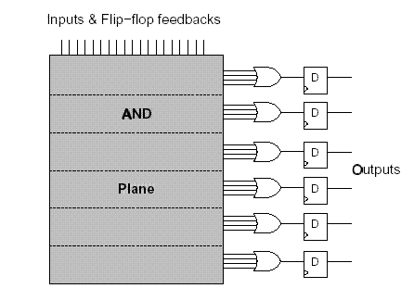
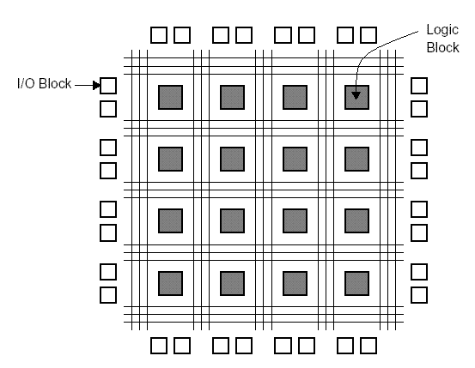
FPGAs

Slide 37
2-input MUX as programmable logic block
Configuration
A
B
S
F=
0
0
0
0
0
X
1
X
A
0
0
Y
1
Y
F
0
Y
X
XY
B
1
X
0
Y
XY
Y
0
X
XY
Y
1
X
X
+
Y
S
1
0
X
X
1
0
Y
Y
1
1
1
1

Slide 38
Implementing Logic functions with LUTs
Each logic block in an FPGA has a small number of inputs and outputs
The most commonly used logic block is a lookup table (LUT), which contains storage cells that are used to implement a small logic function

Slide 39
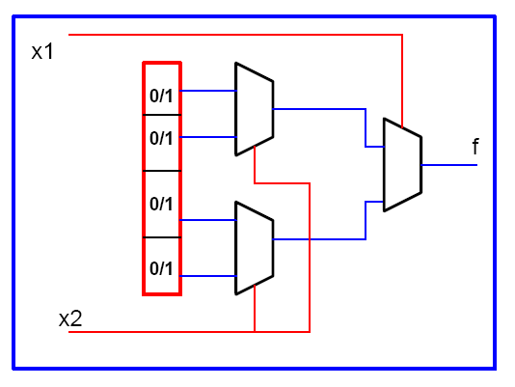
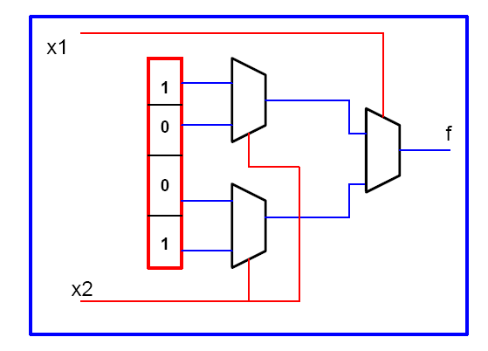
Two-input LUT

Slide 40
LUT-Based Logic Cell
In
Out
Out
00
0
01
1
10
1
Memory
11
0
ln1
ln2

Slide 41
2-input mux as programmable logic block
Configuration
A
B
S
F=
0
0
0
0
0
X
1
X
A
0
0
Y
1
Y
F
0
Y
X
XY
B
1
X
0
Y
XY
Y
0
X
XY
Y
1
X
X
1
Y
S
1
0
X
X
1
0
Y
Y
1
1
1
1

Slide 42
Logic Cell of Actel Fuse-Based FPGA

Slide 43
Look-up Table Based Logic Cell

