Slide 1
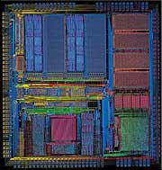
VLSI Design Course
Parviz Keshavarzi
Quick VHDL
Review
Oct. 10th, 2004

Slide 2
Acknowledgement
These slides used or are derived from the following source:
  Dr. Karam Chatha’s VHDL course taught at Arizona State University.
  Melnik
  Jason D. Bakos “VHDL and HDL Designer Primer” university of South Carolina
  Tuft Slides
  Nitin Yogi, Digital Logic Circuits course (yoginit@auburn.edu)
  ECE 448 George Mason University

Slide 3
Part 1:
VHDL In a Glance

Slide 4
VHDL Program Structure
Every VHDL program consists of two main parts:
  Entity
  Architecture
Entity describes Inputs and outputs of a design
Architecture describes functionality of a design

Slide 5
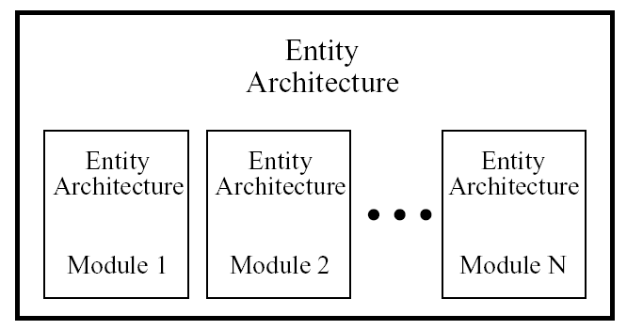
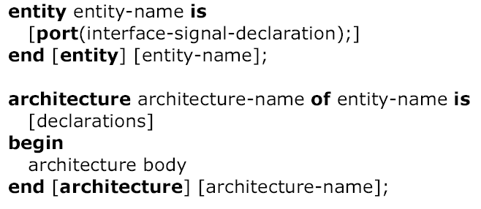
VHDL Program Structure

Slide 6
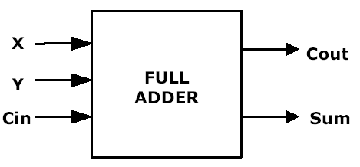
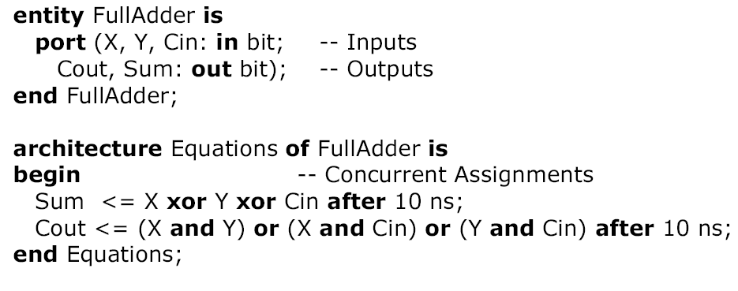
Entity-Architecture Pair
Full Adder Example

Slide 7
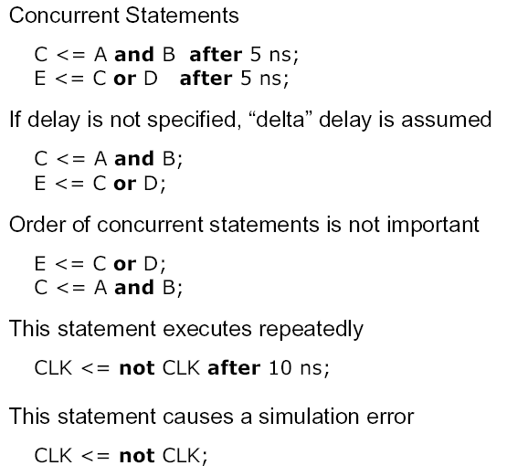
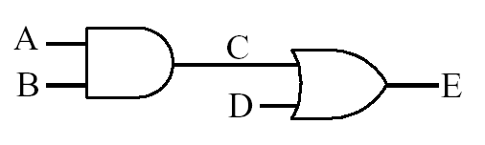
VHDL Description of
Combinational Networks

Slide 8
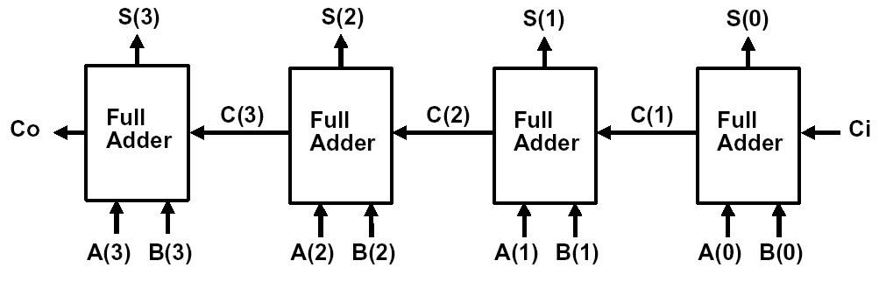
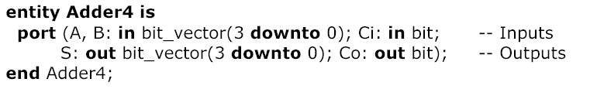
4-bit Adder

Slide 9
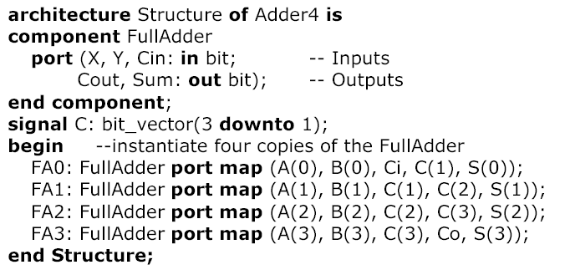
4-bit Adder (cont’d)

Slide 10
Process
Contain sequential statements that define algorithms
Executed when one of the signals in the sensitivity list has an event
proc1: process (a,b,c)
begin
x<=a and b and c;
end process proc1;
proc2: process
begin
x<=a and b and c;
wait on a,b,c;
end process proc2;

Slide 11
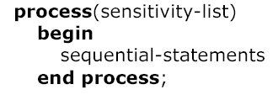
Modeling Flip-Flops Using VHDL Processes
Whenever one of the signals in the sensitivity list changes, the sequential statements are executed
in sequence one time
General form of process

Slide 12
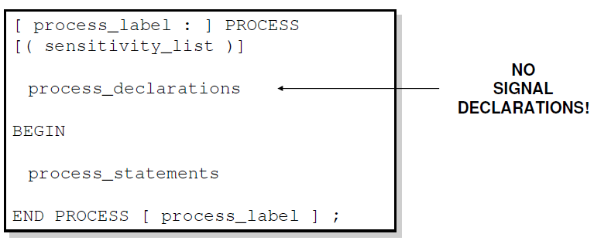
Sequential Style Syntax
Assignments are executed sequentially inside processes.

Slide 13
Sequential Statements
{Signal, Variable} assignments
Flow control
  if <condition> then <statments>
  [elsif <condition> then <statments>]
  else <statements>
  end if;
  for <range> loop <statments> end loop;
  while <condition> loop <statments> end loop;
  case <condition> is
    when <value> => <statements>;
    when <value> => <statements>;
    when others => <statements>;
Wait on <signal> until <expression> for <time>;

Slide 14

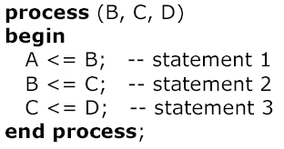
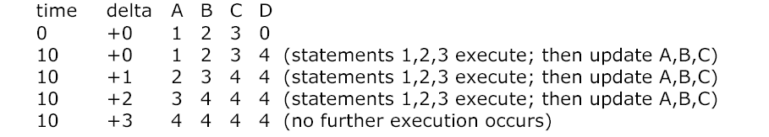
Concurrent Statements vs. Process
Simulation Results
A, B, C, D are integers
A=1, B=2, C=3, D=0
D changes to 4 at time 10
time delta A B C D
0 +0 1 2 3 0
+0 1 2 3 4 (stat. 3 exe.)
10 +1 1 2 4 4 (stat. 2 exe.)
+2 1 4 4 4 (stat. 1 exe.)
10 +3 4 4 4 4 (no exec.)

Slide 15
Concurrent Statements vs. Process
A, B, C, D are integers
A=1, B=2, C=3, D=0
D changes to 4 at time 10
Simulation Results
time delta A B C D
0 +0 0 1 2 0
+0 1 2 3 4 (stat. 3 exe.)
10 +1 1 2 4 4 (stat. 2 exe.)
+2 1 4 4 4 (stat. 1 exe.)
10 +3 4 4 4 4 (no exec.)

Slide 16
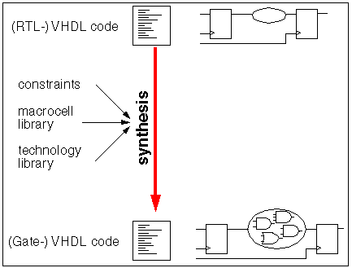
Synthesis
From high level description to the gate level netlist, it is usually with the help of synthesis tools.
For VHDL, only a subset of the language is synthesizable, and different tools support different subsets.
RTL style code is encouraged because it is synthesizable.
In RTL, it is possible to split the code into two blocks (e.g. process) that contain either purely combinational logic or registers.
FSM is also synthesizable
For simulation, we can use the unsynthesizable VHDL or Verilog code in the test bench to generate the stimulus.

Slide 19
Part 2:
VHDL

Slide 20
Intro to VHDL
Need for Hardware Description Languages
  Systems become more complex
  Design at the gate and flip-flop level becomes
  very tedious and time consuming
HDLs allow
  Design and debugging at a higher level before
  conversion to the gate and flip-flop level
  Tools for synthesis do the conversion
VHDL, Verilog
VHDL – VHSIC Hardware Description Language

Slide 21
Intro to VHDL
Developed originally by DARPA
  for specifying digital systems
International IEEE standard (IEEE 1076-1993)
Hardware Description, Simulation, Synthesis
Provides a mechanism for digital design and
reusable design documentation
Support different description levels
  Structural (specifying interconnections of the gates),
  Dataflow (specifying logic equations), and
  Behavioral (specifying behavior)
Top-down, Technology Dependent

Slide 22
VHDL (Appendix B in Textbook)
HDL => VHDL / Verilog
VHDL more verbose, better for team projects
Not case-sensitive
VHDL => “VHSIC Hardware Description Language”
VHSIC => “US DoD Very-High-Speed Integrated Circuit”
DoD project
  Document behavior of ASICs from suppliers
  Alternative to manuals
Used to describe behavior of digital logic
  Extensions for analog
High-level programming language, subset of Ada
  Also looks like Pascal
IEEE standards: 1987, 1993, 2000, 2002
First came the language…
…next came simulators…
…then came synthesizers (FPGA and ASIC)

Slide 23
VHDL
By its nature, VHDL is
  Self-documenting
  Allows for easy testbench design (simulators, instruments)
Any VHDL code may be simulated
Only some VHDL codes may be synthesized
  Depends on packages, data types, and constructs
VHDL descriptions (programs) have structure similar to C++
Each design (component) is made up of
  Entity section
    Component interface (I/O)
    Analogous to C++ header (public methods only)
  Architecture section
    Contains behavior (implementation)
    Can have multiple architectures for any entity
    Example: different types of adders with consistent interfaces

Slide 24
Subsequent versions of VHDL
  IEEE-1076 1987
  IEEE-1076 1993 ← most commonly supported by CAD tools
  IEEE-1076 2000 (minor changes)
  IEEE-1076 2002 (minor changes)
  IEEE-1076 2008

Slide 26
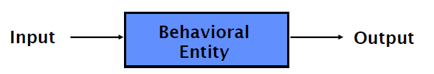
Basic Form of VHDL Code
Every VHDL design description consists of two parts:
  entity
  architecture
The entity section is used to declare I/O ports of the circuit.
The architecture portion describes the circuit’s behavior.

Slide 27
Basic Form of VHDL Code (cont.)
Every VHDL design description consists of at least:
  one entity / architecture pair,
  or one entity with multiple architectures.
A behavioral model is similar to a “black box”.
Standardized design libraries are included before entity declaration.

Slide 28
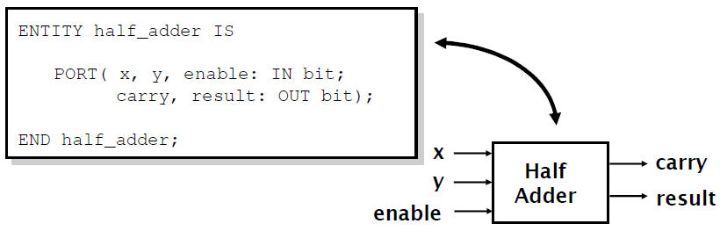
Entity Declaration
An entity declaration describes the interface of the component.
PORT clause indicates input and output ports.
An entity can be thought of as a symbol for a component.

Slide 29
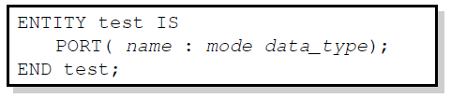
Port Declaration
PORT declaration establishes the interface of the object to the outside world.
Three parts of the PORT declaration
  Name
    Any identifier that is not a reserved word.
  Mode
    In, Out, Inout, Buffer
  Data type
    Any declared or predefined datatype.
Sample PORT declaration syntax:

Slide 30
Entity Declaration
Entity Declaration describes an interface of the component, i.e. input and output ports.
Entity name
Port names
Port type
Semicolon
ENTITY nand_gate IS
PORT(
a : IN STD_LOGIC;
b : IN STD_LOGIC;
z : OUT STD_LOGIC
);
END nand_gate;
No Semicolon after last port
Reserved words
Port modes (data flow directions)

Slide 31
VHDL entity
entity my_ckt is
port (
A: in bit;
B: in bit;
S: in bit;
X: out bit;
Y: out bit
);
end my_ckt;
Datatypes:
In-built
User-defined
Name of the circuit
User-defined
Filename same as circuit name
Example.
  Circuit name: my_ckt
  Filename: my_ckt.vhd
Name of the circuit
User-defined
Filename same as circuit name recommended
Example:
  Circuit name: my_ckt
  Filename: my_ckt.vhd
my_ckt
A
X
B
Y
S
Direction of port
3 main types:
in: Input
out: Output
inout: Bidirectional
Port names or
Signal names
Note the absence of semicolon “;” at the end of the last signal and the presence at the end of the closing bracket

Slide 32
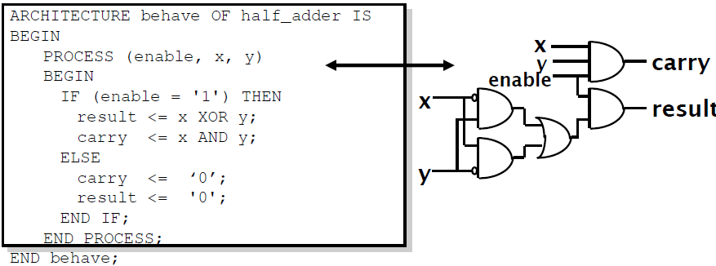
Architecture Declaration
Architecture declarations describe the operation of the component.
Many architectures may exist for one entity, but only one may be active at a time.
An architecture is similar to a schematic of the component.

Slide 33
Example VHDL Code
3 sections to a piece of VHDL code
File extension for a VHDL file is .vhd
Name of the file should be the same as the entity name (nand_gate.vhd) [OpenCores Coding Guidelines]
LIBRARY ieee;
USE ieee.std_logic_1164.all;
ENTITY nand_gate IS
PORT(
a : IN STD_LOGIC;
b : IN STD_LOGIC;
z : OUT STD_LOGIC);
END nand_gate;
ARCHITECTURE model OF nand_gate IS
BEGIN
z <= a NAND b;
END model;
LIBRARY DECLARATION
ENTITY DECLARATION
ARCHITECTURE BODY

Slide 34

Libraries

Slide 35
Library Declarations
LIBRARY ieee;
USE ieee.std_logic_1164.all;
ENTITY nand_gate IS
PORT(
a : IN STD_LOGIC;
b : IN STD_LOGIC;
z : OUT STD_LOGIC);
END nand_gate;
ARCHITECTURE dataflow OF nand_gate IS
BEGIN
z <= a NAND b;
END dataflow;
Library declaration
Use all definitions from the package
std_logic_1164

Slide 36
Library declarations - syntax
LIBRARY library_name;
USE library_name.package_name.package_parts;

Slide 37
Fundamental parts of a library
LIBRARY
PACKAGE 1
PACKAGE 2
TYPES
CONSTANTS
FUNCTIONS
PROCEDURES
COMPONENTS
TYPES
CONSTANTS
FUNCTIONS
PROCEDURES
COMPONENTS

Slide 38
Libraries
ieee
std
work
Need to be explicitly
declared
Specifies multi-level logic system,
including STD_LOGIC, and
STD_LOGIC_VECTOR data types
Specifies pre-defined data types
(BIT, BOOLEAN, INTEGER, REAL,
SIGNED, UNSIGNED, etc.), arithmetic
operations, basic type conversion
functions, basic text i/o functions, etc.
Visible by default
Holds current designs after compilation

Slide 39
BIT versus STD_LOGIC
BIT type can only have a value of '0' or '1'
STD_LOGIC can have nine values
  '0', '1', 'Z', 'U', 'X', 'L', 'H', 'W', '-'
  Useful mainly for simulation
  '0', '1', and 'Z' are synthesizable
  (your codes should contain only these
  three values)

Slide 40
Standard Libraries
Include library ieee; before entity declaration.
ieee.std_logic_1164 defines a standard for designers to use in describing interconnection data types used in VHDL modeling.
ieee.std_logic_arith provides a set of arithmetic, conversion, comparison functions for signed, unsigned, std_ulogic, std_logic, std_logic_vector.
Ieee.std_logic_unsigned provides a set of unsigned arithmetic, conversion, and comparison functions for std_logic_vector.
See all available packages at http://www.cs.umbc.edu/portal/help/VHDL/stdpkg.html

Slide 41
Built-in Datatypes
Scalar (single valued) signal types:
  bit
  boolean
  integer
  Examples:
    A: in bit;
    G: out boolean;
    K: out integer;
Aggregate (collection or array) signal types:
  bit_vector: array of bits representing binary numbers
  signed: array of bits representing signed binary numbers
  Examples:
    D: in bit_vector(0 to 7);
    E: in bit_vector(7 downto 0);
    M: in signed (4 downto 0);
    --signed 5 bit_vector binary number

Slide 42
User-defined datatype
Construct datatypes arbitrarily or using built-in datatypes
Examples:
  type temperature is (high, medium, low);
  type byte is array(0 to 7) of bit;

Slide 44
Process
Contains sequentially executed statements
Execution is controlled either via
  sensitivity list (contains trigger signals), or
  wait-statements
  (Executed when one of the signals in the sensitivity list has an event)
Be careful about incomplete sensitivity list.
Exists within an architecture only
Several processes run concurrently
The process label is optional
architecture RTL of AND_OR_XOR is
begin
A_O_X: process (A, B)
begin
Z_OR <= A or B;
Z_AND <= A and B;
Z_XOR <= A xor B;
end process A_O_X ;
end RTL;
Sensitivity list
architecture RTL of AND_OR_XOR is
begin
A_O_X: process
begin
Z_OR <= A or B;
Z_AND <= A and B;
Z_XOR <= A xor B;
wait on A,B;
end process A_O_X ;
end RTL;

Slide 45
Data Objects
Constants : Holds a value that cannot be changed within the design description
constant width: integer:=8;
    (The identifier width may be used several times in the code.)
Signals : represent wires, used to interconnect components
Variables : used in processes and subprograms

Slide 46
Data Objects (Cont’d)
architecture example of and8 is
begin
my_and: process (a_bus)
variable tmp: bit;
begin
tmp:=‘1’;
for i in 7 downto 0 loop
tmp:= a_bus(i) and tmp;
end loop;
x<=tmp;
end process my_and;
end example;
Note: Variable does not represent wires like signals

Slide 47
Data Objects
There are three types of data objects:
  Signals
    Can be considered as wires in a schematic.
    Can have current value and future values.
  Variables and Constants
    Used to model the behavior of a circuit.
    Used in processes, procedures and functions.

Slide 48

Constant Declaration
A constant can have a single value of a given type.
A constant’s value cannot be changed during the simulation.
Constants declared at the start of an architecture can be used anywhere in the architecture.
Constants declared in a process can only be used inside the specific process.
CONSTANT constant_name : type_name [ : = value];
CONSTANT rise_fall_time : TIME : = 2 ns;
CONSTANT data_bus : INTEGER : = 16;

Slide 49
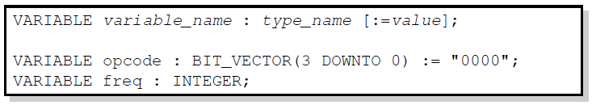
Variable Declaration
Variables are used for local storage of data.
Variables are generally not available to multiple components or processes.
All variable assignments take place immediately.
Variables are more convenient than signals for the storage of (temporary) data.

Slide 50
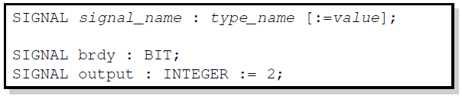
Signal Declaration
Signals are used for communication between components.
Signals are declared outside the process.
Signals can be seen as real, physical signals.
Some delay must be incurred in a signal assignment.

Slide 51
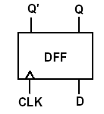
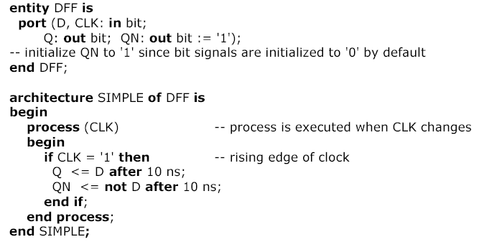
D Flip-flop Model
Bit values are enclosed
in single quotes

Slide 54
Generics
entity ADDER is generic(n: natural :=2); port( A: in std_logic_vector(n-1 downto 0); B: in std_logic_vector(n-1 downto 0); carry: out std_logic; sum: out std_logic_vector(n-1 downto 0) ); end ADDER;
entity ADDER is generic(n: natural :=2); port( A: in std_logic_vector(n-1 downto 0); B: in std_logic_vector(n-1 downto 0); carry: out std_logic; sum: out std_logic_vector(n-1 downto 0) ); end ADDER;
entity ADDER is generic(n: natural :=2); port( A: in std_logic_vector(n-1 downto 0); B: in std_logic_vector(n-1 downto 0); carry: out std_logic; sum: out std_logic_vector(n-1 downto 0) ); end ADDER;
entity ADDER is generic(n: natural :=2); port( A: in std_logic_vector(n-1 downto 0); B: in std_logic_vector(n-1 downto 0); carry: out std_logic; sum: out std_logic_vector(n-1 downto 0) ); end ADDER;
Generics allow the component to be customized upon instantiation.
Generics pass information from the entity to the architecture.
Common uses of generics
  Customize timing
  Alter range of subtypes
  Change size of arrays
ENTITY adder IS
GENERIC(n: natural :=2);
PORT(
A: IN STD_LOGIC_VECTOR(n-1 DOWNTO 0);
B: IN STD_LOGIC_VECTOR(n-1 DOWNTO 0);
C: OUT STD_LOGIC;
SUM: OUT STD_LOGIC_VECTOR(n-1 DOWNTO 0) );
END adder;

Slide 55
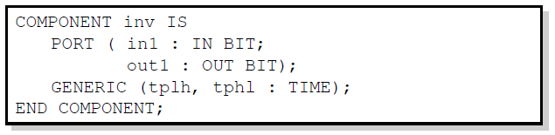
Technology Modeling
One use of generics is to alter the timing of a certain component.
It is possible to indicate a generic timing delay and then specify the exact delay at instantiation.
The example above declares the interface to a component named inv.
The propagation time for high-to-low and low-to-high transitions can be specified later.

Slide 56
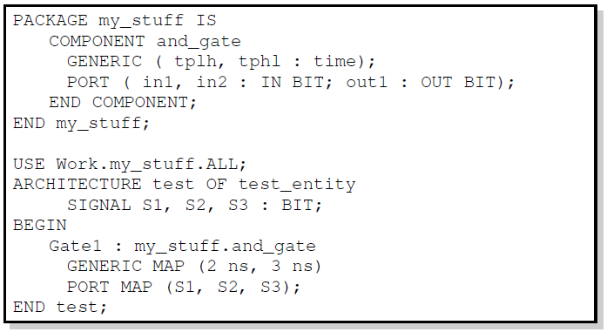
Structural Statements
The GENERIC MAP is similar to the PORT MAP in that it maps specific values to generics declared in the component.

Slide 57
Generate Statement
Structural for-loops: The GENERATE statement
  Some structures in digital hardware are repetitive in nature. (RAM, ROM, registers, adders, multipliers, …)
  VHDL provides the GENERATE statement to automatically create regular hardware.
  Any VHDL concurrent statement may be included in a GENERATE statement, including another GENERATE statement.

Slide 58
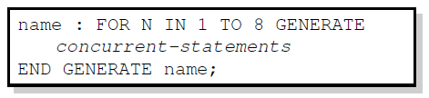
Generate Statement Syntax
All objects created are similar.
The GENERATE parameter must be discrete and is undefined outside the GENERATE statement.

Slide 59
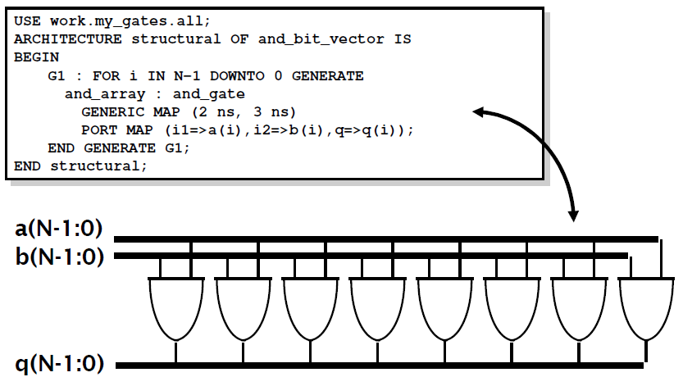
Example: Array of AND-gates

Slide 61
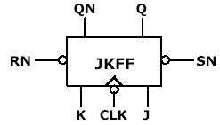

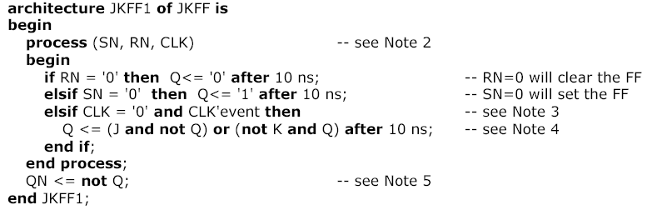
JK Flip-Flop Model

Slide 62
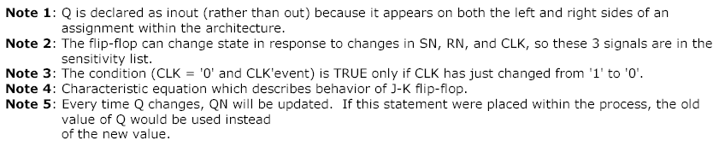
JK Flip-Flop Model

Slide 63
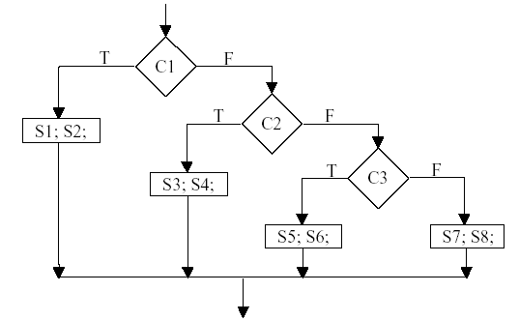
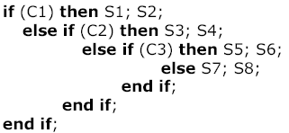
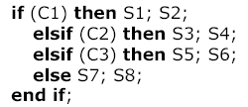
Using Nested IFs and ELSEIFs

Slide 64
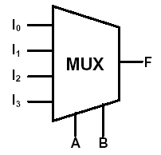
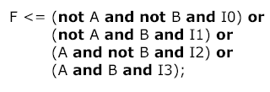
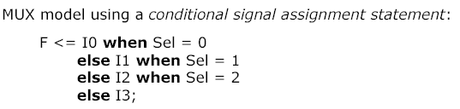
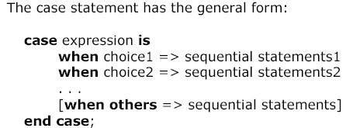
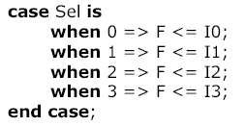
VHDL Models for a MUX
Sel represents the integer
equivalent of a 2-bit binary number with bits A and B
If a MUX model is used inside a process,
the MUX can be modeled using a CASE statement
(cannot use a concurrent statement):

Slide 65
MUX Models (1)
library IEEE;
use IEEE.std_logic_1164.all;
use IEEE.std_logic_unsigned.all;
entity SELECTOR is
port (
A : in std_logic_vector(15 downto 0);
SEL : in std_logic_vector( 3 downto 0);
Y : out std_logic);
end SELECTOR;
architecture RTL1 of SELECTOR is
begin
p0 : process (A, SEL)
begin
if (SEL = "0000") then Y <= A(0);
elsif (SEL = "0001") then Y <= A(1);
elsif (SEL = "0010") then Y <= A(2);
elsif (SEL = "0011") then Y <= A(3);
elsif (SEL = "0100") then Y <= A(4);
elsif (SEL = "0101") then Y <= A(5);
elsif (SEL = "0110") then Y <= A(6);
elsif (SEL = "0111") then Y <= A(7);
elsif (SEL = "1000") then Y <= A(8);
elsif (SEL = "1001") then Y <= A(9);
elsif (SEL = "1010") then Y <= A(10);
elsif (SEL = "1011") then Y <= A(11);
elsif (SEL = "1100") then Y <= A(12);
elsif (SEL = "1101") then Y <= A(13);
elsif (SEL = "1110") then Y <= A(14);
else Y <= A(15);
end if;
end process;
end RTL1;

Slide 66
MUX Models (2)
library IEEE;
use IEEE.std_logic_1164.all;
use IEEE.std_logic_unsigned.all;
entity SELECTOR is
port (
A : in std_logic_vector(15 downto 0);
SEL : in std_logic_vector( 3 downto 0);
Y : out std_logic);
end SELECTOR;
architecture RTL3 of SELECTOR is
begin
with SEL select
Y <= A(0) when "0000",
A(1) when "0001",
A(2) when "0010",
A(3) when "0011",
A(4) when "0100",
A(5) when "0101",
A(6) when "0110",
A(7) when "0111",
A(8) when "1000",
A(9) when "1001",
A(10) when "1010",
A(11) when "1011",
A(12) when "1100",
A(13) when "1101",
A(14) when "1110",
A(15) when others;
end RTL3;

Slide 67
MUX Models (3)
library IEEE;
use IEEE.std_logic_1164.all;
use IEEE.std_logic_unsigned.all;
entity SELECTOR is
port (
A : in std_logic_vector(15 downto 0);
SEL : in std_logic_vector( 3 downto 0);
Y : out std_logic);
end SELECTOR;
architecture RTL2 of SELECTOR is
begin
p1 : process (A, SEL)
begin
case SEL is
when "0000" => Y <= A(0);
when "0001" => Y <= A(1);
when "0010" => Y <= A(2);
when "0011" => Y <= A(3);
when "0100" => Y <= A(4);
when "0101" => Y <= A(5);
when "0110" => Y <= A(6);
when "0111" => Y <= A(7);
when "1000" => Y <= A(8);
when "1001" => Y <= A(9);
when "1010" => Y <= A(10);
when "1011" => Y <= A(11);
when "1100" => Y <= A(12);
when "1101" => Y <= A(13);
when "1110" => Y <= A(14);
when others => Y <= A(15);
end case;
end process;
end RTL2;

Slide 68
MUX Models (4)
library IEEE;
use IEEE.std_logic_1164.all;
use IEEE.std_logic_unsigned.all;
entity SELECTOR is
port (
A : in std_logic_vector(15 downto 0);
SEL : in std_logic_vector( 3 downto 0);
Y : out std_logic);
end SELECTOR;
architecture RTL4 of SELECTOR is
begin
Y <= A(conv_integer(SEL));
end RTL4;

Slide 70
Part 2:
Quick VHDL
Review

Slide 72
Why use an HDL?
Question:
How do we know that we have not made a mistake when we manually draw a schematic and connect components to implement a function?
Answer:
By describing the design in a high-level (=easy to understand) language, we can simulate our design before we manufacture it. This allows us to catch design errors, i.e., that the design does not work as we thought it would.
Simulation guarantees that the design behaves as it should.
Notes:
This diagram show you how optical mammography works
Four wavelength lights, (690,750,788,856nm), are modulated electronically around 70 Mhz. The modulated lights are guided and projected to breast by optical fiber bundle.
The source and detector located on opposite sides of breast, and will move mechanicly and screening the breast tissue.
Due to the diffusive nature of light propagation in breast tissue, the amplitude and phase of received light will change and shift. Prof. Fantini’s group can generate a image of the breast if they know the amplitude and phase data.
The photon mulitiplier tube convert the optical singal to electrical signal. The amplitude and phase data, which can be measured from electrical signal .
The spectral dependences of blood vessel, cancer and mastopathy are different. That’s why they use four wavelengths lights here.
Here are the four images for different wavelenghs lights.
The four images are combined to generate a oxygenation-index image,
The arrow indicated the position of a 2.5cm invasive ductal carcinoma

Slide 73
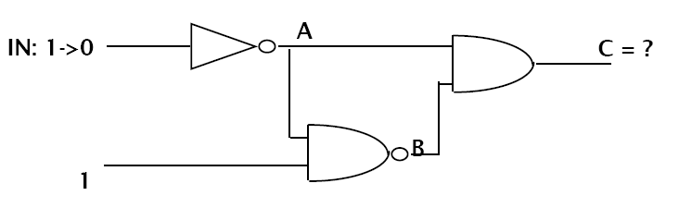
How does the simulation work?
Notes:
We are electrical engineering guy, our goal is to develop a image sensor basing on CMOS technology, so they can replace the bulky device and have more flexibility.
This diagram show the proposed architecture of our image sensor. The photo detector array convert the received light to current. The preamplifier will amplify the weak current signal from photo-detector. The boosted signal will be fed to analog signal processing circuits to generate the amplitude, DC and phase data.
The challenge is they want to detect extremely low optical power, 1 nW. To detect such low level light at very high frequency, 70 Mhz. the input referred noise of preamplifier supposed to be as low as several fA per squre root of Hz, Assuming the responsivity of photodiode is 0.5 A/W, which is even lower than the thermal noise of MOS transistor with typical size.
The extremely low noise and high frequency are the big problem here. One way we can do is design a novel preamplifier with extremely low input referred noise. or we can improve the responsivity of the photodetector.

Slide 74
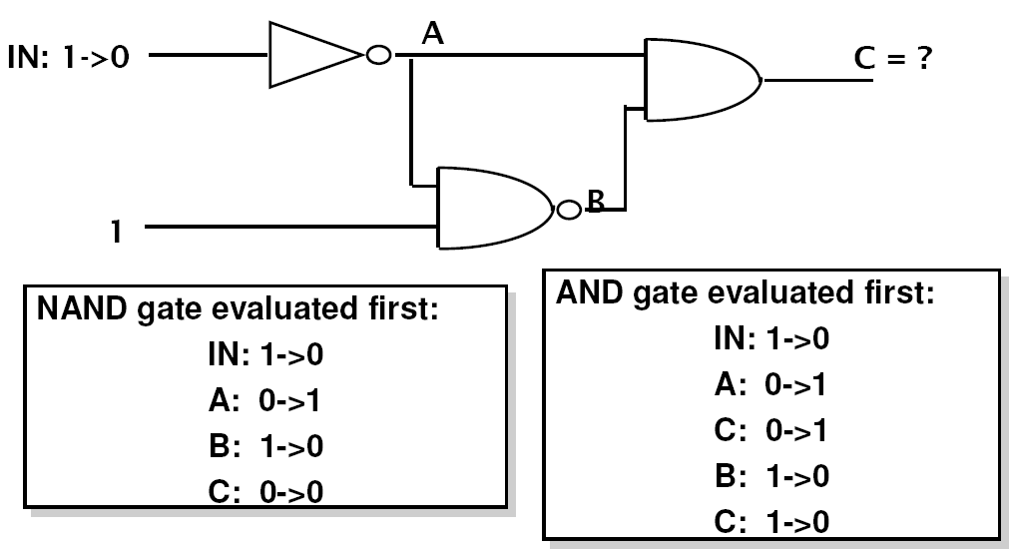
What is the output of C?
Notes:
We are electrical engineering guy, our goal is to develop a image sensor basing on CMOS technology, so they can replace the bulky device and have more flexibility.
This diagram show the proposed architecture of our image sensor. The photo detector array convert the received light to current. The preamplifier will amplify the weak current signal from photo-detector. The boosted signal will be fed to analog signal processing circuits to generate the amplitude, DC and phase data.
The challenge is they want to detect extremely low optical power, 1 nW. To detect such low level light at very high frequency, 70 Mhz. the input referred noise of preamplifier supposed to be as low as several fA per squre root of Hz, Assuming the responsivity of photodiode is 0.5 A/W, which is even lower than the thermal noise of MOS transistor with typical size.
The extremely low noise and high frequency are the big problem here. One way we can do is design a novel preamplifier with extremely low input referred noise. or we can improve the responsivity of the photodetector.

Slide 75
The two-phase simulation cycle
Go through all functions. Compute the next value to appear on the output using current input values and store it in a local data area (a value table inside the function).
2) Go through all functions. Transfer the new value from the
local table inside to the data area holding the values of
the outputs (=inputs to the next circuit)

Slide 76
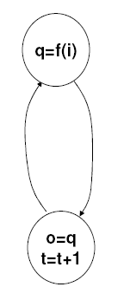
Cycle-based simulators
Go through all functions using current inputs and compute next output
Update outputs & increase time with 1 delay unit

Slide 77
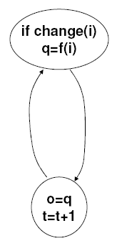
Event-based Simulators
Go through all functions whose inputs has changed and compute next output
Update outputs & increase time with 1 delay unit

Slide 78
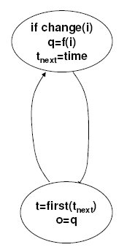
Event-based simulators with event queues
Go through all functions whose inputs has changed and compute value and time for next output change
Increase time to first scheduled event & update signals

Slide 79
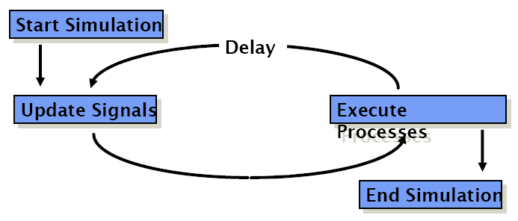
VHDL Simulation Cycle
VHDL uses a simulation cycle to model the stimulus and response nature of digital hardware.

Slide 80
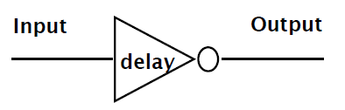
VHDL Delay Models
Delay is created by scheduling a signal assignment for a future time.
Delay in a VHDL cycle can be of several types
  Inertial
  Transport
  Delta

Slide 81
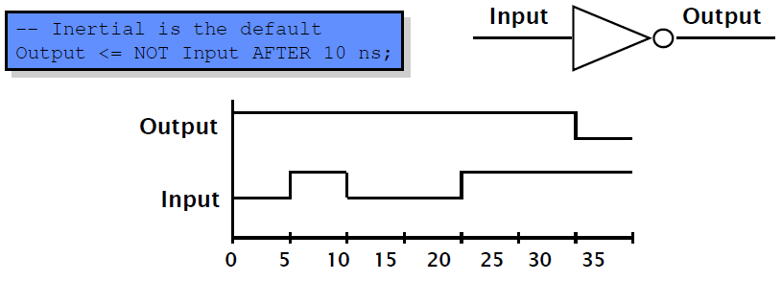
Inertial Delay
Default delay type
Allows for user specified delay
Absorbs pulses of shorter duration than the specified delay

Slide 82
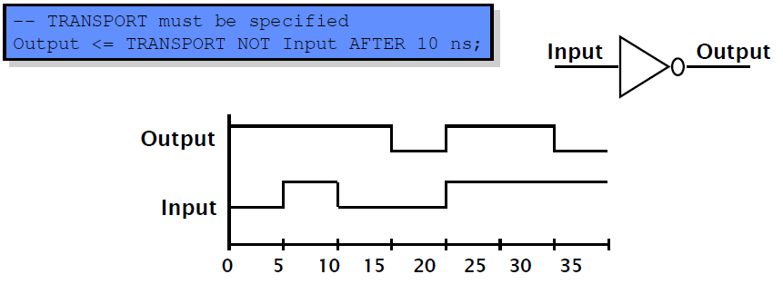
Transport Delay
Must be explicitly specified by user
Allows for user specified delay
Passes all input transitions with delay

Slide 83
Delta Delay
• Delta delay needed to provide support for concurrent
operations with zero delay
  – The order of execution for components with zero delay is not clear
• Scheduling of zero delay devices requires the delta
delay
  – A delta delay is necessary if no other delay is specified
  – A delta delay does not advance simulator time
  – One delta delay is an infinitesimal amount of time
  – The delta is a scheduling device to ensure repeatability

Slide 84
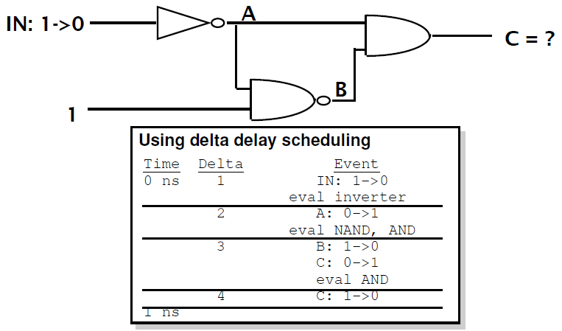
Example – Delta Delay

Slide 86
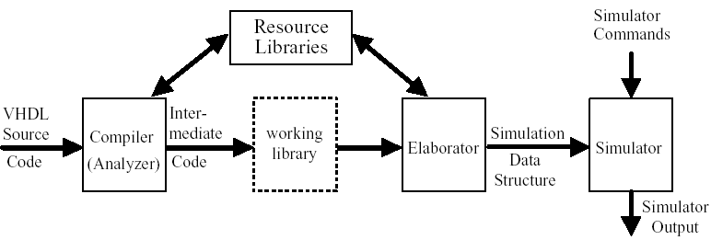
Compilation and Simulation of VHDL Code
Compiler (Analyzer) – checks the VHDL source code
  does it conforms with VHDL syntax and semantic rules
  are references to libraries correct
Intermediate form used by a simulator or by a synthesizer
Elaboration
  create ports, allocate memory storage, create interconnections, ...
  establish mechanism for executing of VHDL processes

Slide 87
Timing Model
VHDL uses the following simulation cycle to model the stimulus and response nature of digital hardware
Start Simulation
Delay
Update Signals
Execute Processes
End Simulation
Notes:
The VHDL timing model controls the stimulus and response sequence of signals in a VHDL model. At the start of a simulation, signals with default values are assigned those values. In the first execution of the simulation cycle, all processes are executed until they reach their first wait statement. These process executions will include signal assignment statements that assign new signal values after prescribed delays.
After all the processes are suspended at their respective wait statements, the simulator will advance simulation time just enough so that the first pending signal assignments can be made (e.g. 1 ns, 3 ns, 1 delta cycle).
After the relevant signals assume their new values, all processes examine their wait conditions to determine if they can proceed. Processes that can proceed will then execute concurrently again until they all reach their respective subsequent wait conditions.
This cycle continues until the simulation termination conditions are met or until all processes are suspended indefinitely because no new signal assignments are scheduled to unsuspend any waiting processes.

Slide 88
Delay Types
All VHDL signal assignment statements prescribe an amount of time that must transpire before the signal assumes its new value
This prescribed delay can be in one of three forms:
  Transport -- prescribes propagation delay only
  Inertial -- prescribes propagation delay and minimum input pulse width
  Delta -- the default if no delay time is explicitly specified
Input
Output
delay
Notes:
There are several types of delay in VHDL, and understanding of how delay works in a process is key to writing and understanding VHDL.
It bears repeating that any signal assignment in VHDL is actually a scheduling for a future value to be placed on that signal. When a signal assignment statement is executed, the signal maintains its original value until the time for the scheduled update to the new value. Any signal assignment statement will incur a delay of one of the three types listed in this slide.

Slide 89
Transport Delay
Transport delay must be explicitly specified
  I.e. keyword “TRANSPORT” must be used
Signal will assume its new value
after specified delay
-- TRANSPORT delay example
Output <= TRANSPORT NOT Input AFTER 10 ns;
Input
Output
Input
Output
0 5 10 15 20 25 30 35
Notes:
The keyword TRANSPORT must be used to specify a transport delay.
Transport delay is the simplest in that when it is specified, any change in an input signal value may result in a new value being assigned to the output signal after the specified propagation delay.
Note that no restrictions are specified on input pulse widths. In this example, Output will be an inverted copy of Input delayed by the 10ns propagation delay regardless of the pulse widths seen on Input .

Slide 90
Inertial Delay
Provides for specification propagation delay and input pulse width, i.e. ‘inertia’ of output:
Inertial delay is default and REJECT is optional:
target <= [REJECT time_expression] INERTIAL waveform;
Output <= NOT Input AFTER 10 ns;
-- Propagation delay and minimum pulse width are 10ns
Input
Input
Output
Output
0 5 10 15 20 25 30 35
Notes:
The keyword INERTIAL may be used in the signal assignment statement to specify an inertial delay, or it may be left out because inertial delay is used by default in VHDL signal assignment statements which contain “after” clauses.
If the optional REJECT construct is not used, the specified delay is then used as both the ‘inertia’ (i.e. minimum input pulse width requirement) and the propagation delay for the signal. Note that in the example above, pulses on Input narrower than 10ns are not observed on Output.

Slide 91
Inertial Delay (cont.)
Example of gate with ‘inertia’ smaller than propagation delay
  e.g. Inverter with propagation delay of 10ns which suppresses pulses shorter than 5ns
Note: the REJECT feature is new
to VHDL 1076-1993
Output <= REJECT 5ns INERTIAL NOT Input AFTER 10ns;
Input
Output
0 5 10 15 20 25 30 35
Notes:
The REJECT construct is a new feature to VHDL introduced in the VHDL 1076-1993 standard. The REJECT construct can only be used with the keyword INERTIAL to include a time parameter that specifies the input pulse width constraint.
Prior to this, a description for such a gate would have needed the use of an intermediate signal with the appropriate inertial delay followed by an assignment of this intermediate signal’s value to the actual output via a transport delay.

Slide 92
Delta Delay
Default signal assignment propagation delay if no delay is explicitly prescribed
  VHDL signal assignments do not take place immediately
  Delta is an infinitesimal VHDL time unit so that all signal assignments can result in signals assuming their values at a future time
  E.g.
Supports a model of concurrent VHDL process execution
  Order in which processes are executed by simulator does not affect simulation output
Output <= NOT Input;
-- Output assumes new value in one delta cycle
Notes:
VHDL allows the designer to describe systems at various levels of abstraction. As such, timing and delay information may not always be included in a VHDL description.
A delta (or delta cycle) is essentially an infinitesimal, but quantized, unit of time. The delta delay mechanism is used to provide a minimum delay in a signal assignment statement so that the simulation cycle described earlier can operate correctly when signal assignment statements do not include explicitly specified delays. That is:
1) all active processes can execute in the same simulation cycle
2) each active process will suspend at wait statement
3) when all processes are suspended simulation is advanced the minimum time necessary so that some signals can take on their new values
4) processes then determine if the new signal values satisfy the conditions to proceed from the wait statement at which they are suspended

Slide 93
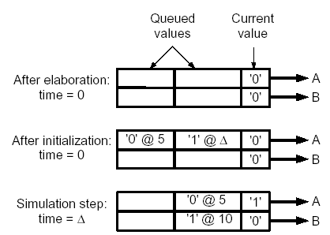


Simulation Example

Slide 94
Problem #1
entity not_another_prob is
port (in1, in2: in bit;
a: out bit);
end not_another_prob;
architecture oh_behave of not_another_prob is
signal b, c, d, e, f: bit;
begin
L1: d <= not(in1);
L2: c<= not(in2);
L3: f <= (d and in2) ;
L4: e <= (c and in1) ;
L5: a <= not b;
L6: b <= e or f;
end oh_behave;
Using the labels, list the order in which the following signal assignments are evaluated if in2 changes from a '0' to a '1'. Assume in1 has been a '1' and in2 has been a '0' for a long time, and then at time t in2 changes from a '0' to a '1'.

Slide 95
Problem #2
Under what conditions do the two assignments below result in the same behavior? Different behavior? Draw waveforms to support your answers.
out <= reject 5 ns inertial (not a) after 20 ns;
out <= transport (not a) after 20 ns;

Slide 96


Modeling a Sequential Machine
Mealy Machine for
8421 BCD to 8421 BCD + 3 bit serial converter
How to model this in VHDL?

Slide 97



Behavioral VHDL Model
Two processes:
  the first represents the combinational network;
  the second represents
  the state register

Slide 98


Simulation of the VHDL Model
Simulation command file:
Waveforms:

Slide 99

Dataflow VHDL Model

Slide 100


Structural Model
Package bit_pack is a part of library BITLIB –
includes gates, flip-flops, counters
(See Appendix B for details)

Slide 101


Simulation of the Structural Model
Simulation command file:
Waveforms:

Slide 102
Wait Statements
... an alternative to a sensitivity list
  Note: a process cannot have both wait statement(s)
  and a sensitivity list
Generic form of a process with wait statement(s)
How wait statements work?
Execute seq. statement until
a wait statement is encountered.
Wait until the specified condition is satisfied.
Then execute the next
set of sequential statements until
the next wait statement is encountered.
...
When the end of the process is reached start over again at the beginning.
process
begin
sequential-statements
wait statement
sequential-statements
wait-statement
...
end process;

Slide 103
Forms of Wait Statements
wait on sensitivity-list;
wait for time-expression;
wait until boolean-expression;
Wait on
  until one of the signals in the sensitivity list changes
Wait for
  waits until the time specified by the time expression has elapsed
  What is this:
  wait for 0 ns;
Wait until
  the boolean expression is evaluated whenever one of the signals in the expression changes, and the process continues execution when the expression evaluates to TRUE

Slide 104

Using Wait Statements (1)

Slide 105

Using Wait Statements (2)

Slide 106
To Do
Read
  Textbook chapters 2.1, 2.2

Slide 108
Timing Model
VHDL uses the following simulation cycle to model the stimulus and response nature of digital hardware
Start Simulation
Delay
Update Signals
Execute Processes
End Simulation
Notes:
The VHDL timing model controls the stimulus and response sequence of signals in a VHDL model. At the start of a simulation, signals with default values are assigned those values. In the first execution of the simulation cycle, all processes are executed until they reach their first wait statement. These process executions will include signal assignment statements that assign new signal values after prescribed delays.
After all the processes are suspended at their respective wait statements, the simulator will advance simulation time just enough so that the first pending signal assignments can be made (e.g. 1 ns, 3 ns, 1 delta cycle).
After the relevant signals assume their new values, all processes examine their wait conditions to determine if they can proceed. Processes that can proceed will then execute concurrently again until they all reach their respective subsequent wait conditions.
This cycle continues until the simulation termination conditions are met or until all processes are suspended indefinitely because no new signal assignments are scheduled to unsuspend any waiting processes.

Slide 109
Review: Delay Types
All VHDL signal assignment statements prescribe an amount of time that must transpire before the signal assumes its new value
This prescribed delay can be in one of three forms:
  Transport -- prescribes propagation delay only
  Inertial -- prescribes propagation delay and minimum input pulse width
  Delta -- the default if no delay time is explicitly specified
Input
Output
delay
Notes:
There are several types of delay in VHDL, and understanding of how delay works in a process is key to writing and understanding VHDL.
It bears repeating that any signal assignment in VHDL is actually a scheduling for a future value to be placed on that signal. When a signal assignment statement is executed, the signal maintains its original value until the time for the scheduled update to the new value. Any signal assignment statement will incur a delay of one of the three types listed in this slide.

Slide 110
Problem #1
entity not_another_prob is
port (in1, in2: in bit;
a: out bit);
end not_another_prob;
architecture oh_behave of not_another_prob is
signal b, c, d, e, f: bit;
begin
L1: d <= not(in1);
L2: c<= not(in2);
L3: f <= (d and in2) ;
L4: e <= (c and in1) ;
L5: a <= not b;
L6: b <= e or f;
end oh_behave;
Using the labels, list the order in which the following signal assignments are evaluated if in2 changes from a '0' to a '1'. Assume in1 has been a '1' and in2 has been a '0' for a long time, and then at time t in2 changes from a '0' to a '1'.

Slide 111
Modeling a Sequential Machine
Mealy Machine for
8421 BCD to 8421 BCD + 3 bit serial converter
How to model this in VHDL?

Slide 112
Behavioral VHDL Model
Two processes:
  the first represents the combinational network;
  the second represents
  the state register

Slide 113
Simulation of the VHDL Model
Simulation command file:
Waveforms:

Slide 114
Dataflow VHDL Model

Slide 115
Structural Model
Package bit_pack is a part of library BITLIB –
includes gates, flip-flops, counters
(See Appendix B for details)

Slide 116
Simulation of the Structural Model
Simulation command file:
Waveforms:

Slide 117
Wait Statements
... an alternative to a sensitivity list
  Note: a process cannot have both wait statement(s)
  and a sensitivity list
Generic form of a process with wait statement(s)
How wait statements work?
Execute seq. statement until
a wait statement is encountered.
Wait until the specified condition is satisfied.
Then execute the next
set of sequential statements until
the next wait statement is encountered.
...
When the end of the process is reached start over again at the beginning.
process
begin
sequential-statements
wait statement
sequential-statements
wait-statement
...
end process;

Slide 118
Forms of Wait Statements
wait on sensitivity-list;
wait for time-expression;
wait until boolean-expression;
Wait on
  until one of the signals in the sensitivity list changes
Wait for
  waits until the time specified by the time expression has elapsed
  What is this:
  wait for 0 ns;
Wait until
  the boolean expression is evaluated whenever one of the signals in the expression changes, and the process continues execution when the expression evaluates to TRUE

Slide 119
Using Wait Statements (1)

Slide 120
Using Wait Statements (2)

Slide 121
Variables
What are they for:
Local storage in processes,
procedures, and functions
Declaring variables
variable list_of_variable_names : type_name
[ := initial value ];
Variables must be declared within the process in which they are used and are local to the process
  Note: exception to this is SHARED variables

Slide 122
Signals
Signals must be declared outside a process
Declaration form
signal list_of_signal_names : type_name
[ := initial value ];
Declared in an architecture can be used
anywhere within that architecture

Slide 123
Constants
Declaration form
constant constant_name : type_name := constant_value;
constant delay1 : time := 5 ns;
Constants declared at the start of an architecture
can be used anywhere within that architecture
Constants declared within a process are local
to that process

Slide 124
Variables vs. Signals
Variable assignment statement
variable_name := expression;
  expression is evaluated and the variable is instantaneously updated
  (no delay, not even delta delay)
Signal assignment statement
signal_name <= expression [after delay];
  expression is evaluated and the signal is scheduled to change after delay; if no delay is specified the signal is scheduled to be updated after a delta delay

Slide 125


Variables vs. Signals (cont’d)
Process Using Signals
Process Using Variables
Sum = ?
Sum = ?

Slide 126
Predefined VHDL Types
Variables, signals, and constants can have any one of the predefined VHDL types or they can have a user-defined type
Predefined Types
  bit – {‘0’, ‘1’}
  boolean – {TRUE, FALSE}
  integer – [-2³¹ - 1.. 2³¹ – 1}
  real – floating point number in range –1.0E38 to +1.0E38
  character – legal VHDL characters including lower- uppercase letters, digits, special characters, ...
  time – an integer with units fs, ps, ns, us, ms, sec, min, or hr

Slide 127
User Defined Type
Common user-defined type is enumerated
type state_type is (S0, S1, S2, S3, S4, S5);
signal state : state_type := S1;
If no initialization, the default initialization is the leftmost element in the enumeration list (S0 in this example)
VHDL is strongly typed language =>
signals and variables of different types cannot be mixed in the same assignment statement,
and no automatic type conversion is performed

Slide 128
Arrays
Example
type SHORT_WORD is array (15 downto 0) of bit;
signal DATA_WORD : SHORT_WORD;
variable ALT_WORD : SHORT_WORD := “0101010101010101”;
constant ONE_WORD : SHORT_WORD := (others => ‘1’);
  ALT_WORD(0) – rightmost bit
  ALT_WORD(5 downto 0) – low order 6 bits
General form
type arrayTypeName is array index_range of element_type;
signal arrayName : arrayTypeName [:=InitialValues];

Slide 129
Arrays (cont’d)
Multidimensional arrays
type matrix4x3 is array (1 to 4, 1 to 3) of integer;
variable matrixA: matrix4x3 :=
((1,2,3), (4,5,6), (7,8,9), (10,11,12));
  matrixA(3, 2) = ?
Unconstrained array type
type intvec is array (natural range<>) of integer;
type matrix is array (natural range<>,natural range<>)
of integer;
  range must be specified when the array object is declared
signal intvec5 : intvec(1 to 5) := (3,2,6,8,1);

Slide 130

Sequential Machine Model
Using State Table

Slide 131

Predefined Unconstrained Array Types
Bit_vector, string
constant A : bit_vector(0 to 5) := “10101”;
-- (‘1’, ‘0’, ‘1’, ‘0’, ‘1’);
Subtypes
  include a subset of the values specified by the type
subtype SHORT_WORD is : bit_vector(15 to 0);
POSITIVE, NATURAL –
predefined subtypes of type integer

Slide 132
VHDL Operators
Binary logical operators: and or nand nor xor xnor
Relational: = /= < <= > >=
Shift: sll srl sla sra rol ror
Adding: + - & (concatenation)
Unary sign: + -
Multiplying: * / mod rem
Miscellaneous: not abs **
Class 7 has the highest precedence (applied first),
followed by class 6, then class 5, etc

Slide 133

Example of VHDL Operators

Slide 134

Example of Shift Operators

Slide 135



VHDL Functions
Functions execute a sequential algorithm and return a single value to calling program
A = “10010101”
General form

Slide 136



For Loops

Slide 137


Add Function

Slide 138
VHDL Procedures
Facilitate decomposition of VHDL code into modules
Procedures can return any number of values
using output parameters
General form
procedure procedure_name (formal-parameter-list) is
  [declarations]
  begin
  Sequential-statements
  end procedure_name;
  procedure_name (actual-parameter-list);

Slide 139


Procedure for Adding Bit_vectors

Slide 140

Parameters for Subprogram Calls

Slide 141


Packages and Libraries
Provide a convenient way of referencing
frequently used functions and components
Package declaration
Package body [optional]

Slide 142


Library BITLIB – bit_pack package

Slide 143

Library BITLIB – bit_pack package

Slide 144

Library BITLIB – bit_pack package

Slide 145

VHDL Model for a 74163 Counter
74613 – 4-bit fully synchronous binary counter
Counter operations
Generate a Cout in state 15 if T=1
  Cout = Q₃Q₂Q₁Q₀T

Slide 146

VHDL Model for a 74163 Counter

Slide 147

Cascaded Counters

Slide 148

Cascaded Counters (cont’d)

Slide 149
Additional Topics in VHDL
Attributes
Transport and Inertial Delays
Operator Overloading
Multivalued Logic and Signal Resolution
IEEE 1164 Standard Logic
Generics
Generate Statements
Synthesis of VHDL Code
Synthesis Examples
Files and Text IO

Slide 150

Signal Attributes
Attributes associated with signals
that return a value
A’event – true if a change in S has just occurred
A’active – true if A has just been reevaluated, even if A does not change

Slide 151
Signal Attributes (cont’d)
Event
  occurs on a signal every time it is changed
Transaction
  occurs on a signal every time it is evaluated
Example:
A <= B - - B changes at time T
 | A’event | B’event
T
T + 1d

Slide 152
Signal Attributes (cont’d)
begin
if (A'event) then Aev := '1';
else Aev := '0';
end if;
if (A'active) then Aac := '1';
else Aac := '0';
end if;
if (B'event) then Bev := '1';
else Bev := '0';
end if;
if (B'active) then Bac := '1';
else Bac := '0';
end if;
if (C'event) then Cev := '1';
else Cev := '0';
end if;
if (C'active) then Cac := '1';
else Cac := '0';
end if;
end process;
end bmtest;
entity test is
end;
architecture bmtest of test is
signal A : bit;
signal B : bit;
signal C : bit;
begin
A <= not A after 20 ns;
B <= '1';
C <= A and B;
process(A, B, C)
variable Aev : bit;
variable Aac : bit;
variable Bev : bit;
variable Bac : bit;
variable Cev : bit;
variable Cac : bit;

Slide 153
Signal Attributes (cont’d)
ns /test/a /test/line__15/bev
delta /test/b /test/line__15/bac
/test/c /test/line__15/cev
/test/line__15/aev /test/line__15/cac
/test/line__15/aac
0 +0 0 0 0 0 0 0 0 0 0
0 +1 0 1 0 0 0 1 1 0 1
20 +0 1 1 0 1 1 0 0 0 0
20 +1 1 1 1 0 0 0 0 1 1
40 +0 0 1 1 1 1 0 0 0 0
40 +1 0 1 0 0 0 0 0 1 1

Slide 154

Signal Attributes (cont’d)
Attributes that create a signal

Slide 155


Examples of Signal Attributes

Slide 156
Using Attributes for Error Checking
check: process
begin
wait until rising_edge(Clk);
assert (D’stable(setup_time))
report(“Setup time violation”)
severity error;
wait for hold_time;
assert (D’stable(hold_time))
report(“Hold time violation”)
severity error;
end process check;

Slide 157

Array Attributes
A can be either an array name or an array type.
Array attributes work with signals, variables, and constants.

Slide 158
Recap: Adding Vectors
Note: Add1 and Add2 vectors must be dimensioned as N-1 downto 0.
Use attributes to write more general procedure that places
no restrictions on the range of vectors other than the lengths must be same.

Slide 159

Procedure for Adding Bit Vectors

Slide 160

Transport and Inertial Delay

Slide 161
Transport and Inertial Delay (cont’d)
Z3 <= reject 4 ns X after 10 ns;
Reject is equivalent to a combination of inertial and transport delay:
Zm <= X after 4 ns;
Z3 <= transport Zm after 6 ns;
Statements executed at time T
– B at T+1, C at T+2
A <= transport B after 1 ns;
A <= transport C after 2 ns;
Statements executed at time T – C at T + 2:
Statements executed at time T
– C at T + 1:
A <= B after 1 ns;
A <= C after 2 ns;
A <= transport B after 2 ns;
A <= transport C after 1 ns;

Slide 162
Operator Overloading
Operators +, - operate on integers
Write procedures for bit vector addition/subtraction
  addvec, subvec
Operator overloading allows using + operator
to implicitly call an appropriate addition function
How does it work?
  When compiler encounters a function declaration in which the function name is an operator enclosed in double quotes, the compiler treats the function as an operator overloading (“+”)
  when a “+” operator is encountered, the compiler automatically checks the types of operands and calls appropriate functions

Slide 163

VHDL Package with Overloaded Operators

Slide 164
Overloaded Operators
A, B, C – bit vectors
A <= B + C + 3 ?
A <= 3 + B + C ?
Overloading can also be applied
to procedures and functions
  procedures have the same name –
  type of the actual parameters in the procedure call determines which version of the procedure is called

Slide 165

Multivalued Logic
Bit (0, 1)
Tristate buffers and buses =>
high impedance state ‘Z’
Unknown state ‘X’
  e. g., a gate is driven by ‘Z’, output is unknown
  a signal is simultaneously driven by ‘0’ and ‘1’

Slide 166

Tristate Buffers
Resolution function to determine the actual value of f since it is driven from two different sources

Slide 167
Signal Resolution
VHDL signals may either be
resolved or unresolved
Resolved signals have an associated
resolution function
Bit type is unresolved –
  there is no resolution function
  if you drive a bit signal to two different values
  in two concurrent statements,
  the compiler will generate an error

Slide 168



Signal Resolution (cont’d)
signal R : X01Z := ‘Z’; ...
R <= transport ‘0’ after 2 ns, ‘Z’ after 6 ns;
R <= transport ‘1’ after 4 ns;
R <= transport ‘1’ after 8 ns, ‘0’ after 10 ns;

Slide 169

Resolution Function for X01Z
Define AND and OR for 4-valued inputs?

Slide 170
AND and OR Functions Using X01Z
AND | ‘X’ | ‘0’ | ‘1’ | ‘Z’
‘X’ | ‘X’ | ‘0’ | ‘X’ | ‘X’
‘0’ | ‘0’ | ‘0’ | ‘0’ | ‘0’
‘1’ | ‘X’ | ‘0’ | ‘1’ | ‘X’
‘Z’ | ‘X’ | ‘0’ | ‘X’ | ‘X’
OR | ‘X’ | ‘0’ | ‘1’ | ‘Z’
‘X’ | ‘X’ | ‘X’ | ‘1’ | ‘X’
‘0’ | ‘X’ | ‘0’ | ‘1’ | ‘X’
‘1’ | ‘1’ | ‘1’ | ‘1’ | ‘1’
‘Z’ | ‘X’ | ‘X’ | ‘1’ | ‘X’

Slide 171
IEEE 1164 Standard Logic
9-valued logic system
  ‘U’ – Uninitialized
  ‘X’ – Forcing Unknown
  ‘0’ – Forcing 0
  ‘1’ – Forcing 1
  ‘Z’ – High impedance
  ‘W’ – Weak unknown
  ‘L’ – Weak 0
  ‘H’ – Weak 1
  ‘-’ – Don’t care
If forcing and weak signal are tied together, the forcing signal dominates.
Useful in modeling the internal operation of certain types of ICs.
In this course we use a subset of the IEEE values: X10Z

Slide 172

Resolution Function for IEEE 9-valued

Slide 173

AND Table for IEEE 9-valued

Slide 174

AND Function for std_logic_vectors

Slide 176
Basic Modeling Concepts
External Interface modeled by “entity” VHDL construct.
Entity name
Port name
entity reg4 is
  port (do,d1,d2,d3,en,clk : in bit;
  qo,q1,q3,q4: out bit;);
end entity reg4;
Port
Port mode
VHDL “port” construct models data input/output.

Slide 177
Entity: example
entity program_rom is
  port ( address : in bit_vector (14 downto 0) ;
      data : out bit_vector (7 downto 0) ;
      enable : in bit );
  subtype instruction_byte is bit_vector (7 downto 0);
  type program is array (0 to 2**14-1) of instruction_byte;
end entity program_rom;
Only type declarations, signal
declarations and constants, no variables.

Slide 178
Basic Modeling Concepts
Internal Functionality modeled by “architecture”
VHDL construct
Architecture name
Entity name
architecture behav of reg4 is
begin
  ……
end architecture behav;

Slide 179
Architecture Example
architecture primitive of and_or_inv is
  signal and_a, and_b, or_a_b : bit;
begin
  and_a: process is
  begin
    and_a <= a1 and a2;
    wait on a1, a2;
  end process;
  ……
end architecture;

Slide 180
Architecture Description
Architecture Description
Concurrent statements
Process statements
Component instantiation
statements
Behavioral modeling
Structural modeling

Slide 181
Signal Assignment & Wait
Process statements consist of sequential statements
very similar to other high-level languages
like C, C++ etc.
Two special kinds of statement are:
  Signal assignment (modeling carriers)
  Wait statement (modeling event response)

Slide 182
Simulation Concepts

Slide 183
Simulation
Refers to execution of a model.
Analysis
Elaboration
Simulation

Slide 184
Analysis
Check for syntax and semantic errors
  syntax: grammar of the language
  semantics: the meaning of the model
Analyze each design unit separately
  entity declaration
  architecture body
  …
  best if each design unit is in a separate file
Analyzed design units are placed in a library
  in an implementation dependent internal form
  current library is called “work”

Slide 185
Elaboration
“Flattening” the design hierarchy
  create ports
  create signals and processes within architecture body
  for each component instance, copy instantiated entity and architecture body
  repeat recursively
    bottom out at purely behavioral architecture bodies
Final result of elaboration
  flat collection of signal nets and processes

Slide 186
Simulation
It refers to the execution of modules in response to
the stimuli from the test bench.
Discrete Event Simulation
  Based on “events” that occur on signals
  An event is a change in the value of the signal
  Simulation is only done of those modules that
  have the effected signal as input.

Slide 187
Simulation
A “typical” process:
  Waits (suspended) for events on its input signals.
  Process is said to be sensitive to those signals.
  Such signals are specified through wait statements.
  When an event occurs on any one signal the process resumes
    It executes all sequential statements until the next wait statement and
    Suspends on reaching the wait statement.

Slide 188
Simulation
A process executes sequential statements that
include signal assignment statements.
In contrast to all other sequential assignment
statements, a signal assignment is not effected
until the next wait statement.
During execution a process is said to schedule
a transaction on a signal.
The transaction is actually processed at the next
wait statement.

Slide 189
Simulation Algorithm
Two step algorithm with a
  Initialization phase and
  Repeated execution of the simulation cycle

Slide 190
Simulation Algorithm
Initialization phase
  each signal is given its initial value
  simulation time set to 0
  for each process
    activate
    execute until a wait statement, then suspend
      execution usually involves scheduling transactions on signals for later times

Slide 191
Simulation Algorithm
Simulation cycle
  advance simulation time to time of next transaction
  for each transaction at this time
    update signal value
      event if new value is different from old value
  for each process sensitive to any of these events, or whose “wait for …” time-out has expired
    resume
    execute until a wait statement, then suspend
Simulation finishes when there are no further scheduled transactions

Slide 192
Backus-naur form (BNF)
For defining syntax
Defined to be operator “<=“
  variable_assign <= target := expression ;
  x := y + 1;
Optional operator “[]”
  - function_call <= name [ (association_list) ]
  zero or one

Slide 193
Backus-naur form (BNF)
Optional operator “{}”
  process is
  begin
    { sequential_statement }
  end process;
  - zero or more
Iterative operator “{…}”
  identifier_list <= identifier, {…} | identifier
  one or more
Choice operator “|”
  mode <= in | out | inout
  one of the many

Slide 194
Signal Assignment
A process executes sequential statements that
include signal assignment statements.
In contrast to all other sequential assignment
statements, a signal assignment is not effected
until the next wait statement.
During execution a process is said to schedule
a transaction on a signal.
The transaction is actually processed at the next
wait statement.

Slide 195
Simulation Example
architecture behav of top is
signal x,y,z : integer := 0;
begin
p1 : process is
variable a, b : integer := 0;
begin
a := a + 20;
b := b + 10;
x <= a + b after 10 ns;
y <= a - b after 20 ns;
wait for 30 ns;
end process;
p2: process is
begin
z <= (x + y);
wait on x,y;
end process;
end behav;
T= 0 ns
a
20
b
10
x
0
y
0
z
0

Slide 196
Simulation Example
architecture behav of top is
signal x,y,z : integer := 0;
begin
p1 : process is
variable a, b : integer := 0;
begin
a := a + 20;
b := b + 10;
x <= a + b after 10 ns;
y <= a - b after 20 ns;
wait for 30 ns;
end process;
p2: process is
begin
z <= (x + y);
wait on x,y;
end process;
end behav;
0 ns
10 ns
20 ns
30 ns
a
20
20
20
40
b
10
10
10
20
x
0
30
30
30
y
0
0
10
10
z
0
30
40
40

Slide 197
VHDL Syntactical Elements and Data Types

Slide 198
Lexical Elements
Comments:
  - A comment line in VHDL is represented by two
  successive dashes “—”.
  A comment extends from “—” to the end of
  the line.
Identifiers:
  Identifiers are names that can be given by the
  user.
  rules:
    >> must start with an alphabetic letter.
    >> can contain alphabetic letters, decimal
    digits and underline character “_”.
    >> cannot end with “_”.
    >> cannot contain successive “_”.

Slide 199
Lexical Elements
Numbers
  Two kinds: integer and real.
  Both integer and real literals can be written in
  exponential notation, eg, 46E5, 1.34E5.
  Both can be expressed in integer base between 2
  and 16:
    The number is written enclosed in “#” and
    preceded by the base
    For example, 8 => 2#100#, 1024 => 2#1#E10
  Long numbers for easier readability can include “_”
  as separator. For example, 123_456.

Slide 200
Lexical Elements
Characters
  written by enclosing it in single quotation marks.
  ‘A’, ‘z’.
Strings
  written by enclosing in double quotation marks.
  “abcdefg”, “123456”
  concatenation operator “&”.
  “abc” & “def” => “abcdef”.
Bit strings
  String of binary, octal or hexadecimal digits
  enclosed in double quotation marks and preceded
  by base
  B”10000”, O”20”, X”10”

Slide 201
Lexical Elements
Special symbols
  operators: +, - , *, /, &
  real number and record: .
  string, bit string and character delimiters: “, #, ‘
  lexical delimiters: , ; :
  precedence specifiers: ()
  array indices: []
  relational: =, >, <
  two character symbols: :=, =>, /=, >=, <=, **
Reserve words
  will be addressed while discussing language
  constructs

Slide 202
Constant Declaration
Constants are used for giving a name to a literal.
constant_decl <=
constant id { ,…} : subtype_indication [ := expr] ;
constant number_of_bytes: integer := 4;
constant size, count: integer := 255;

Slide 203
Variable Declaration and Assignment
Variables act as placeholders for quantities that
change during simulation.
variable_decl <=
variable id { ,…} : subtype_indication [ := expr] ;
variable index, sum : integer := 0;
variable_assign <= [label : ] id := expr ;
pc := 1;
index := index + 1;

Slide 204
Type
Every name or id in VHDL has an associated “type”.
The “type” determines the operations that can be
applied to the name.
VHDL along with its packages provides pre-defined
types.
Additionally the user can define new types.

Slide 205
User defined type
Useful when pre-defined types are insufficient.
type_decl <= type identifier is type_defn ;
type apples is range 0 to 100;
type oranges is range 0 to 100;
Default value is left hand side of range.

Slide 206
Integer type
“integer” is a pre-defined type used to represent
whole numbers.
variable x, y : integer ;
VHDL standard requires that the implementation be
able to represent numbers from –2^31 + 1 to 2^31 – 1.
User can define new “integer” types.
type_decl <= type identifier is int_type_defn ;
int_type_defn <= range expr ( to | downto ) expr
type month is range 1 to 12 ;
type count_down is range 10 downto 0;

Slide 207
Integer type : operations
Addition: +
Subtraction or negation: -
Multiplication: *
Division: /
Modulo: mod
a = b*n + (a mod b), sign of b, n: integer
(-5) mod 3 = 1
Remainder: rem
a = (a/b)*b + (a rem b), sign of a
(-5) rem 3 = 1
Absolute value: abs
Exponentiation: **
Logical: =, /=, <, >, <=, >=

Slide 208
Floating-point type
“real” is a pre-defined type used to represent
floating-point numbers.
variable x, y : real ;
Similar to integers the user can also define
new real types with limited range.
type temp is range –273.0 to 1000.0 ;

Slide 209
Floating point type: operations
Addition: +
Subtraction or negation: -
Multiplication: *
Division: /
Absolute value: abs
Exponentiation: **
Logical: =, /=, <, >, <=, >=

Slide 210
Physical type
User defined types for mass, length, current etc.
phy_type_defn <=
type type_id is range expr ( to | downto ) expr
units unit_id ;
{ id = phy_literal ; }
end units [ type_id ] ;
type distance is range 0 to 1E9
units
mm;
m = 1000 mm;
km = 1000 m;
end units distance;

Slide 211
Physical type: operations
Addition: +
Subtraction or negation: -
Multiplication by integer or real: *
Division by integer or real: /
Absolute value: abs
Exponentiation: **
Logical: =, /=, <, >, <=, >=

Slide 212
Time type
Predefined physical type.
type time is range implementation defined
units
fs;
ps = 1000 fs;
ns = 1000 ps;
us = 1000 ns;
ms = 1000 us;
sec = 1000 ms;
min = 60 sec;
hr = 60 min;
end units;

Slide 213
Enumerated types
Useful for giving names to a values of an object
(variable or signal).
type alu_func is (disable, pass, add,sub,mult,div);

Slide 214
Predefined enum types
Character
type character is ( ‘a’, ‘b’, ‘c’, ……….);
Operations: =, /=, <, >, <=, >=
Boolean
type boolean is ( false,true);
Operations: and, or, nand, nor, xor, xnor, not,
=, /=, <, >, <=, >=

Slide 215
Bit type
Bit is also a predefined enumerated type
type bit is (‘0’, ‘1’);
Operations
  Logical: =, /=, <, >, <=, >=
  Boolean: and, or, nand, nor, xor, xnor, not
  Shift: sll, srl, sla, sra, rol, ror

Slide 216
Subtypes
Sub types are useful for limiting the range of base
type
type month is 1 to 31;
subtype working_day is 1 to 3;
variable x,y : month;
variable z : working_day;
y = x + z;

Slide 217
Scalar Type Attributes (all)
T’left : Left most value of T
T’right : Right most value of T
T’low : Least value of T
T’high : Highest value of T
T’ascending : true if T is ascending, false otherwise
T’image(x) : A string representing the value of x
T’value(s) : The value in T that is represented by s.

Slide 218
Example
type set_index is range 21 downto 11;
set_index’left = 21
set_index’right = 11
set_index’low = 11
set_index’high = 21
set_index’ascending = false
set_index’image(14) = “14”
set_index’value(“20”) = 20

Slide 219
Scalar attributes (discrete)
Discrete types are integer and all enumerated types.
T’pos(x): position of x in T
T’val(n): value in T at position n
T’succ(x): successor of x in T
T’pred(x): predecessor of x in T
T’leftof(x): value in T at position one left of x
T’rightof(x): value in T at position one right of x

Slide 220
Example
type logic_level is (unknown, low, undriven, high);
logic_level’pos(unknown) = 0
logic_level’val(3) = high
logic_level’succ(unknown) = low
logic_level’pred(undriven) = low

Slide 221
Process & Sequential Statements

Slide 222
Process stmt: example
Equivalent statements
p1: process is
begin
  c <= a and b;
  wait on a, b;
end process;
p2: process (a, b) is
begin
  c <= a and b;
end process;
If the model requires one or more wait statements
inside a process description then we cannot use
the sensitivity list construct.

Slide 223
Sequential statements
These statements can appear inside a process
description :
  variable assignments
  if-then-else
  case
  loop
    infinite loop
    while loop
    for loop
  assertion and report
  signal assignments
  function and procedure calls

Slide 224
If stmt: examples
if sel = 0 then
  result <= input_0; -- executed if sel = 0
else
  result <= input_1; -- executed if sel /= 0
end if;
if sel = 0 then
  result <= input_0; -- executed if sel = 0
elseif sel = 1 then
  result <= input_1; -- executed if sel = 1
else
  result <= input_2; -- executed if sel /= 0, 1
end if;

Slide 225
Case stmt: examples
type opcodes is (nop, add, sub, ld, st, jmp, br, halt);
case opcode is
  when add to ld => op := mem_op;
  when br downto st => op := add_op;
  when others => op := 0;
end case;
case opcode is
  when add => acc = acc + op;
  when sub => acc = acc – op;
  when nop => null;
end case;

Slide 226
Case stmt: rules
all possible values of the selector expression must
be covered,
each possible value must be covered by one and
only one choice,
the choice values must be locally static, that is known
at analysis stage, and
if the others choice is used, it must be the last
alternative and the only choice in the alternative.

Slide 227
Loop statements
VHDL provides three types of loop or iterative constructs:
  infinite loop
  while loop
  for loop

Slide 228
Infinite loop: example
p1: process is
begin
  ……
  L1: loop
    ……
    L2 : loop
      ……
      -- nested loop
      ……
    end loop;
    ……
  end loop;
  wait;
end process;

Slide 229
Exit stmt: examples
loop
  …
  exit ; -- jumps out of the inner most loop
  …
end loop;
…… -- exit causes the execution to start from this statement onwards
……
exit loop1; -- jumps out of loop
-- with label loop1
exit when x = 1; -- jumps out of inner
-- most loop when
-- condition is true

Slide 230
While loop: example
entity cos is
  port (theta: in real; result: out real;);
end entity;
architecture series of cos is
begin
  P1: process (theta) is
    variable sum, term, n: real;
  begin
    sum := 1.0; term := 1.0; n := 0.0;
    while abs term > abs (sum/1.0E6) loop
      n := n + 2.0;
      term := (-term) * (theta ** 2) / ( (n-1) * n);
      sum := sum + term;
    end loop;
    result <= sum;
  end process;
end architecture;

Slide 231
For loop
Construct for specifying deterministic iteration.
for_loop_stmt <=
  [ loop_label : ]
for id in discrete_range loop
    { sequential_stmt }
  end loop [ loop_label ] ;
discrete_range <= expr ( to | downto ) expr
Loop
parameter
for count in 0 to 127 loop
  count_out <= count;
  wait for 5 ns;
end loop;

Slide 232
For loop: rules
Loop parameter’s type is the base type of the discrete
range.
Loop parameter is a constant inside the loop body.
It can be used in an expression but not written to.
Loop parameter is not required to be explicitly decl.
Loop parameter’s scope is defined by the loop body.
Consequently, it hides any variable of the same name
inside the loop body.

Slide 233
For loop: example
P1: process is
  variable i, j: integer;
begin
  i := loop_param; -- ERROR
  for loop_param in 1 to 10 loop
    …
    loop_param := 5; -- ERROR
    …
  end loop;
  j := loop_param; -- ERROR
end process;

Slide 234
Assertion statement
A functionally correct model may need to satisfy
certain conditions.
Some of these can specified by “assert” statements.
Assert statements are particularly useful for
de-bugging.
Report statement
Useful for writing trace writes in VHDL

Slide 235
Assert & report stmt: example
assert value <= max_value;
assert value <= max_value
  report “Value too large”;
type severity_level is (note,warning,error,failure);
assert clock_width >= 100 ns
  report “clock width too small”
  severity failure;

Slide 236
Processes and Signals
Delay Modeling

Slide 237
Processes and Signals
Signals are used for communicating between
concurrently executing processes.
A process that writes to a signal is called its driver.
A “normal” signal can have one and only process
process as its driver.
In otherwords, two processes cannot write to the
same signal.
Exceptions are “resolved” signals that will be
discussed later.

Slide 238
Signals and Transactions
A signal assignment does not take effect immediately
after the execution of the statement.
A signal assignment schedules a transaction for the
signal.
The transaction is effected only when the process hits
a wait statement.
After all the processes are suspended (that is are at
their respective wait statements) the transactions
are processed.

Slide 239
Example
P1: process is
begin
  …
  …
  x <= ‘1’ after 5 ns;
  wait for 7 ns;
  x <= ‘0’ after 5 ns;
  wait for 7 ns;
  x <= ‘1’ after 5 ns;
  wait for 7 ns;
  …
end process;
0
5
10
15
20
25
‘1’
5
‘0’
12
‘1’
19

Slide 240
Delay Mechanism
VHDL provides two kinds of delay mechanism for
signal assignments:
        Transport delay and
        Inertial delay (default)
x <= transport ‘1’ after 5ns;
y <= inertial ‘0’ after 10 ns;

Slide 241
Delay Mechanisms
Delay mechanisms do not show any effects if there
are no transactions in the queue when the new
transaction is added.
Conversely, due to delay mechanisms a new
transaction may effect already scheduled
transactions on the same signal.

Slide 242
Cases for Transactions
CASE I: New transaction at a earlier simulation time
than an already existing transaction.
CASE II: New transaction at a later simulation time
than an already existing transaction.

Slide 243
Case I: Earlier than an existing transaction
P1: process is
begin
  …
  …
  x <= ‘1’ after 5 ns;
  wait for 5 ns;
  x <= ‘1’ after 12 ns;
  wait for 5 ns;
  x <= ‘0’ after 2 ns;
  wait for 7 ns;
  …
end process;
0
5
10
15
20
25
‘1’
5
‘0’
12
‘1’
17
New Transaction

Slide 244
Case II: Later than an existing transaction
P1: process is
begin
  …
  …
  x <= ‘1’ after 5 ns;
  wait for 5 ns;
  x <= ‘1’ after 12 ns;
  wait for 5 ns;
  x <= ‘0’ after 15 ns;
  wait for 7 ns;
  …
end process;
0
5
10
15
20
25
‘1’
5
‘1’
17
‘0’
25
New Transaction

Slide 245
Delay mechanism and
Case I: “New earlier than existing”
Both transport and inertial delay mechanisms result
in “deletion” of transactions that are after the new
transaction.
0
5
10
15
20
25
‘0’
12
‘1’
17

Slide 246
Transport delay and
Case II: “New later than existing”
In transport delay mechanism the new transaction
does not effect the previous transactions that are
scheduled at an earlier simulation time.
0
5
10
15
20
25
‘1’
17
‘0’
25

Slide 247
Inertial delay and
Case II: “New later than existing”
In inertial delay mechanism the new transaction
examines the previously scheduled transactions.
All immediate previous transactions that have the same value
are retained.
Any previous transaction with a different value and all transactions before
that (irrespective of value) are deleted.
0
5
10
15
20
25
‘1’
17
‘0’
25

Slide 248
Example: Inertial delay
11 ns
‘1’
12 ns
‘0’
14 ns
‘1’
15 ns
‘0’
16 ns
‘1’
17 ns
‘1’
20 ns
‘1’
25 ns
‘0’
18 ns
‘1’
16 ns
‘1’
17 ns
‘1’
18 ns
‘1’

Slide 249
Inertial delay and reject limit
signal_assign_stmt <=
[ label : ] id <= [ delay_mechanism ] waveform ;
waveform <= ( value_expr [ after time_expr ] ) { , … }
Delay_mechanism <=
  transport | [ reject time_expr ] inertial
s <= reject 5 ns inertial ‘1’ after 8 ns
Look in the window of 5 ns previous to the new
transaction.

Slide 250
Inertial delay and reject limit
New transaction is scheduled at t_new time and
Reject limit is set to t_r time then
The statement will look at transactions scheduled at
( t_new – t_r ) to t_new time.

Slide 251
Example: Inertial delay
Reject limit is 5 ns.
11 ns
‘1’
12 ns
‘0’
14 ns
‘1’
15 ns
‘0’
16 ns
‘1’
17 ns
‘1’
20 ns
‘1’
25 ns
‘0’
18 ns
‘1’
11 ns
‘1’
12 ns
‘0’
16 ns
‘1’
17 ns
‘1’
18 ns
‘1’

Slide 252
p1: process is
begin
  s <= ‘1’ after 50 ns, ‘0’ after 100 ns;
  wait for 100 ns;
end;
Inertial delay
Transport delay
0
50
100
150
200

Slide 253
p1: process is
begin
  s <= ‘1’ after 50 ns;
  s <= ‘0’ after 100 ns;
  wait for 100 ns;
end;
0
50
100
150
200

Slide 254
Signal attributes
S’delayed(T) : a signal with same values as S
but delayed by time T.
S’stable(T) : a boolean signal that is true if
there has been no event on S
in the time interval T up to
current time.
S’quiet(T) : a boolean signal that is true if
there has been no transaction on S
in the time interval T up to
current time.
S’transaction : a signal of type bit that changes value
from ‘0’ to ‘1’ or vice versa every time
there is a transaction on S.

Slide 255
Signal attributes
S’event : True if there is an event on S in the
current simulation cycle, false otherwise.
S’active : True if there is an transaction on S in the
current simulation cycle, false otherwise.
S’last_event : Time interval since the last event on S.
S’last_active : Time interval since the last transaction
on S.
S’last_value : The value of S just before the last
event on S.

Slide 256
Wait Statements

Slide 257
Wait statements
wait_stmt <=
[ label : ] wait [ on signal_name{ , … } ]
[ until boolean_expr ]
[ for time_expr ] ;
wait;
wait on a, b, c;
wait until x = 1;
wait for 100 ns;

Slide 258
Wait for
“Wait for” results in the process being suspended
for the time specified in the construct.
wait for 10 ns;

Slide 259
Wait on
“Wait on” results in the process being suspended
until an event takes place on any one of the signals.
The list of signals is also called a sensitivity list.
half_adder: process is
begin
  s <= a xor b after 10 ns;
  c <= a and b after 10 ns;
  wait on a, b;
end process;
half_adder: process (a, b) is
begin
  s <= a xor b after 10 ns;
  c <= a and b after 10 ns;
end process;

Slide 260
Wait until
wait until condition;
In the simple case the condition expression must
contain at least one signal (maybe more), say “s1”.
The “wait until” construct is then interpreted
as follows:
ONLY WHEN
SENSITIVITY LIST
IS EMPTY!!!
wait on s1 until condition;
The list of signals (similar to s1) is also called the
sensitivity list.

Slide 261
Wait until
wait on s1, s2, s3 until condition;
The condition is evaluated only when an event
occurs on a signal in the sensitivity list.
The process is resumed when the condition
evaluates to TRUE.
Hence the process is resumed when
    An event occurs in the sensitivity list and
    The condition evaluates to TRUE.

Slide 262
Mixed wait statements
wait on sensitivity_list until condition;
An event occurs and condition is true.
wait on sensitivity_list for time_expr;
An event occurs or time expires.
wait until condition for time_expr;
Condition is true or time expires.

Slide 263
Delta Delay Concept

Slide 264
Delta Delay
A delay of 0 fs (smallest unit) in signal assignment
is called delta delay.
Delta delays do not cause the simulation time to
advance.
Delta delays are useful when modeling at higher
levels of abstraction

Slide 265
Delta Delay: Example
cpu: process is
begin
  addr <= PC;
  mem_rd <= 1;
  wait until mem_rdy = ‘1’;
  inst_reg := rd_data;
  mem_rd <= ‘0’;
  wait until mem_rdy = ‘0’;
  ……
end process;
mem: process is
begin
  wait until mem_rd = ‘1’
  or mem_wr = ‘1’;
  if mem_rd = ‘1’ then
    rd_data <= store(addr);
    mem_rdy <= 1;
    wait until mem_rd = ‘0’;
    mem_rdy <= 0;
  else
    …
  endif;
end process;

Slide 266
Delta Delay: Example
0
+1 d
+2 d
+3 d
+4 d
cpu
addr
mem_rd
mem
rd_data
mem_rdy

Slide 267
Arrays, Libraries, Packages..

Slide 268
Arrays: example
type word1 is array (0 to 31) of bit;
type word2 is array (31 downto 0) of bit;
type state is (initial, idle, active, error);
type state_counts1 is array (state) of natural;
type state_counts2 is array (state range initial
to active) of natural;

Slide 269
Arrays: example
variable buffer_reg: word;
signal s1: word;
buffer_reg(0) := ‘1’;
s1(0) <= ‘0’;

Slide 270
Multi-dimensional arrays
type symbol is (‘a’, ‘t’, ‘d’, ‘h’);
type state is range 0 to 6;
type trans_matrix is array(state, symbol) of state;
variable trans_table: trans_matrix;
trans_table(0, ‘a’) := 1;

Slide 271
Type declarations
Type declarations can be done inside the declarative
parts of entity, architecture, and process statements.
entity_decl <=
entity id is
  [ port ( port_interface_list ) ; ]
  { entity_declarative_item }
end [ entity ] [ id ] ;
arch_body <=
architecture id of entity_name is
  { block_decl_item }
begin
{ concurrent_stmt }
end [ architecture ] [ id ] ;
process_stmt <=
[ process_label : ]
process [ ( signal_name { , … } ) ] [ is ]
  { process_decl_item }
begin
{ sequential_stmt }
end process [ process_label] ;

Slide 272
Libraries and Packages
Alternatively VHDL provides two constructs
  Libraries and
  Packages
for declaring types and sub-programs.
The objective is to group together declarations
in one place.
The grouped declarations are utilized for
modeling a large application.

Slide 273
Libraries
A library refers to a collection of declarations
(type, entity, sub-program) and their
implementations (architecture, sub-program body).
The actual specification of a library varies from
one simulation package to another.
A library can with its collections of declarations
and design units can be made visible as follows:
Lib_clause <=
library id { , … } ;

Slide 274
Library: example
The system admin in company XYZ inc. loads the
in-house cells in /project/wasp/lib.
The system admin then defines an identifier
“wasp_lib” that maps on to the directory.
The declarations can be made visible in our model
file by :
library wasp_lib;

Slide 275
Accessing library declarations
The declarations in a library can be accessed by
writing the name of the library followed by
“.” and the design unit or declaration.
entity wasp_lib.in_pad(struct)…
wait for wasp_lib.Tmax;

Slide 276
Special library: work
The identifier “work” is a special library that maps
on to the present directory.
All the design units in the present directory are
visible to all models.
Hence, an explicit declaration of “work” library is
not required.
However, one needs to specify the “work” when
accessing declarations and design units in other
files.

Slide 277
Example
entity test_bench is
end entity test_bench;
architecture test_reg4 of test_bench is
signal d0, d1, d2, d3, en, clk, q0, q1, q2, q3 : bit;
begin
dut : entity work.reg4(behav)
port map ( d0, d1, d2, d3, en, clk, q0, q1, q2, q3 );
stimulus : process is
begin
d0 <= ’1’; d1 <= ’1’; d2 <= ’1’; d3 <= ’1’; wait for 20 ns;
en <= ’0’; clk <= ’0’; wait for 20 ns;
en <= ’1’; wait for 20 ns;
clk <= ’1’; wait for 20 ns;
d0 <= ’0’; d1 <= ’0’; d2 <= ’0’; d3 <= ’0’; wait for 20 ns;
en <= ’0’; wait for 20 ns;
…
wait;
end process stimulus;
end architecture test_reg4;

Slide 278
Packages
A library may include one or more packages.
Library
Package A
Package B
Package C
Alternately, a package could be defined as a
stand alone design unit.

Slide 279
Package declaration and body
A package definition is split across two VHDL
declarations:
  package declaration : that defines an external
  interface.
  package body : that describes the actual
  implementation.

Slide 280
Package declaration
The syntax of a package declaration is as follows:
package_decl <=
  package id is
    { package_declarative_part}
  end [ package ] [ id ] ;
package cpu_types is
  constant word_size: positive := 16;
  constant address_size : positive := 24;
  subtype word is bit_vector(word_size – 1 downto 0);
  subtype address is bit_vector(address_size –1 downto 0);
  type status_value is (halted, idle, fetch, mem_rd,
  mem_wr, io_rd, io_wr, int_ack);
end package cpu_types;

Slide 281
Accessing package declarations
The declarations in a package can be accessed by
  writing the name of the library, followed by “.”
  followed by package name, followed by “.”
  and the design unit or declaration.
library wasp_lib;
entity wasp_lib.asic.in_pad(struct)…
wait for wasp_lib.asic.Tmax;
wait for work.fpga.Tmax;

Slide 282
Package body
The syntax of a package body is as follows:
package_body <= package body id is
        { package_body_declarative_part}
  end [ package body ] [ id ] ;
package cpu_types is
  constant word_size: positive := 16;
  function extract_opcode (instr_word: word)
  return opcode;
end package cpu_types;
package body cpu_types is
  function extract_opcode (instr_word: word)
  return opcode is
  begin
  ….
end package body cpu_types;

Slide 283
Use clause
A construct to get around the tedious library and
and package access code.
use_clause <= use selected_name { , … } ;
selected_name <= name . ( identifier | character_literal
| operator_symbol | all )
name <= id | selected_name | ………

Slide 284
Use clause example
use work.cpu_types;
variable data_word : cpu_types.word;
variable next_address : cpu_types.address;
use work.cpu_types.word, work.cpu_type.address;
variable data_word : word;
variable next_address : address;
use work.cpu_types.all;
variable data_word : word;
variable next_address : address;

Slide 285
Predefined package standard
VHDL includes declarations of predefined types and
operators that are stored in the library “std”.
A user is not required to explicitly declare the
standard library.
The following declaration is implicit for each VHDL
model file.
library std, work; use std.standard.all;
NOTE: It does not include “use work.all”;

Slide 286
Predefined package standard
Has predefined declarations of:
boolean
bit
character
severity_level
integer
natural
positive
real
time
string
bit_vector
file_open_kind
file open_status

Slide 287
IEEE library and packages
IEEE has defined packages for modeling and
synthesizing hardware.
library ieee;
use ieee.std_logic_1164.std_ulogic;
The two basic packages are
  std_logic_1164 : multi-valued logic
  numeric_bit and numeric_std : for synthesis

Slide 288
IEEE Multivalue Logic System
Multi-valued logic with 9 possible values:
type std_ulogic is ( ‘U’, -- uninitialized
‘X’, -- forcing unknown
‘0’, -- forcing 0
‘1’, -- forcing 1
‘Z’, -- high impedance
‘W’, -- weak unknown
‘L’, -- weak 0
‘H’, -- weak 1
‘-’, -- don’t care
);

Slide 289
VHDL synthesis packages
numeric_bit and numeric_std
Both of them define arithmetic operations on
integers represented using vectors of bit and
std_logic elements.
Both of them contain two basic types: signed
and unsigned
type unsigned is array (natural range <>) of bit;
type signed is array (natural range <>) of bit;

Slide 290
VHDL mathematical packages
Real number mathematical package and
complex number mathematical package.
Real number package defines various constants
and functions.
Complex number package defines complex numbers
and functions that operate on complex numbers.

Slide 291
Subprograms: Functions and Procedures

Slide 292
Subprograms
Often the algorithmic model becomes so large
that it needs to be split in to distinct code
segments.
Sometimes a set of statements need to be
executed over and over again in different
parts of the model.
Splitting the model in to subprograms is a
programming practice that addresses the
above mentioned issues.

Slide 293
Procedures and Functions
VHDL provides two sub-program constructs:
  Procedure : generalization for a set of
  statements.
  Function : generalization for an expression.
Both procedure and function have an interface
specification and body specification.

Slide 294
Declaration of Procedures and Functions
Both procedure and functions can be declared
in the declarative parts of:
Entity
Process
Architecture
Package interface
Other procedures and functions

Slide 295
Procedure Example 1
procedure mult_and is
begin
res := 0;
  for index in some_bit_vector’range loop
    if some_bit_vector[index] = 0 then
      return;
    end if;
  end loop;
  res := 1;
end procedure;

Slide 296
Procedure Example 2
procedure do_arith (variable op : in func_code) is
  variable res: integer;
begin
  case op is
    when add => res := op1 + op2;
    when sub => res := op1 – op2;
  end case;
  dest <= res after Tpd;
  z_flag <= res = 0 after Tpd;
end procedure;

Slide 297
Files

Slide 298
Files
In all the testbenches we created so far, the test
stimuli were coded inside each testbench.
Hence, if we need to change the test stimuli we
need to modify the model or create a new model.
Input and output files can be used to get around
this problem.

Slide 299
File reading
Given a file definition, VHDL implicitly provides the
following subprograms:
type file_type is file of element_type;
procedure read ( file f: file_type; value : out element_type;
length : out natural);
function endfile ( file f: file_type ) return boolean;
If the length of the element is greater than the length
of the actual data on the file, it is placed left justified
in the element.

Slide 300
Example
p1: process is
  type bit_vector_file is file of bit_vectors;
  file vectors: bit_vector_file open read_mode is “vec.dat”;
  variable next_vector : bit_vector (63 downto 0);
  variable actual_len: natural;
begin
  while not endfile(vectors) loop
    read (vectors,next_vector,actual_len);
    if actual_len > next_vector’length then
      report “vector too long”;
    else
      for bit_index in 1 to actual_len loop
        ….
      end loop;
    end if;
  end loop;
  wait;
end process;

Slide 301
File writing
Given a file definition, VHDL implicitly provides the
following subprograms:
type file_type is file of element_type;
procedure write ( file f: file_type; value : in element_type);

Slide 302
Problem Description
Write a process description that writes the
data of integer type from an input signal to
a file.
Assume that the input signal “s1” is an “in”
port of the top level entity.
Assume the file name to be “out.dat”.

Slide 303
Example
P1: process (s1) is
  type integer_file is file of integer;
  file out_file: integer_file open write_mode is
  “out.dat”;
begin
  write (out_file,s1);
end;

Slide 304
Signals and Resolution Function

Slide 305
Resolved signals
Thus far we have assumed only one driver per
signal.
That is, only one process can apply signal
assignments to a signal.
Resolved signals handle the case when there are
more than one driver for a signal.

Slide 306
Example
architecture b of e is
  signal x: bit;
begin
  p1: process is
  begin
    …
    x <= ‘1’;
    …
  end process;
  p2: process is
  begin
    …
    x <= ‘0’;
    …
  end process;
  p3: process is
  begin
    …
    if x = ‘1’ then
    …
  end process
end architecture;
p1 and p2 are said to have
“drivers” for the signal x.
Since, both p1 and p2 are
driving x, x is required
to be a resolved signal.

Slide 307
Resolution function
Resolved signals are characterized by a resolution
function.
The resolution function takes as input an
unconstrained array of signal transaction values
and returns the resolved value for the signal.
The resolution function is invoked when all
the processes are suspended.
The scheduled transactions from the various
signal drivers are passed to the function and
it determines the final value.

Slide 308
Example
type tri_state_logic is (‘0’,’1’,’Z’);
type tri_state_logic_array is array (integer
    range <>) of tri_state_logic;
function resolve_tri_state_logic
(values: in tri_state_logic_array)
return tri_state_logic;
signal s1: resolve_tri_state_logic tri_state_logic;
subtype resolve_logic is resolve_tri_state_logic
  tri_state_logic;
signal s2, s3 : resolve_logic;

Slide 309
Example
entity tri_state_buffer is
  port (a, enable: in tri_state_logic;
  y : out tri_state_logic);
end entity;
architecture of gl of misc is
  signal sel_value: resolve_logic;
begin
  c1: entity work.tri_state_buffer(behav)
    port map (a …,y => sel_value);
  c2: entity work.tri_state_buffer(behav)
    port map (a …,y => sel_value);
end;

Slide 310
Thank you!!

Slide 311
VHDL Coding for Synthesis
ECE 448
Lecture 9

Slide 312
Required reading
S. Lee, Advanced Digital Logic Design,
  Chapter 4.4, Synthesis Heuristics (handout)

Slide 313
Non-synthesizable VHDL

Slide 314
Delays
Delays are not synthesizable
Statements, such as
wait for 5 ns
a <= b after 10 ns
will not produce the required delay, and
should not be used in the code intended
for synthesis.

Slide 315
Initializations
Declarations of signals (and variables)
with initialized values, such as
SIGNAL a : STD_LOGIC := ‘0’;
cannot be synthesized, and thus should
be avoided.
If present, they will be ignored by the
synthesis tools.
Use set and reset signals instead.

Slide 316
Reports and asserts
Reports and asserts, such as
report "Initialization complete";
assert initial_value <= max_value
report "initial value too large"
severity error;
cannot be synthesized, but they
can be freely used in the code intended for
synthesis.
They will be used during simulation and
ignored during synthesis.

Slide 317
Floating-point operations
Operations on signals (and variables)
of the type
real
are not synthesizable by the
current generation of synthesis tools.

Slide 318
Dual-edge flip-flops
PROCESS ( Clk )
BEGIN
IF rising_edge(Clk) or falling_edge(CLk) THEN
Q <= D ;
END IF ;
END PROCESS ;
Dual-edge flip-flops and registers not synthesizable
using FPGA tools

Slide 319
Synthesizable VHDL

Slide 320
Register Transfer Level (RTL) Design Description
…
Combinational
Logic
Combinational
Logic
Registers

Slide 321
VHDL Design Styles
VHDL Design
Styles
dataflow
structural
behavioral
Concurrent
statements
Components and
interconnects
Sequential statements
Registers
Shift registers
Counters
State machines
synthesizable
and more
if you are careful

Slide 322
Combinational Logic Synthesis
for
Beginners

Slide 323
Simple rules for beginners
For combinational logic,
use only concurrent statements
concurrent signal assignment (⇐)
conditional concurrent signal assignment
(when-else)
selected concurrent signal assignment
(with-select-when)
generate scheme for equations
(for-generate)

Slide 324
Simple rules for beginners
For circuits composed of
- simple logic operations (logic gates)
- simple arithmetic operations (addition,
subtraction, multiplication)
- shifts/rotations by a constant
use
concurrent signal assignment (⇐)

Slide 325
Simple rules for beginners
For circuits composed of
- multiplexers
- decoders, encoders
- tri-state buffers
use
conditional concurrent signal assignment
(when-else)
selected concurrent signal assignment
(with-select-when)

Slide 326
Left vs. right side of the assignment
Left side
<=
<= when-else
with-select <=
Right side
Expressions including:
Internal signals (defined
in a given architecture)
Ports of the mode
- in
- inout
Internal signals (defined
in a given architecture)
Ports of the mode
- out
- inout

Slide 327
Arithmetic operations
Synthesizable arithmetic operations:
Addition, +
Subtraction, -
Comparisons, >, >=, <, <=
Multiplication, *
Division by a power of 2, /2**6
(equivalent to right shift)
Shifts by a constant, SHL, SHR

Slide 328
Arithmetic operations
The result of synthesis of an arithmetic
operation is a
- combinational circuit
- without pipelining.
The exact internal architecture used
(and thus delay and area of the circuit)
may depend on the timing constraints specified
during synthesis (e.g., the requested maximum
clock frequency).

Slide 329
Operations on Unsigned Numbers
For operations on unsigned numbers
USE ieee.std_logic_unsigned.all
and
signals (inputs/outputs) of the type
STD_LOGIC_VECTOR
OR
USE ieee.std_logic_arith.all
and
signals (inputs/outputs) of the type
UNSIGNED

Slide 330
Operations on Signed Numbers
For operations on signed numbers
USE ieee.std_logic_signed.all
and
signals (inputs/outputs) of the type
STD_LOGIC_VECTOR
OR
USE ieee.std_logic_arith.all
and
signals (inputs/outputs) of the type
SIGNED

Slide 331
Signed and Unsigned Types
Behave exactly like
STD_LOGIC_VECTOR
plus, they determine whether a given vector
should be treated as a signed or unsigned number.
Require
USE ieee.std_logic_arith.all;

Slide 332
Integer Types
Operations on signals (variables)
of the integer types:
INTEGER, NATURAL,
and their sybtypes, such as
TYPE day_of_month IS RANGE 0 TO 31;
are synthesizable in the range
-(2³¹-1) .. 2³¹ -1 for INTEGERs and their subtypes
0 .. 2³¹ -1 for NATURALs and their subtypes

Slide 333
Integer Types
Operations on signals (variables)
of the integer types:
INTEGER, NATURAL,
are less flexible and more difficult to control
than operations on signals (variables) of the type
        STD_LOGIC_VECTOR
        UNSIGNED
        SIGNED, and thus
are recommened to be avoided by beginners.

Slide 334
Addition of Signed Numbers (1)
LIBRARY ieee ;
USE ieee.std_logic_1164.all ;
USE ieee.std_logic_signed.all ;
ENTITY adder16 IS
PORT ( Cin : IN STD_LOGIC ;
X, Y : IN STD_LOGIC_VECTOR(15 DOWNTO 0) ;
S : OUT STD_LOGIC_VECTOR(15 DOWNTO 0) ;
Cout, Overflow : OUT STD_LOGIC ) ;
END adder16 ;
ARCHITECTURE Behavior OF adder16 IS
SIGNAL Sum : STD_LOGIC_VECTOR(16 DOWNTO 0) ;
BEGIN
Sum <= ('0' & X) + Y + Cin ;
S <= Sum(15 DOWNTO 0) ;
Cout <= Sum(16) ;
Overflow <= Sum(16) XOR X(15) XOR Y(15) XOR Sum(15) ;
END Behavior ;

Slide 335
Addition of Signed Numbers (2)
LIBRARY ieee ;
USE ieee.std_logic_1164.all ;
USE ieee.std_logic_arith.all ;
ENTITY adder16 IS
PORT ( Cin : IN STD_LOGIC ;
X, Y : IN SIGNED(15 DOWNTO 0) ;
S : OUT SIGNED(15 DOWNTO 0) ;
Cout, Overflow : OUT STD_LOGIC ) ;
END adder16 ;
ARCHITECTURE Behavior OF adder16 IS
SIGNAL Sum : SIGNED(16 DOWNTO 0) ;
BEGIN
Sum <= ('0' & X) + Y + Cin ;
S <= Sum(15 DOWNTO 0) ;
Cout <= Sum(16) ;
Overflow <= Sum(16) XOR X(15) XOR Y(15) XOR Sum(15) ;
END Behavior ;

Slide 336
Addition of Signed Numbers (3)
ENTITY adder16 IS
PORT ( X, Y : IN INTEGER RANGE -32768 TO 32767 ;
S : OUT INTEGER RANGE -32768 TO 32767 ) ;
END adder16 ;
ARCHITECTURE Behavior OF adder16 IS
BEGIN
S <= X + Y ;
END Behavior ;

Slide 337
Addition of Unsigned Numbers
LIBRARY ieee ;
USE ieee.std_logic_1164.all ;
USE ieee.std_logic_unsigned.all ;
ENTITY adder16 IS
PORT ( Cin : IN STD_LOGIC ;
X, Y : IN STD_LOGIC_VECTOR(15 DOWNTO 0) ;
S : OUT STD_LOGIC_VECTOR(15 DOWNTO 0) ;
Cout : OUT STD_LOGIC ) ;
END adder16 ;
ARCHITECTURE Behavior OF adder16 IS
SIGNAL Sum : STD_LOGIC_VECTOR(16 DOWNTO 0) ;
BEGIN
Sum <= ('0' & X) + Y + Cin ;
S <= Sum(15 DOWNTO 0) ;
Cout <= Sum(16) ;
END Behavior ;

Slide 338
Multiplication of signed and unsigned numbers (1)
LIBRARY ieee;
USE ieee.std_logic_1164.all;
USE ieee.std_logic_arith.all ;
entity multiply is
port(
a : in STD_LOGIC_VECTOR(15 downto 0);
b : in STD_LOGIC_VECTOR(7 downto 0);
cu : out STD_LOGIC_VECTOR(11 downto 0);
cs : out STD_LOGIC_VECTOR(11 downto 0)
);
end multiply;
architecture dataflow of multiply is
SIGNAL sa: SIGNED(15 downto 0);
SIGNAL sb: SIGNED(7 downto 0);
SIGNAL sres: SIGNED(23 downto 0);
SIGNAL sc: SIGNED(11 downto 0);
SIGNAL ua: UNSIGNED(15 downto 0);
SIGNAL ub: UNSIGNED(7 downto 0);
SIGNAL ures: UNSIGNED(23 downto 0);
SIGNAL uc: UNSIGNED(11 downto 0);

Slide 339
Multiplication of signed and unsigned numbers (2)
begin
-- signed multiplication
sa <= SIGNED(a);
sb <= SIGNED(b);
sres <= sa * sb;
sc <= sres(11 downto 0);
cs <= STD_LOGIC_VECTOR(sc);
-- unsigned multiplication
ua <= UNSIGNED(a);
ub <= UNSIGNED(b);
ures <= ua * ub;
uc <= ures(11 downto 0);
cu <= STD_LOGIC_VECTOR(uc);
end dataflow;

Slide 340
Combinational Logic Synthesis
for
Intermediates

Slide 341
Describing combinational logic using processes
LIBRARY ieee ;
USE ieee.std_logic_1164.all ;
ENTITY dec2to4 IS
PORT ( w : IN STD_LOGIC_VECTOR(1 DOWNTO 0) ;
En : IN STD_LOGIC ;
y : OUT STD_LOGIC_VECTOR(0 TO 3) ) ;
END dec2to4 ;
ARCHITECTURE Behavior OF dec2to4 IS
BEGIN
PROCESS ( w, En )
BEGIN
IF En = '1' THEN
CASE w IS
WHEN "00" => y <= "1000" ;
WHEN "01" => y <= "0100" ;
WHEN "10" => y <= "0010" ;
WHEN OTHERS => y <= "0001" ;
END CASE ;
ELSE
y <= "0000" ;
END IF ;
END PROCESS ;
END Behavior ;

Slide 342
Describing combinational logic using processes
LIBRARY ieee ;
USE ieee.std_logic_1164.all ;
ENTITY seg7 IS
PORT ( bcd : IN STD_LOGIC_VECTOR(3 DOWNTO 0) ;
leds : OUT STD_LOGIC_VECTOR(1 TO 7) ) ;
END seg7 ;
ARCHITECTURE Behavior OF seg7 IS
BEGIN
PROCESS ( bcd )
BEGIN
CASE bcd IS -- abcdefg
WHEN "0000" => leds <= "1111110" ;
WHEN "0001" => leds <= "0110000" ;
WHEN "0010" => leds <= "1101101" ;
WHEN "0011" => leds <= "1111001" ;
WHEN "0100" => leds <= "0110011" ;
WHEN "0101" => leds <= "1011011" ;
WHEN "0110" => leds <= "1011111" ;
WHEN "0111" => leds <= "1110000" ;
WHEN "1000" => leds <= "1111111" ;
WHEN "1001" => leds <= "1110011" ;
WHEN OTHERS => leds <= "-------" ;
END CASE ;
END PROCESS ;
END Behavior ;

Slide 343
Describing combinational logic using processes
LIBRARY ieee ;
USE ieee.std_logic_1164.all ;
ENTITY compare1 IS
PORT ( A, B : IN STD_LOGIC ;
AeqB : OUT STD_LOGIC ) ;
END compare1 ;
ARCHITECTURE Behavior OF compare1 IS
BEGIN
PROCESS ( A, B )
BEGIN
AeqB <= '0' ;
IF A = B THEN
AeqB <= '1' ;
END IF ;
END PROCESS ;
END Behavior ;

Slide 344
Incorrect code for combinational logic
- Implied latch (1)
LIBRARY ieee ;
USE ieee.std_logic_1164.all ;
ENTITY implied IS
PORT ( A, B : IN STD_LOGIC ;
AeqB : OUT STD_LOGIC ) ;
END implied ;
ARCHITECTURE Behavior OF implied IS
BEGIN
PROCESS ( A, B )
BEGIN
IF A = B THEN
AeqB <= '1' ;
END IF ;
END PROCESS ;
END Behavior ;

Slide 345
Incorrect code for combinational logic
- Implied latch (2)
A
B
AeqB

Slide 346
Describing combinational logic using processes
Rules that need to be followed:
All inputs to the combinational circuit should be included
in the sensitivity list
No other signals should be included
in the sensitivity list
None of the statements within the process
should be sensitive to rising or falling edges
All possible cases need to be covered in the internal
IF and CASE statements in order to avoid
implied latches

Slide 347
Covering all cases in the IF statement
Using ELSE
IF A = B THEN
AeqB <= '1' ;
ELSE
AeqB <= '0' ;
Using default values
AeqB <= '0' ;
IF A = B THEN
AeqB <= '1' ;

Slide 348
Covering all cases in the CASE statement
Using WHEN OTHERS
CASE y IS
WHEN S1 => Z <= "10";
WHEN S2 => Z <= "01";
WHEN OTHERS => Z <= "00";
END CASE;
CASE y IS
WHEN S1 => Z <= "10";
WHEN S2 => Z <= "01";
WHEN S3 => Z <= "00";
WHEN OTHERS => Z <= „--";
END CASE;
Using default values
Z <= "00";
CASE y IS
WHEN S1 => Z <= "10";
WHEN S2 => Z <= "10";
END CASE;

Slide 349
Sequential Logic Synthesis
for
Beginners

Slide 350
For Beginners
Use processes with very simple structure only
to describe
- registers
- shift registers
- counters
- state machines.
Use examples discussed in class as a template.
Create generic entities for registers, shift registers, and
counters, and instantiate the corresponding components in
a higher level circuit using GENERIC MAP PORT MAP.
Supplement sequential components with
combinational logic described using concurrent statements.

Slide 351
Sequential Logic Synthesis
for
Intermediates

Slide 352
For Intermmediates
Use Processes with IF and CASE statements only. Do not use LOOPS or VARIABLES.
Sensitivity list of the PROCESS should include only signals that can by themsleves change the outputs of the sequential circuit (typically, clock and asynchronous set or reset)
Do not use PROCESSes without sensitivity list
(they can be synthesizable, but make simulation inefficient)

Slide 353
For Intermmediates (2)
Given a single signal, the assignments to this signal should
only be made within a single process block in order to avoid
possible conflicts in assigning values to this signal.
Process 1: PROCESS (a, b)
BEGIN
y <= a AND b;
END PROCESS;
Process 2: PROCESS (a, b)
BEGIN
y <= a OR b;
END PROCESS;

Slide 355
Describing Structure in VHDL
Entity – Defines new item's name & ports (inputs/outputs)
  std_logic means bit type, defined in ieee library
Architecture – Describes internals, which we named "Circuit"
  Declares 3 previously-defined components
  Declares internal signals
    Note "--" comment
  Instantiates and connects those components

Slide 356
Describing Combinational Behavior in VHDL
Describing an OR gate's behavior
  Entity defines input/output ports
  Architecture
    Process – Describes behavior
      Process "sensitive" to x and y
        Means behavior only executes when x changes or y changes
      Behavior assigns a new value to output port F, computed using built-in operator "or"
library
ieee;
use
ieee.std_logic_1164.all;
entity
OR2
is
port
(x, y:
in
std_logic;
F:
out
std_logic
);
end
OR2;
architecture
behavior
of
OR2
is
begin
process
(x, y)
begin
F <= x
or
y;
end process
;
end
behavior;

Slide 357
Describing Combinational Behavior in VHDL
Describing a custom function's behavior
  Desired function: f = c'*(h+p)
  Entity defines input/output ports (not shown)
  Architecture
    Process
      Sensitive to c, h, and p
      Assigns a new value to output port f, computed using built-in operators "not", "and", and "or"
architecture
beh
of
DoorOpener
is
begin
process
(c, h, p)
begin
f <=
not
(c)
and
(h
or
p);
end process
;
end
beh;

Slide 358
Testbench in VHDL
Entity
  No inputs or outputs
Architecture
  Declares component to test, declares signals
  Instantiates component, connects to signals
  Process writes input signals, checks output signal
    Waits a small amount of time after writing input signals
    Checks for correct output value using "assert" statement
DoorOpener1
process
Testbench
Set input values, check output values
SystemToTest

Slide 359
Describing a 4-bit Register in VHDL
Entity
  4 data inputs, 4 data outputs, and a clock input
  Use std_logic_vector for 4-bit data
    I: in std_logic_vector(3 downto 0)
    I <= "1000" would assign I(3)=1, I(2)=0, I(1)=0, I(0)=0
Architecture
  Process sensitive to clock input
    First statement detects if change on clock was a rising edge
    If clock change was rising edge, sets output Q to input I
    Ports are signals, and signals store values – thus, output retains new value until set to another value

Slide 360
Describing an Oscillator in VHDL
Entity
  Defines clock output
Architecture
  Process
    Has no sensitivity list, so executes non-stop as infinite loop
    Sets clock to 0, waits 10 ns, sets clock to 1, waits 10 ns, repeats

Slide 361
Describing a Controller in VHDL
Inputs: b; Outputs: x
x=0
FSM
inputs
b
x
FSM
outputs
outputs
FSM
Off
b
’
Combinational
logic
n1
n0
b
s1
s0
x=1
x=1
x=1
clk
State register
On1
On2
On3
FSM behavior captured using architecture with 2 processes
  First process models state register
    Asynchronous reset sets state to "S_Off"
    Rising clock edge sets currentstate to nextstate
  Second process models combinational logic
    Sensitive to currentstate and FSM inputs
    Sets FSM outputs based on currentstate
    Sets nextstate based on currentstate and present FSM input values
  Note declaration of new type, statetype

Slide 362
Datapath Component Description using Hardware Description Languages
9.4
Will consider description of three datapath components
  Full-adders
  Carry-ripple adders
  Up-counter
a
si
tap
a
r
t
n
o
c
o
t
g

Slide 363
Describing a Full-Adder in VHDL
a
b
ci
Entity
  Declares inputs/outputs
Architecture
  Described behaviorally (could have been described structurally)
  Process sensitive to inputs
  Computes expressions, sets outputs
s = a xor b xor ci
co = bc + ac + ab
Full adder
c
o
s

Slide 364
Describing a Carry-Ripple Adder in VHDL
a3
b3
a2
b2
a1
b1
a0
b0
ci
Entity
  Declares inputs/outputs
  Uses std_logic_vector for 4-bit inputs/outputs
Architecture
  Described structurally by composing four full-adders (could have been described behaviorally instead)
  Declares full-adder component, instantiates four full-adders, connects
    Note use of three internal signals for connecting carry-out of one stage to carry-in of next stage
a
b
ci
a
b
ci
a
b
ci
a
b
ci
F
A
F
A
F
A
F
A
c
o
s
c
o
s
c
o
s
c
o
s
co3
co2
co1
c
o
s3
s2
s1
s0

Slide 365
Describing an Up-Counter in VHDL
4-bit up-counter
c
n
t
ld
4-bit register
tempC
4
4
4
+1
4
t
c
C
Described structurally (could have been described behaviorally)
Includes process that updates output port C whenever internal signal tempC changes
  Need tempC signal because can't read C due to C being an output port

Slide 366
RTL Design using Hardware Description Languages
9.5
Will consider two forms of RTL descriptions
  High-level state machine
  Controller and datapath
a
si
tap
a
r
t
n
o
c
o
t
g

Slide 367
High-Level State Machine of the Laser-Based Distance Measurer in VHDL
Architecture similar to FSM, but single process
Asynch reset forces to state S0
For each rising clock
  Perform state's computation
  Prepare to go to next state based on state and inputs
B’
S’
S0
S1
B
S2
S3
S
S4
L = 0
Dctr = 0
L = 1
L=0
D = Dctr / 2
D = 0
Dctr = Dctr + 1
(calculate D)

Slide 368
Controller and Datpath of the Laser-Based Distance Measurer in VHDL
At highest level, just connection of controller and datapath components
B
L
to laser
from button
from sensor
Controller
Dreg_clr
S
Dreg_ld
Dctr_clr
Datapath
Dctr_cnt
to display
D
16
300 MHz Clock

Slide 369
Datapath of the Laser-Based Distance Measurer in VHDL
D
a
tap
a
th
D
r
eg_clr
>>1
D
r
eg_ld
16
D
c
tr_clr
clear
D
c
t
r
: 16-bit
clear
I
D
r
eg: 16-bit
D
c
tr_c
n
t
c
ou
n
t
u
p
-
c
ou
n
t
er
load
r
e
g
is
t
er
Q
16
Q
16
D
B
L
Datapath just another connection of components
  Assume up-counter, register, and shift-right components are already designed (similar to earlier-designed items)
Controller
Dreg_clr
S
Dreg_ld
Dctr_clr
Datapath
Dctr_cnt
D
16
300 MHz Clock

Slide 370
Controller of the Laser-Based Distance Measurer in VHDL
Inputs: B, S
Outputs: L, Dreg_clr, Dreg_ld, Dctr_clr, Dctr_cnt
B’
S’
S0
S1
B
S2
S3
S
S4
L = 0
Dctr_clr = 1
(clear count)
L = 1
L = 0
Dreg_ld = 1
Dctr_cnt = 0
(load D reg with Dctr/2)
(stop counting)
Dreg_clr = 1
(laser off)
(clear D reg)
(laser on)
Dctr_cnt = 1
(laser off)
(count up)
FSM similar to high-level state machine
  But high-level operations replaced by low-level datapath signals
  Use two-process FSM description approach

Slide 371
Controller and Datpath of the Laser-Based Distance Measurer in Verilog
At highest level, just connection of controller and datapath components
B
L
to laser
from button
from sensor
Controller
Dreg_clr
S
Dreg_ld
Dctr_clr
Datapath
Dctr_cnt
to display
D
16
300 MHz Clock

