Slide 1
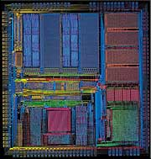
ASIC and FPGA Design Course
Parviz Keshavarzi
Quick VHDL
Review
Feb. 2020

Slide 2
Acknowledgement
These slides used or are derived from the following source:
  Dr. Karam Chatha’s VHDL course taught at Arizona State University.
  Melnik
  Jason D. Bakos “VHDL and HDL Designer Primer” university of South Carolina
  Tuft Slides
  Nitin Yogi, Digital Logic Circuits course (yoginit@auburn.edu)
  ECE 448 George Mason University

Slide 3
Part 1:
VHDL In a Glance

Slide 4
VHDL Program Structure
Every VHDL program consists of two main parts:
  Entity
  Architecture
Entity describes Inputs and outputs of a design
Architecture describes functionality of a design

Slide 5
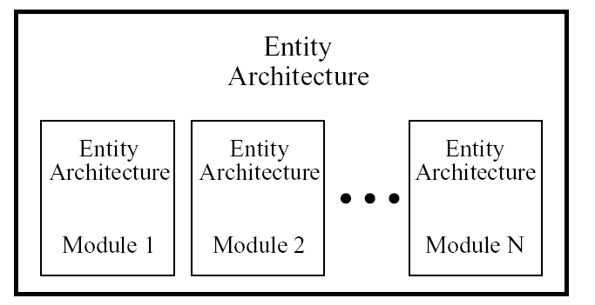
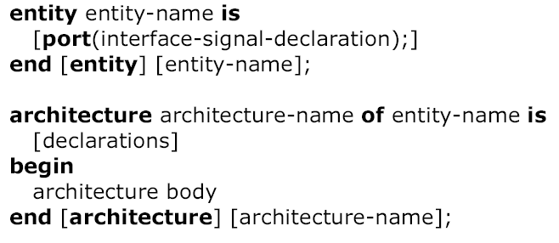
VHDL Program Structure

Slide 6
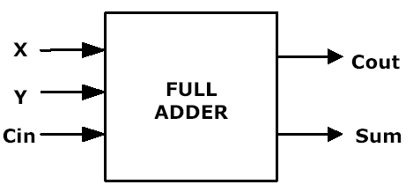
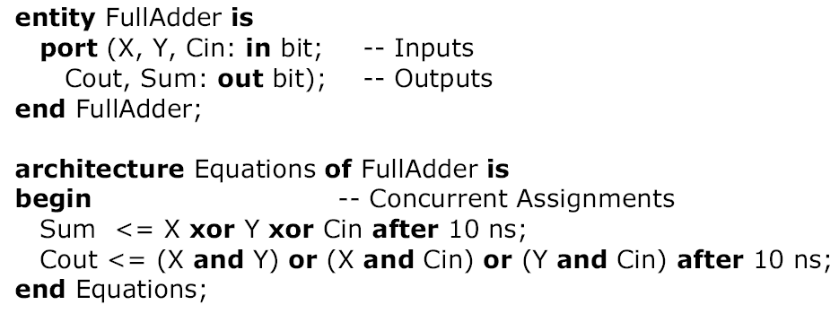
Entity-Architecture Pair
Full Adder Example

Slide 7
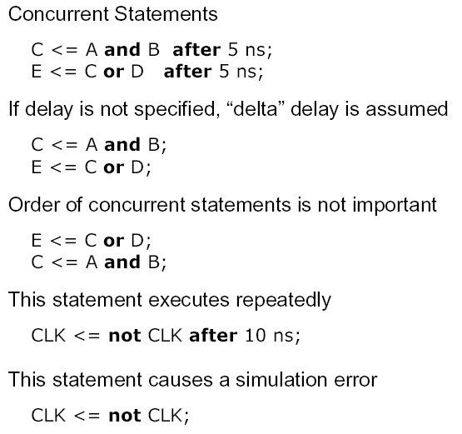
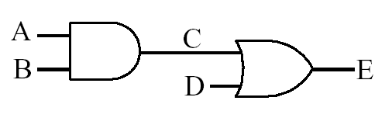
VHDL Description of
Combinational Networks

Slide 8
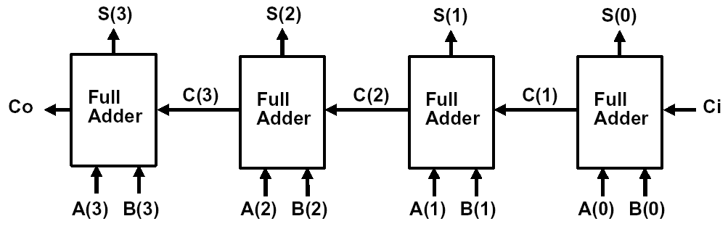
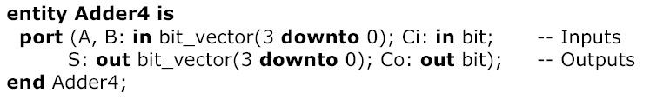
4-bit Adder

Slide 9
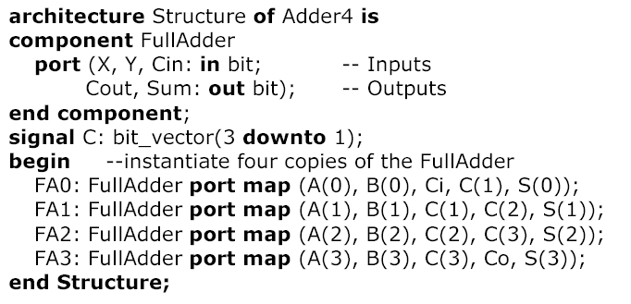
4-bit Adder (cont’d)

Slide 10

Process
Contain sequential statements that define algorithms
Executed when one of the signals in the sensitivity list has an event
proc1: process (a,b,c)
begin
x<=a and b and c;
end process proc1;
proc2: process
begin
x<=a and b and c;
wait on a,b,c;
end process proc2;

Slide 11
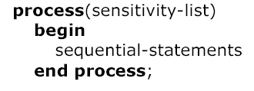
Modeling Flip-Flops Using VHDL Processes
Whenever one of the signals in the sensitivity list changes, the sequential statements are executed
in sequence one time
General form of process

Slide 12
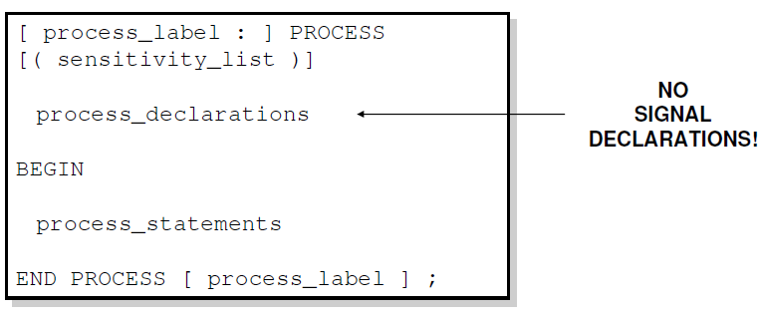
Sequential Style Syntax
Assignments are executed sequentially inside processes.

Slide 13
Sequential Statements
{Signal, Variable} assignments
Flow control
  if <condition> then <statments>
  [elsif <condition> then <statments>]
  else <statements>
  end if;
  for <range> loop <statments> end loop;
  while <condition> loop <statments> end loop;
  case <condition> is
    when <value> => <statements>;
    when <value> => <statements>;
    when others => <statements>;
Wait on <signal> until <expression> for <time>;

Slide 14
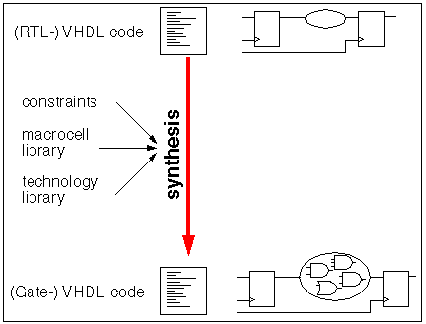
Synthesis
From high level description to the gate level netlist, it is usually with the help of synthesis tools.
For VHDL, only a subset of the language is synthesizable, and different tools support different subsets.
RTL style code is encouraged because it is synthesizable.
In RTL, it is possible to split the code into two blocks (e.g. process) that contain either purely combinational logic or registers.
FSM is also synthesizable
For simulation, we can use the unsynthesizable VHDL or Verilog code in the test bench to generate the stimulus.

Slide 17
Part 2:
VHDL

Slide 18
Intro to VHDL
Need for Hardware Description Languages
  Systems become more complex
  Design at the gate and flip-flop level becomes
  very tedious and time consuming
HDLs allow
  Design and debugging at a higher level before
  conversion to the gate and flip-flop level
  Tools for synthesis do the conversion
VHDL, Verilog
VHDL – VHSIC Hardware Description Language

Slide 19
Intro to VHDL
Developed originally by DARPA
  for specifying digital systems
International IEEE standard (IEEE 1076-1993)
Hardware Description, Simulation, Synthesis
Provides a mechanism for digital design and
reusable design documentation
Support different description levels
  Structural (specifying interconnections of the gates),
  Dataflow (specifying logic equations), and
  Behavioral (specifying behavior)
Top-down, Technology Dependent

Slide 20
VHDL (Appendix B in Textbook)
HDL => VHDL / Verilog
VHDL more verbose, better for team projects
Not case-sensitive
VHDL => “VHSIC Hardware Description Language”
VHSIC => “US DoD Very-High-Speed Integrated Circuit”
DoD project
  Document behavior of ASICs from suppliers
  Alternative to manuals
Used to describe behavior of digital logic
  Extensions for analog
High-level programming language, subset of Ada
  Also looks like Pascal
IEEE standards: 1987, 1993, 2000, 2002
First came the language…
…next came simulators…
…then came synthesizers (FPGA and ASIC)

Slide 21
VHDL
By its nature, VHDL is
  Self-documenting
  Allows for easy testbench design (simulators, instruments)
Any VHDL code may be simulated
Only some VHDL codes may be synthesized
  Depends on packages, data types, and constructs
VHDL descriptions (programs) have structure similar to C++
Each design (component) is made up of
  Entity section
    Component interface (I/O)
    Analogous to C++ header (public methods only)
  Architecture section
    Contains behavior (implementation)
    Can have multiple architectures for any entity
    Example: different types of adders with consistent interfaces

Slide 22
Subsequent versions of VHDL
  IEEE-1076 1987
  IEEE-1076 1993 ← most commonly supported by CAD tools
  IEEE-1076 2000 (minor changes)
  IEEE-1076 2002 (minor changes)
  IEEE-1076 2008

Slide 24
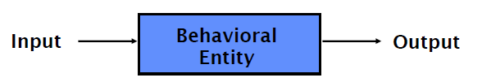
Basic Form of VHDL Code
Every VHDL design description consists of two parts:
  entity
  architecture
The entity section is used to declare I/O ports of the circuit.
The architecture portion describes the circuit’s behavior.

Slide 25
Basic Form of VHDL Code (cont.)
Every VHDL design description consists of at least:
  one entity / architecture pair,
  or one entity with multiple architectures.
A behavioral model is similar to a “black box”.
Standardized design libraries are included before entity declaration.

Slide 26
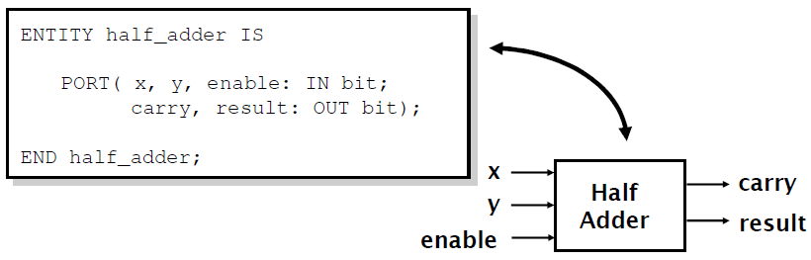
Entity Declaration
An entity declaration describes the interface of the component.
PORT clause indicates input and output ports.
An entity can be thought of as a symbol for a component.

Slide 27
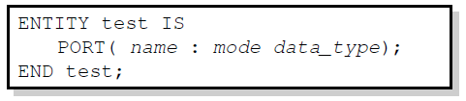
Port Declaration
PORT declaration establishes the interface of the object to the outside world.
Three parts of the PORT declaration
  Name
    Any identifier that is not a reserved word.
  Mode
    In, Out, Inout, Buffer
  Data type
    Any declared or predefined datatype.
Sample PORT declaration syntax:

Slide 28
Entity Declaration
Entity Declaration describes an interface of the component, i.e. input and output ports.
Entity name
Port names
Port type
Semicolon
ENTITY nand_gate IS
PORT(
a : IN STD_LOGIC;
b : IN STD_LOGIC;
z : OUT STD_LOGIC
);
END nand_gate;
No Semicolon after last port
Reserved words
Port modes (data flow directions)

Slide 29
VHDL entity example
entity my_ckt is
port (
A: in bit;
B: in bit;
S: in bit;
X: out bit;
Y: out bit
);
end my_ckt;
Datatypes:
In-built
User-defined
Name of the circuit
User-defined
Filename same as circuit name
Example.
  Circuit name: my_ckt
  Filename: my_ckt.vhd
Name of the circuit
User-defined
Filename same as circuit name recommended
Example:
  Circuit name: my_ckt
  Filename: my_ckt.vhd
my_ckt
A
X
B
Y
S
Direction of port
3 main types:
in: Input
out: Output
inout: Bidirectional
Port names or
Signal names
Note the absence of semicolon “;” at the end of the last signal and the presence at the end of the closing bracket

Slide 30
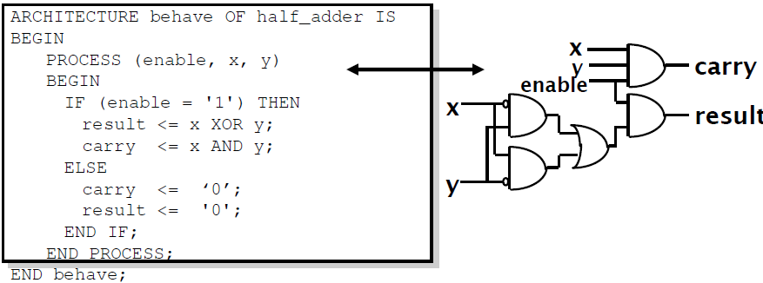
Architecture Declaration
Architecture declarations describe the operation of the component.
Many architectures may exist for one entity, but only one may be active at a time.
An architecture is similar to a schematic of the component.

Slide 31
Example VHDL Code
3 sections to a piece of VHDL code
File extension for a VHDL file is .vhd
Name of the file should be the same as the entity name (nand_gate.vhd) [OpenCores Coding Guidelines]
LIBRARY ieee;
USE ieee.std_logic_1164.all;
ENTITY nand_gate IS
PORT(
a : IN STD_LOGIC;
b : IN STD_LOGIC;
z : OUT STD_LOGIC);
END nand_gate;
ARCHITECTURE model OF nand_gate IS
BEGIN
z <= a NAND b;
END model;
LIBRARY DECLARATION
ENTITY DECLARATION
ARCHITECTURE BODY

Slide 32

Libraries

Slide 33
Library Declarations
LIBRARY ieee;
USE ieee.std_logic_1164.all;
ENTITY nand_gate IS
PORT(
a : IN STD_LOGIC;
b : IN STD_LOGIC;
z : OUT STD_LOGIC);
END nand_gate;
ARCHITECTURE dataflow OF nand_gate IS
BEGIN
z <= a NAND b;
END dataflow;
Library declaration
Use all definitions from the package
std_logic_1164

Slide 34
Library declarations - syntax
LIBRARY library_name;
USE library_name.package_name.package_parts;

Slide 35
Fundamental parts of a library
LIBRARY
PACKAGE 1
PACKAGE 2
TYPES
CONSTANTS
FUNCTIONS
PROCEDURES
COMPONENTS
TYPES
CONSTANTS
FUNCTIONS
PROCEDURES
COMPONENTS

Slide 36
Libraries
ieee
std
work
Specifies multi-level logic system,
including STD_LOGIC, and
STD_LOGIC_VECTOR data types
Need to be explicitly
declared
Specifies pre-defined data types
(BIT, BOOLEAN, INTEGER, REAL,
SIGNED, UNSIGNED, etc.), arithmetic
operations, basic type conversion
functions, basic text i/o functions, etc.
Visible by default
Holds current designs after compilation

Slide 37
BIT versus STD_LOGIC
BIT type can only have a value of '0' or '1'
STD_LOGIC can have nine values
  '0', '1', 'Z', 'U', 'X', 'L', 'H', 'W', '-'
  Useful mainly for simulation
  '0', '1', and 'Z' are synthesizable
  (your codes should contain only these
  three values)

Slide 38
Standard Libraries
Include library ieee; before entity declaration.
ieee.std_logic_1164 defines a standard for designers to use in describing interconnection data types used in VHDL modeling.
ieee.std_logic_arith provides a set of arithmetic, conversion, comparison functions for signed, unsigned, std_ulogic, std_logic, std_logic_vector.
Ieee.std_logic_unsigned provides a set of unsigned arithmetic, conversion, and comparison functions for std_logic_vector.
See all available packages at http://www.cs.umbc.edu/portal/help/VHDL/stdpkg.html

Slide 39
Built-in Datatypes
Scalar (single valued) signal types:
  bit
  boolean
  integer
  Examples:
    A: in bit;
    G: out boolean;
    K: out integer;
Aggregate (collection or array) signal types:
  bit_vector: array of bits representing binary numbers
  signed: array of bits representing signed binary numbers
  Examples:
    D: in bit_vector(0 to 7);
    E: in bit_vector(7 downto 0);
    M: in signed (4 downto 0);
    --signed 5 bit_vector binary number

Slide 40
User-defined datatype
Construct datatypes arbitrarily or using built-in datatypes
Examples:
  type temperature is (high, medium, low);
  type byte is array(0 to 7) of bit;

Slide 42
Process
Contains sequentially executed statements
Execution is controlled either via
  sensitivity list (contains trigger signals), or
  wait-statements
  (Executed when one of the signals in the sensitivity list has an event)
Be careful about incomplete sensitivity list.
Exists within an architecture only
Several processes run concurrently
The process label is optional
architecture RTL of AND_OR_XOR is
begin
A_O_X: process (A, B)
begin
Z_OR <= A or B;
Z_AND <= A and B;
Z_XOR <= A xor B;
end process A_O_X ;
end RTL;
Sensitivity list
architecture RTL of AND_OR_XOR is
begin
A_O_X: process
begin
Z_OR <= A or B;
Z_AND <= A and B;
Z_XOR <= A xor B;
wait on A,B;
end process A_O_X ;
end RTL;

Slide 43
Data Objects
Constants : Holds a value that cannot be changed within the design description
constant width: integer:=8;
    (The identifier width may be used several times in the code.)
Signals : represent wires, used to interconnect components
Variables : used in processes and subprograms

Slide 44
Data Objects (Cont’d)
architecture example of and8 is
begin
my_and: process (a_bus)
variable tmp: bit;
begin
tmp:=‘1’;
for i in 7 downto 0 loop
tmp:= a_bus(i) and tmp;
end loop;
x<=tmp;
end process my_and;
end example;
Note: Variable does not represent wires like signals

Slide 45
Data Objects
There are three types of data objects:
  Signals
    Can be considered as wires in a schematic.
    Can have current value and future values.
  Variables and Constants
    Used to model the behavior of a circuit.
    Used in processes, procedures and functions.

Slide 46

Constant Declaration
A constant can have a single value of a given type.
A constant’s value cannot be changed during the simulation.
Constants declared at the start of an architecture can be used anywhere in the architecture.
Constants declared in a process can only be used inside the specific process.
CONSTANT constant_name : type_name [ : = value];
CONSTANT rise_fall_time : TIME : = 2 ns;
CONSTANT data_bus : INTEGER : = 16;

Slide 47
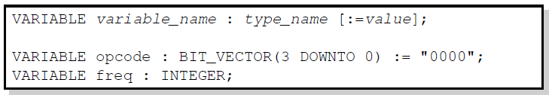
Variable Declaration
Variables are used for local storage of data.
Variables are generally not available to multiple components or processes.
All variable assignments take place immediately.
Variables are more convenient than signals for the storage of (temporary) data.

Slide 48
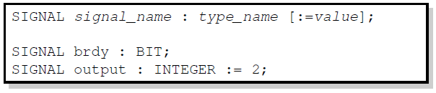
Signal Declaration
Signals are used for communication between components.
Signals are declared outside the process.
Signals can be seen as real, physical signals.
Some delay must be incurred in a signal assignment.

Slide 52
Generics
entity ADDER is generic(n: natural :=2); port( A: in std_logic_vector(n-1 downto 0); B: in std_logic_vector(n-1 downto 0); carry: out std_logic; sum: out std_logic_vector(n-1 downto 0) ); end ADDER;
entity ADDER is generic(n: natural :=2); port( A: in std_logic_vector(n-1 downto 0); B: in std_logic_vector(n-1 downto 0); carry: out std_logic; sum: out std_logic_vector(n-1 downto 0) ); end ADDER;
entity ADDER is generic(n: natural :=2); port( A: in std_logic_vector(n-1 downto 0); B: in std_logic_vector(n-1 downto 0); carry: out std_logic; sum: out std_logic_vector(n-1 downto 0) ); end ADDER;
entity ADDER is generic(n: natural :=2); port( A: in std_logic_vector(n-1 downto 0); B: in std_logic_vector(n-1 downto 0); carry: out std_logic; sum: out std_logic_vector(n-1 downto 0) ); end ADDER;
Generics allow the component to be customized upon instantiation.
Generics pass information from the entity to the architecture.
Common uses of generics
  Customize timing
  Alter range of subtypes
  Change size of arrays
ENTITY adder IS
GENERIC(n: natural :=2);
PORT(
A: IN STD_LOGIC_VECTOR(n-1 DOWNTO 0);
B: IN STD_LOGIC_VECTOR(n-1 DOWNTO 0);
C: OUT STD_LOGIC;
SUM: OUT STD_LOGIC_VECTOR(n-1 DOWNTO 0) );
END adder;

Slide 53
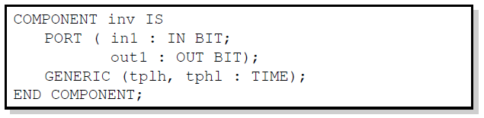
Technology Modeling
One use of generics is to alter the timing of a certain component.
It is possible to indicate a generic timing delay and then specify the exact delay at instantiation.
The example above declares the interface to a component named inv.
The propagation time for high-to-low and low-to-high transitions can be specified later.

Slide 54
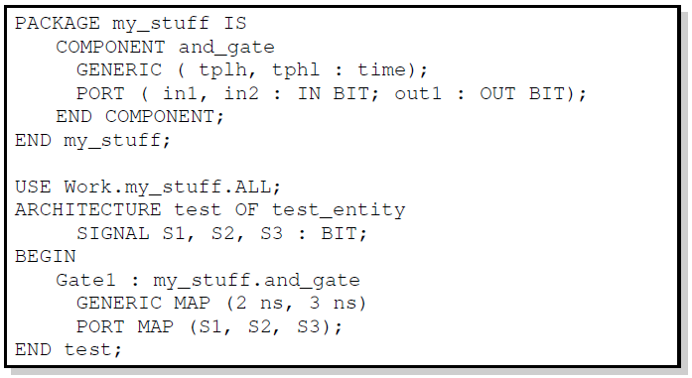
Structural Statements
The GENERIC MAP is similar to the PORT MAP in that it maps specific values to generics declared in the component.

Slide 55
Generate Statement
Structural for-loops: The GENERATE statement
  Some structures in digital hardware are repetitive in nature. (RAM, ROM, registers, adders, multipliers, …)
  VHDL provides the GENERATE statement to automatically create regular hardware.
  Any VHDL concurrent statement may be included in a GENERATE statement, including another GENERATE statement.

Slide 56
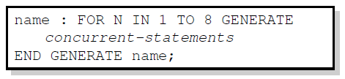
Generate Statement Syntax
All objects created are similar.
The GENERATE parameter must be discrete and is undefined outside the GENERATE statement.

Slide 57
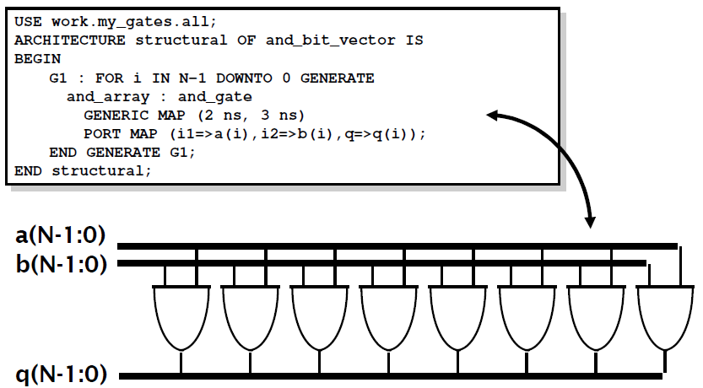
Example: Array of AND-gates

Slide 59
Types of VHDL Description: Alternative convention
VHDL Descriptions
Behavioral
Structural
dataflow
algorithmic
Components
& interconnects
Concurrent
statements
Sequential
statements

Slide 60
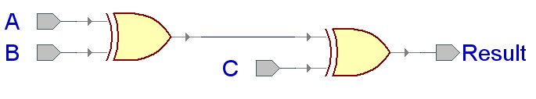
xor3 Example

Slide 61
Entity xor3_gate
LIBRARY ieee;
USE ieee.std_logic_1164.all;
ENTITY xor3_gate IS
PORT(
A : IN STD_LOGIC;
B : IN STD_LOGIC;
C : IN STD_LOGIC;
Result : OUT STD_LOGIC
);
end xor3_gate;

Slide 62
Dataflow Architecture (xor3_gate)
ARCHITECTURE dataflow OF xor3_gate IS
SIGNAL U1_OUT: STD_LOGIC;
BEGIN
U1_OUT <= A XOR B;
Result <= U1_OUT XOR C;
END dataflow;
U1_OUT

Slide 63
Dataflow Description
Describes how data moves through the system and the various processing steps.
  Dataflow uses series of concurrent statements to realize logic.
  Dataflow is most useful style when series of Boolean equations can represent a logic → used to implement simple combinational logic
  Dataflow code also called “concurrent” code
Concurrent statements are evaluated at the same time; thus, the order of these statements doesn’t matter
  This is not true for sequential/behavioral statements
    This order…
    U1_out <= A XOR B;
    Result <= U1_out XOR C;
    Is the same as this order…
    Result <= U1_out XOR C;
    U1_out <= A XOR B;

Slide 64
Structural Architecture in VHDL 93
ARCHITECTURE structural OF xor3_gate IS
SIGNAL U1_OUT: STD_LOGIC;
BEGIN
U1: entity work.xor2(dataflow)
PORT MAP (I1 => A,
I2 => B,
Y => U1_OUT);
U2: entity work.xor2(dataflow)
PORT MAP (I1 => U1_OUT,
I2 => C,
Y => Result);
END structural;
A
B
xor3_gate
Result
C
U1_OUT
I1
Y
I1
I2
Y
I2
PORT NAME
LOCAL WIRE NAME

Slide 65
xor2
xor2.vhd
LIBRARY ieee;
USE ieee.std_logic_1164.all;
ENTITY xor2 IS
PORT(
I1 : IN STD_LOGIC;
I2 : IN STD_LOGIC;
Y : OUT STD_LOGIC);
END xor2;
ARCHITECTURE dataflow OF xor2 IS
BEGIN
Y <= I1 xor I2;
END dataflow;

Slide 66
Structural Architecture in VHDL 87
ARCHITECTURE structural OF xor3_gate IS
SIGNAL U1_OUT: STD_LOGIC;
COMPONENT xor2
PORT(
I1 : IN STD_LOGIC;
I2 : IN STD_LOGIC;
Y : OUT STD_LOGIC
);
END COMPONENT;
BEGIN
U1: xor2 PORT MAP (I1 => A,
I2 => B,
Y => U1_OUT);
U2: xor2 PORT MAP (I1 => U1_OUT,
I2 => C,
Y => Result);
END structural;
A
B
xor3_gate
Result
C
U1_OUT
I1
Y
I1
I2
Y
I2
PORT NAME
LOCAL WIRE NAME

Slide 67
Structural Description
Structural design is the simplest to understand. This style is the closest to schematic capture and utilizes simple building blocks to compose logic functions.
Components are interconnected in a hierarchical manner.
Structural descriptions may connect simple gates or complex, abstract components.
Structural style is useful when expressing a design that is naturally composed of sub-blocks.

Slide 68
Behavioral Architecture (xor3 gate)
ARCHITECTURE behavioral OF xor3 IS
BEGIN
xor3_behave: PROCESS (A, B, C)
BEGIN
IF ((A XOR B XOR C) = '1') THEN
Result <= '1';
ELSE
Result <= '0';
END IF;
END PROCESS xor3_behave;
END behavioral;

Slide 69
Behavioral Description
It accurately models what happens on the inputs and outputs of the black box (no matter what is inside and how it works).
This style uses PROCESS statements in VHDL.

